Slide 1
Recap: How to stitch together a panorama (a.k.a. mosaic)?
Basic Procedure
  Take a sequence of images from the same position
    Rotate the camera about its optical center
  Compute transformation (homography) between second image and first using corresponding points.
  Transform the second image to overlap with the first.
  Blend the two together to create a mosaic.
  (If there are more images, repeat)
Source: Steve Seitz

Slide 2
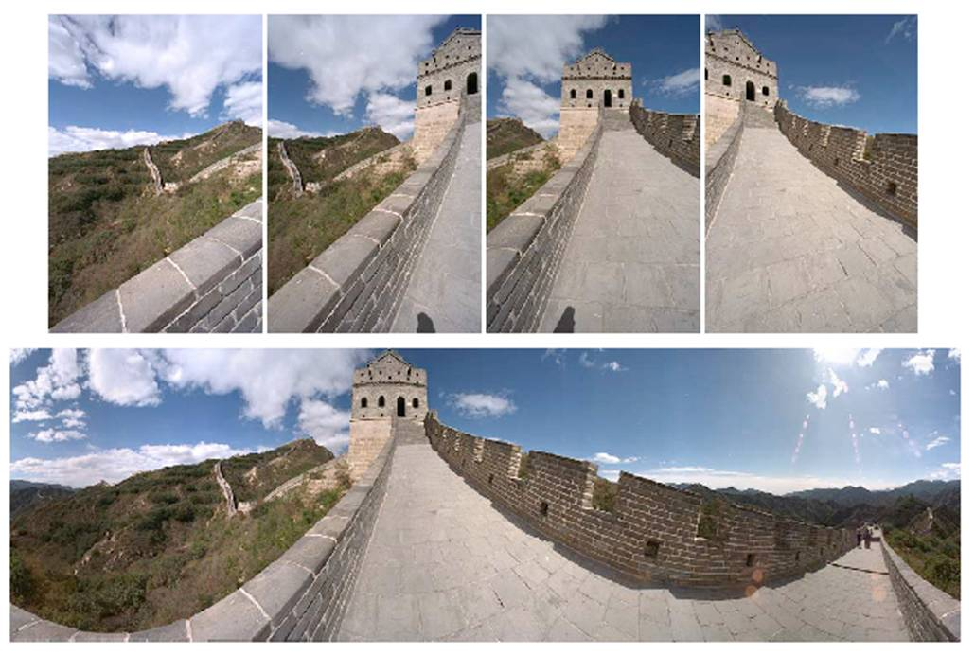
Image reprojection
image from S. Seitz
mosaic PP
The mosaic has a natural interpretation in 3D
  The images are reprojected onto a common plane
  The mosaic is formed on this plane
  Mosaic is a synthetic wide-angle camera
Source: Steve Seitz

Slide 3
Homography
To apply a given homography H
  Compute p’ = Hp (regular matrix multiply)
  Convert p’ from homogeneous to image coordinates
p’
H
p

Slide 4


Inverse warping
T⁻¹(x,y)
y
y’
x
x
x’
f(x,y)
g(x’,y’)
Get each pixel g(x’,y’) from its corresponding location
(x,y) = T⁻¹(x’,y’) in the first image
Q: what if pixel comes from “between” two pixels?
Slide from Alyosha Efros, CMU

Slide 5
Inverse warping
T⁻¹(x,y)
y
y’
x
x
x’
f(x,y)
g(x’,y’)
Get each pixel g(x’,y’) from its corresponding location
(x,y) = T⁻¹(x’,y’) in the first image
Q: what if pixel comes from “between” two pixels?
A: Interpolate color value from neighbors
  nearest neighbor, bilinear…
>> help interp2
Slide from Alyosha Efros, CMU

Slide 6





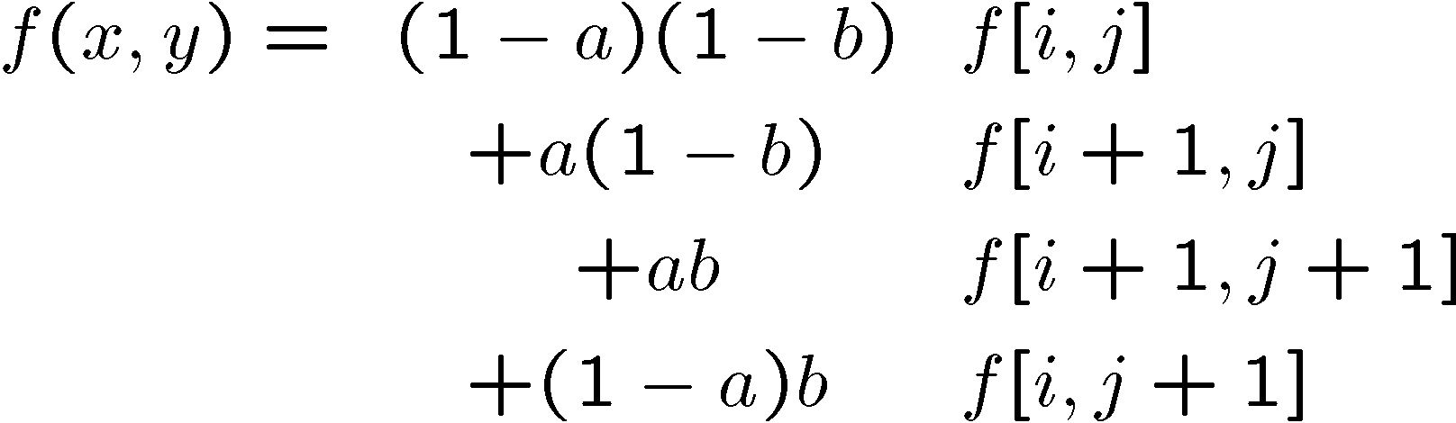
Bilinear interpolation
Sampling at f(x,y):
Slide from Alyosha Efros, CMU

Slide 7


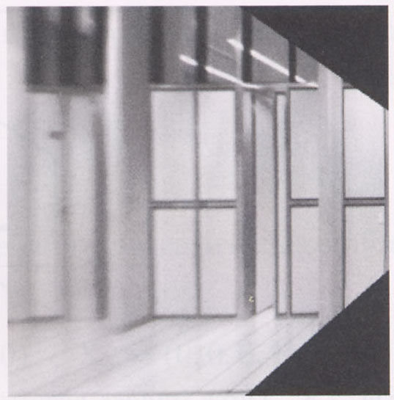
Image warping with homographies
image plane in front
image plane below
black area
where no pixel
maps to
Source: Steve Seitz

Slide 8
Image rectification
p’
p

Slide 9
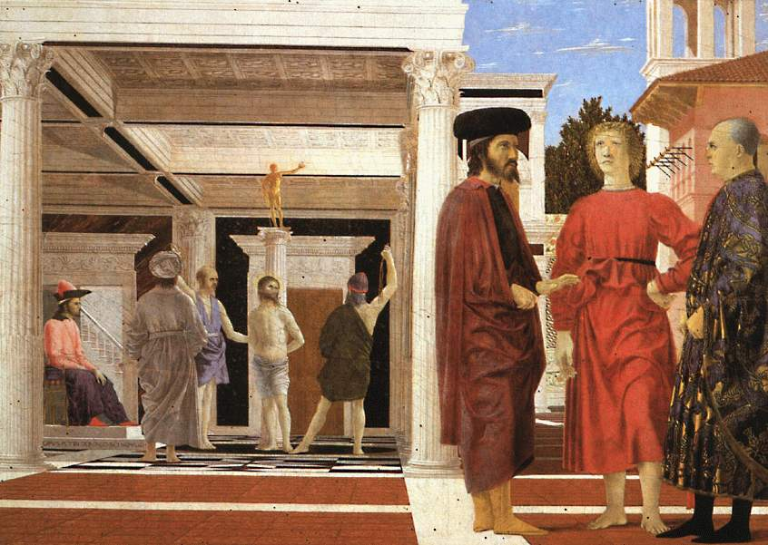
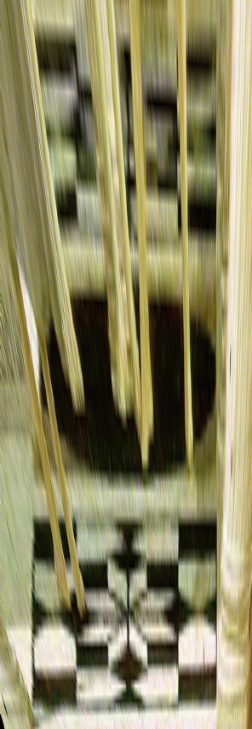

Analysing patterns and shapes
What is the shape of the b/w floor pattern?
Homography
The floor (enlarged)
Automatically
rectified floor
Slide from Antonio Criminisi

Slide 10
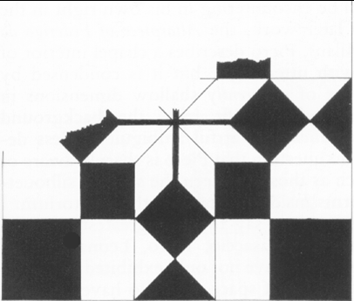
Analysing patterns and shapes
Automatic rectification
From Martin Kemp The Science of Art
(manual reconstruction)
Slide from Antonio Criminisi

Slide 11
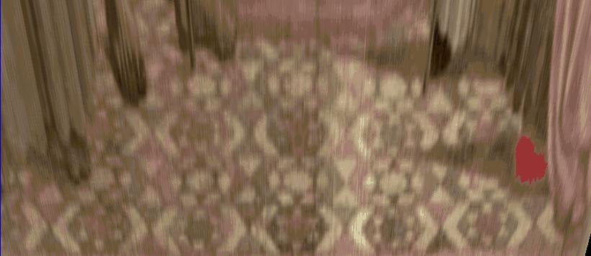
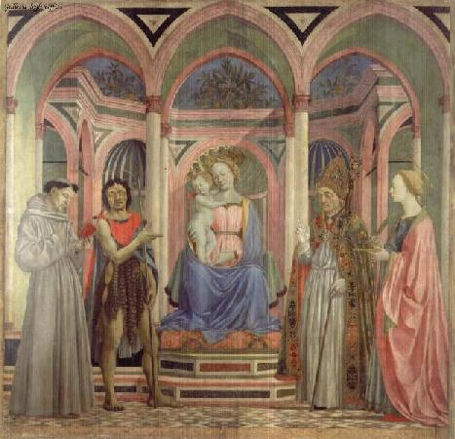
Analysing patterns and shapes
What is the (complicated)
shape of the floor pattern?
Automatically rectified floor
St. Lucy Altarpiece, D. Veneziano
Slide from Criminisi

Slide 12
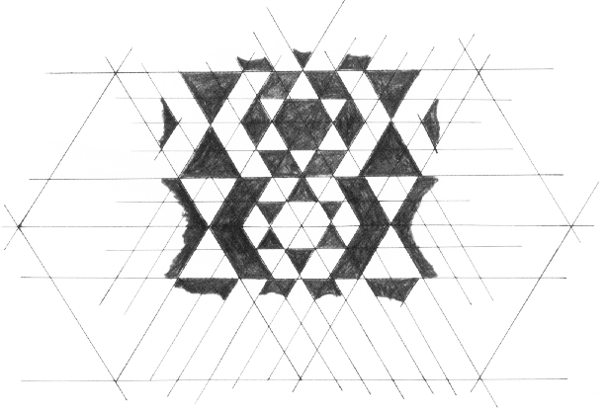
Analysing patterns and shapes
Automatic
rectification
From Martin Kemp, The Science of Art
(manual reconstruction)
Slide from Criminisi

Slide 13
Changing camera center
Does it still work?
synthetic PP
PP1
PP2
Source: Alyosha Efros

Slide 14
Recall: same camera center
real
camera
synthetic
camera
Can generate synthetic camera view
as long as it has the same center of projection.
Source: Alyosha Efros

Slide 15

…Or: Planar scene (or far away)
PP3
PP1
PP2
PP3 is a projection plane of both centers of projection, so we are OK!
This is how big aerial photographs are made
Source: Alyosha Efros

Slide 16
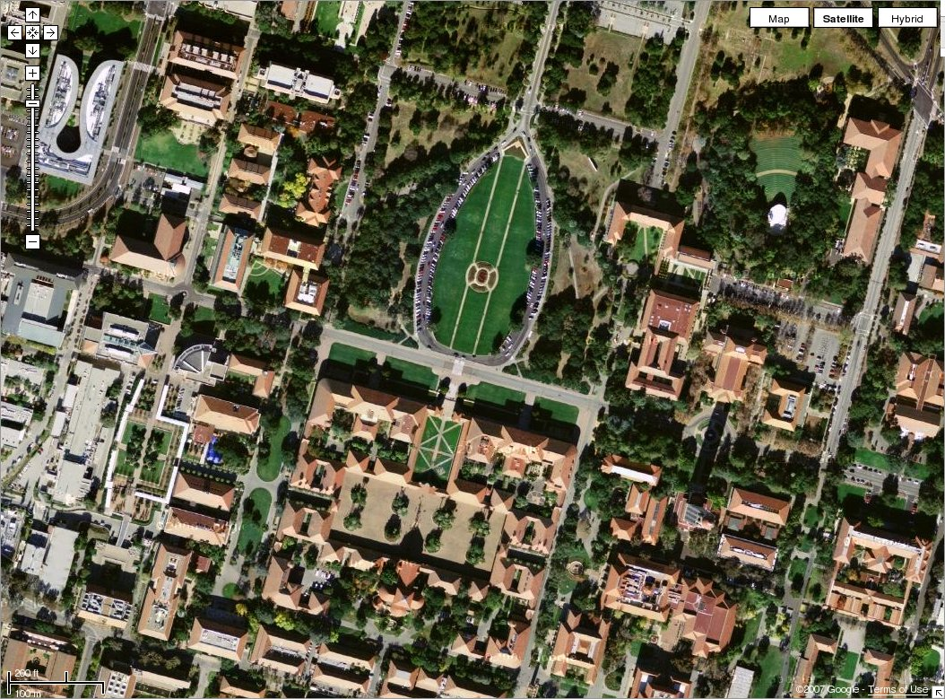

Slide 17
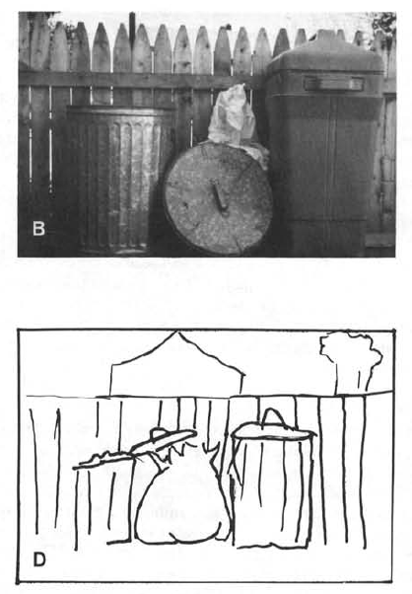
Boundary extension
Wide-Angle Memories of Close-Up Scenes, Helene Intraub and Michael Richardson, Journal of Experimental Psychology: Learning, Memory, and Cognition, 1989, Vol. 15, No. 2, 179-187

Slide 18
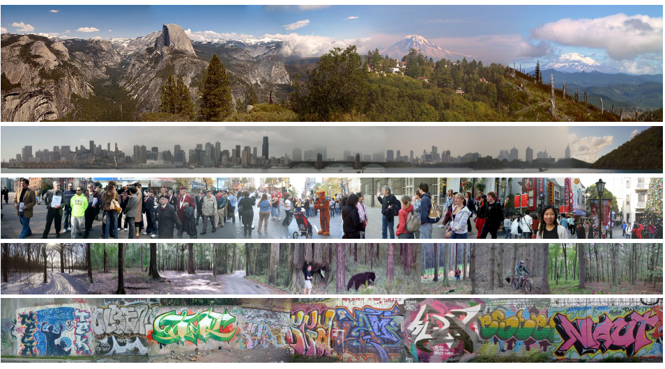
Creating and Exploring a Large Photorealistic Virtual Space
Josef Sivic, Biliana Kaneva, Antonio Torralba, Shai Avidan and William T. Freeman, Internet Vision Workshop, CVPR 2008.
http://www.youtube.com/watch?v=E0rboU10rPo

Slide 19
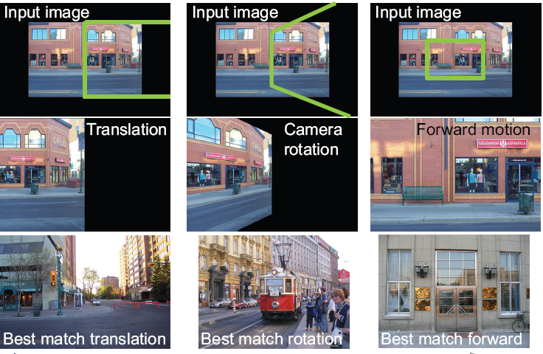
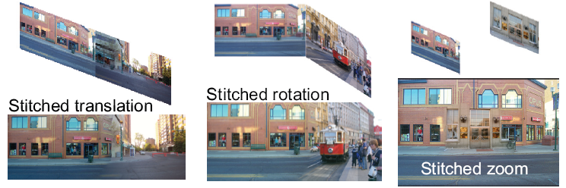
Creating and Exploring a Large Photorealistic Virtual Space
Current view, and desired view in green
Synthesized view from new camera
Induced camera motion

Slide 20
Review
How many matches needed to compute the homography?
Which scales better to high-dimensional parameter spaces, Hough or RANSAC?
Hough represents uncertainty in the parameter space, whereas RANSAC represents uncertainty in image space. Why?

Slide 21

Stereo
Thurs Mar 22
Kristen Grauman
UT Austin

Slide 22
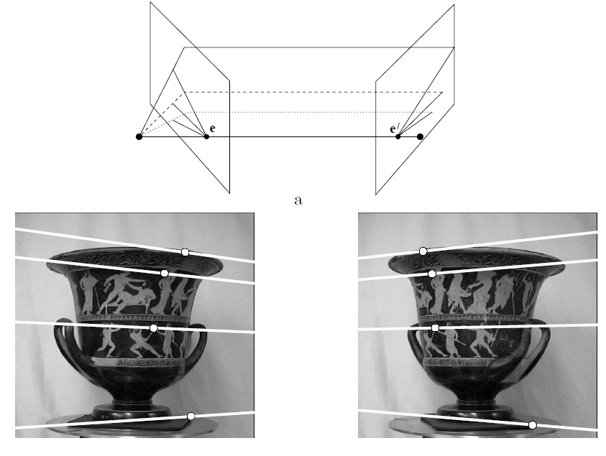
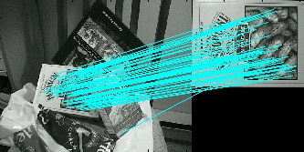
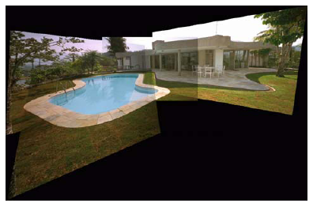
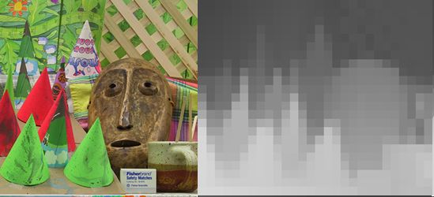
Multiple views
Multi-view geometry, matching, invariant features, stereo vision
Lowe
Hartley and Zisserman
Kristen Grauman

Slide 23
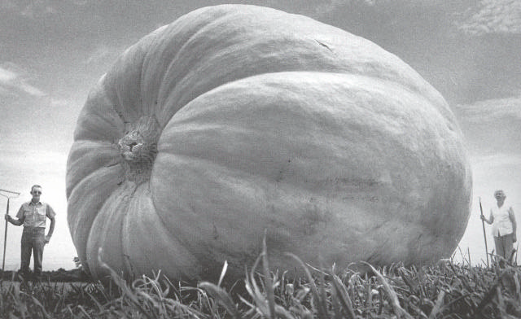
Why multiple views?
Structure and depth are inherently ambiguous from single views.
Images from Lana Lazebnik

Slide 24
Why multiple views?
Structure and depth are inherently ambiguous from single views.
P1
P2
P1’=P2’
Optical center
Kristen Grauman

Slide 25
What cues help us to perceive 3d shape and depth?

Slide 26
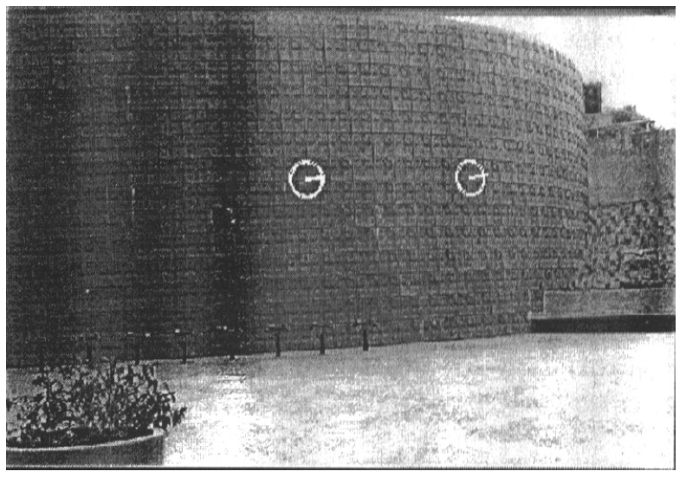
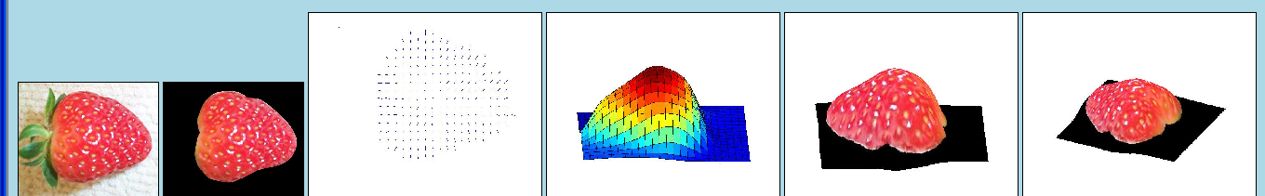
Texture
[From A.M. Loh. The recovery of 3-D structure using visual texture patterns. PhD thesis]
Notes:
26

Slide 27

Perspective effects
Image credit: S. Seitz

Slide 28
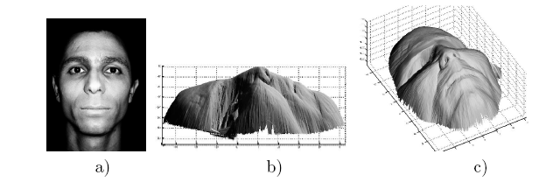
Shading
[Figure from Prados & Faugeras 2006]
Notes:
28

Slide 29
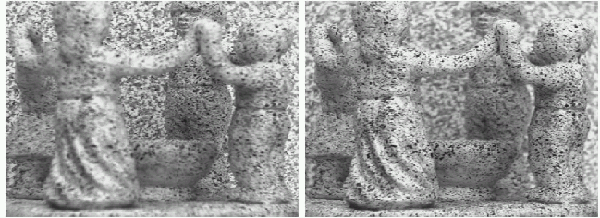
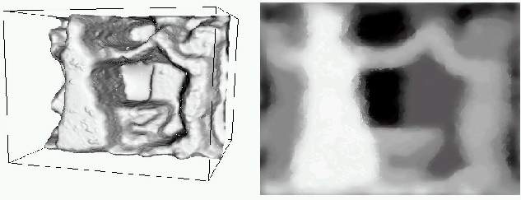
Focus/defocus
Images from same point of view, different camera parameters
3d shape / depth estimates
[figs from H. Jin and P. Favaro, 2002]

Slide 30
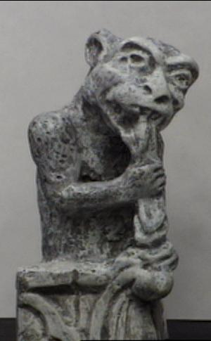
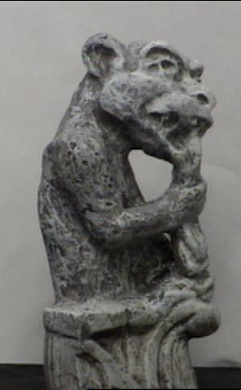
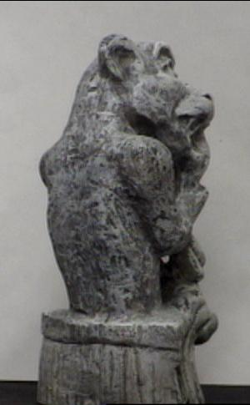
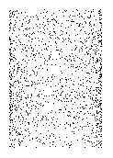
Motion
Figures from L. Zhang
http://www.brainconnection.com/teasers/?main=illusion/motion-shape

Slide 31
Estimating scene shape
“Shape from X”: Shading, Texture, Focus, Motion…
Stereo:
  shape from “motion” between two views
  infer 3d shape of scene from two (multiple) images from different viewpoints
Main idea:
scene point
image plane
optical center
Kristen Grauman
Notes:
31

Slide 32
Outline
Human stereopsis
Epipolar geometry and the epipolar constraint
  Case example with parallel optical axes
  General case with calibrated cameras
Stereo solutions
  Correspondences
  Additional constraints

Slide 33
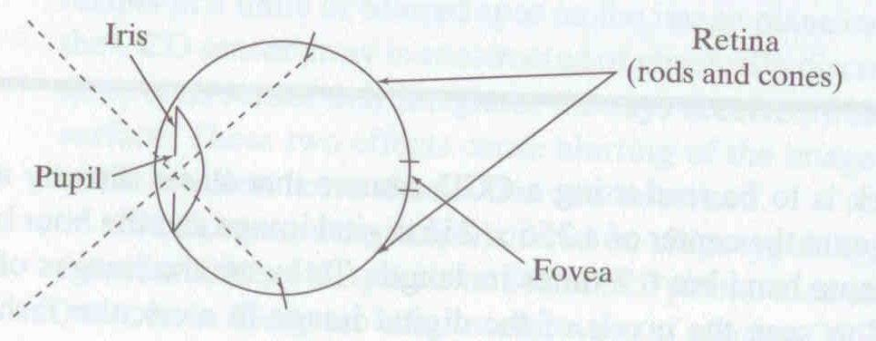
Human eye
Pupil/Iris – control amount of light passing through lens
Retina - contains sensor cells, where image is formed
Fovea – highest concentration of cones
Fig from Shapiro and Stockman

Slide 34
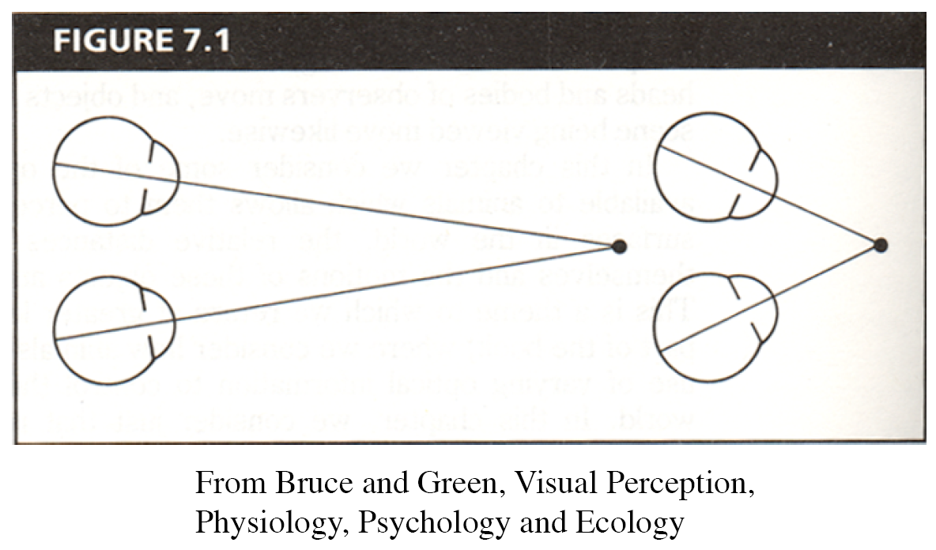
Human eyes fixate on point in space – rotate so that corresponding images form in centers of fovea.
Human stereopsis: disparity
Notes:
34

Slide 35
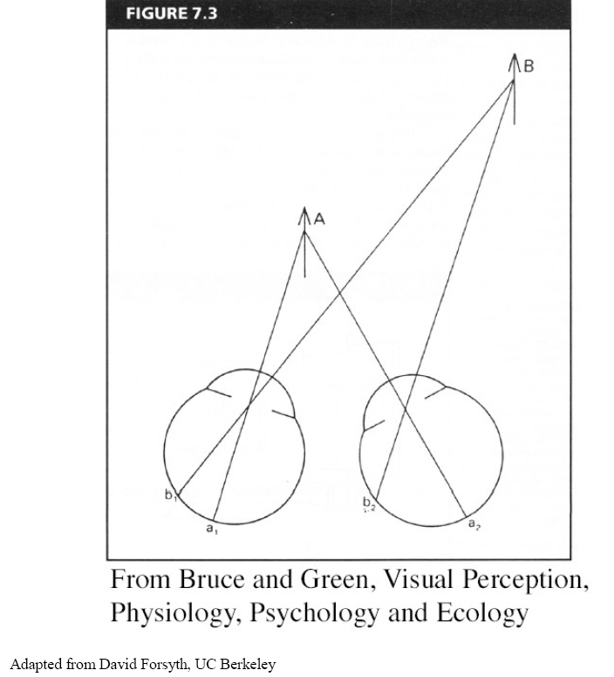
Human stereopsis: disparity
Disparity occurs when eyes fixate on one object; others appear at different visual angles
Notes:
35

Slide 36
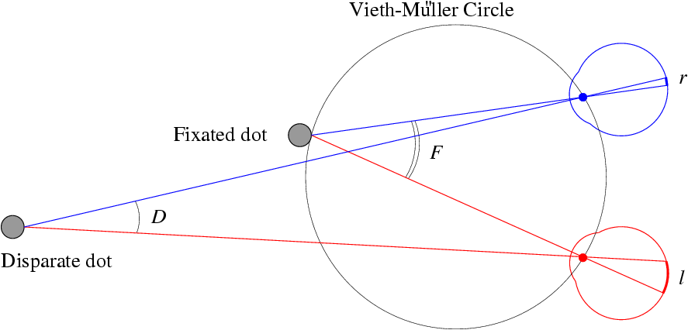
Human stereopsis: disparity
d=0
Disparity: d = r-l = D-F.
Forsyth & Ponce
Notes:
36

Slide 37
Random dot stereograms
Julesz 1960: Do we identify local brightness patterns before fusion (monocular process) or after (binocular)?
To test: pair of synthetic images obtained by randomly spraying black dots on white objects
Notes:
37

Slide 38
Random dot stereograms
Forsyth & Ponce
Notes:
38

Slide 39
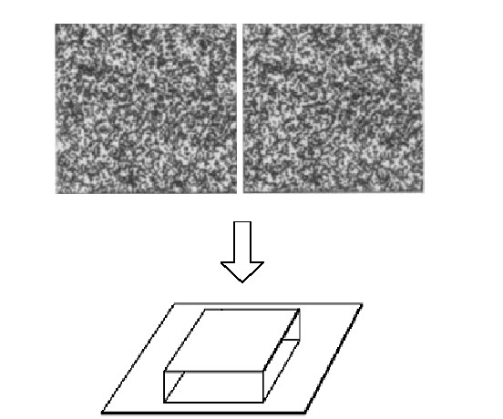
Random dot stereograms
Notes:
39

Slide 40
Random dot stereograms
When viewed monocularly, they appear random; when viewed stereoscopically, see 3d structure.
Conclusion: human binocular fusion not directly associated with the physical retinas; must involve the central nervous system
Imaginary “cyclopean retina” that combines the left and right image stimuli as a single unit
Notes:
40

Slide 41
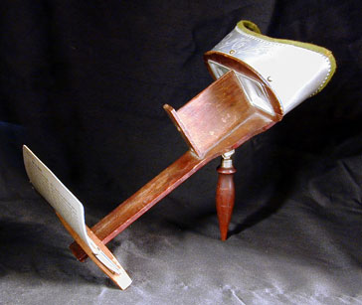
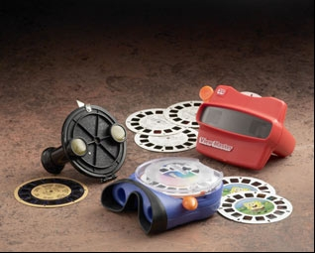
Stereo photography and stereo viewers
Take two pictures of the same subject from two slightly different viewpoints and display so that each eye sees only one of the images.
Image from fisher-price.com
Invented by Sir Charles Wheatstone, 1838

Slide 42
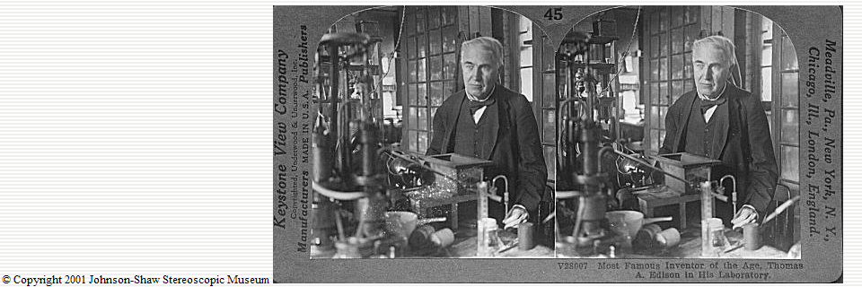
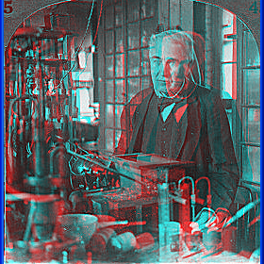
http://www.johnsonshawmuseum.org
Notes:
42

Slide 43
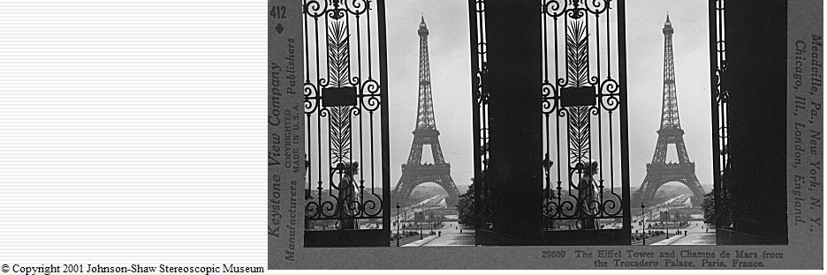
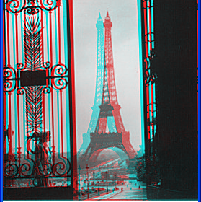
http://www.johnsonshawmuseum.org
Notes:
43

Slide 44
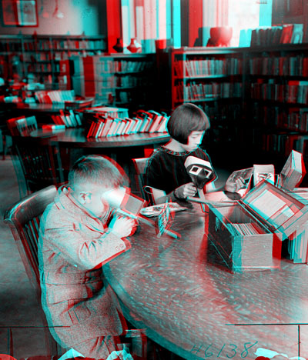

Public Library, Stereoscopic Looking Room, Chicago, by Phillips, 1923
Notes:
44

Slide 45
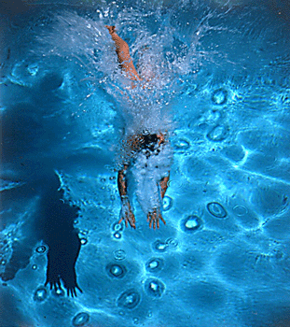
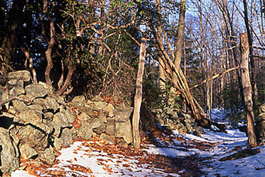
http://www.well.com/~jimg/stereo/stereo_list.html
Kristen Grauman
Notes:
45

Slide 46
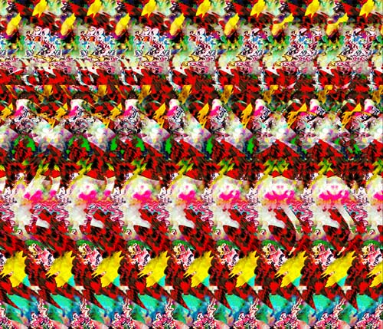
Autostereograms
Exploit disparity as depth cue using single image.
(Single image random dot stereogram, Single image stereogram)
Images from magiceye.com
Kristen Grauman
Notes:
46

Slide 47
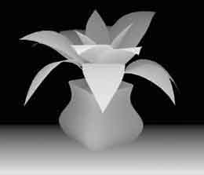
Autostereograms
Images from magiceye.com
Kristen Grauman
Notes:
47

Slide 48
Outline
Human stereopsis
Stereograms
Epipolar geometry and the epipolar constraint
  Case example with parallel optical axes
  General case with calibrated cameras

Slide 49
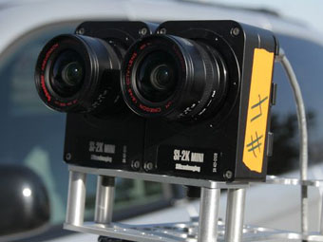
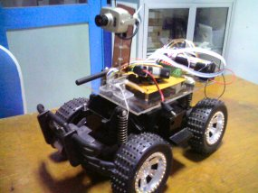
Stereo vision
Two cameras, simultaneous views
Single moving camera and static scene
Kristen Grauman

Slide 50
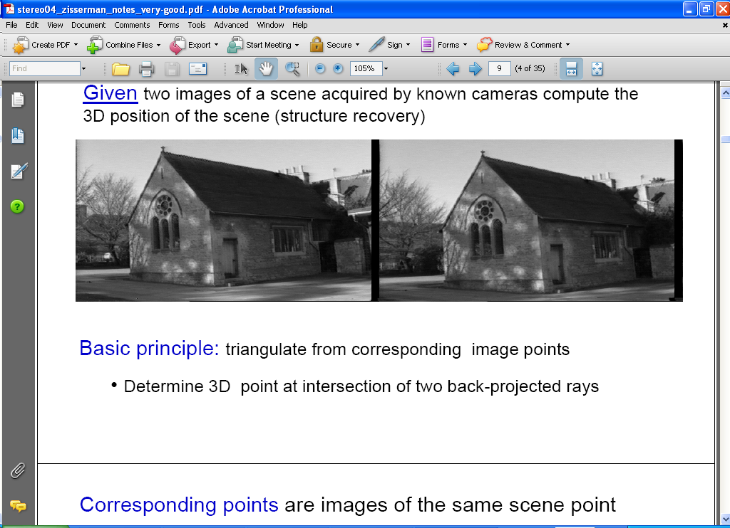
Estimating depth with stereo
Stereo: shape from “motion” between two views
We’ll need to consider:
Info on camera pose (“calibration”)
Image point correspondences
scene point
image plane
optical center
Notes:
50

Slide 51
Geometry for a simple stereo system
First, assuming parallel optical axes, known camera parameters (i.e., calibrated cameras):

Slide 52
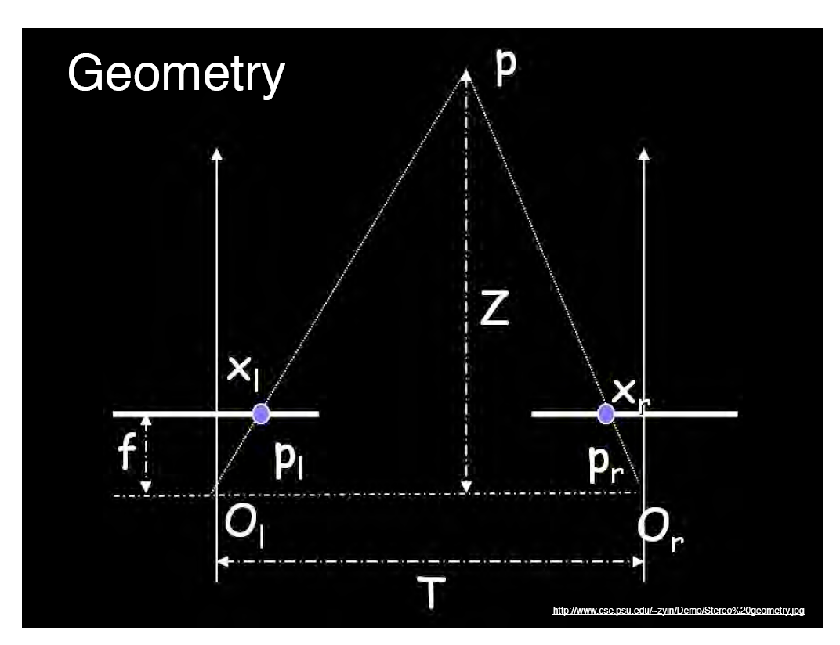
World point
Depth of p
image point (left)
image point (right)
Focal length
optical center (right)
optical center (left)
baseline
Notes:
52

Slide 53
Geometry for a simple stereo system
Assume parallel optical axes, known camera parameters (i.e., calibrated cameras). What is expression for Z?
Similar triangles (p_{l}, P, p_{r}) and (O_{l}, P, O_{r}):
disparity
Notes:
53

Slide 54


Depth from disparity
image I(x,y)
Disparity map D(x,y)
image I´(x´,y´)
(x´,y´)=(x+D(x,y), y)
So if we could find the corresponding points in two images, we could estimate relative depth…

Slide 55
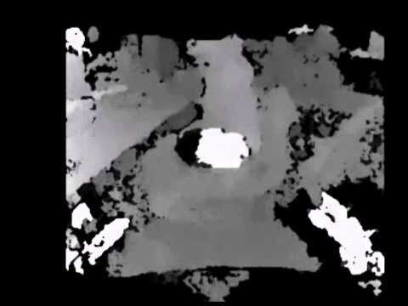
Depth from disparity

Slide 56
Outline
Human stereopsis
Stereograms
Epipolar geometry and the epipolar constraint
  Case example with parallel optical axes
  General case with calibrated cameras

Slide 57
General case, with calibrated cameras
The two cameras need not have parallel optical axes.
Vs.

Slide 58
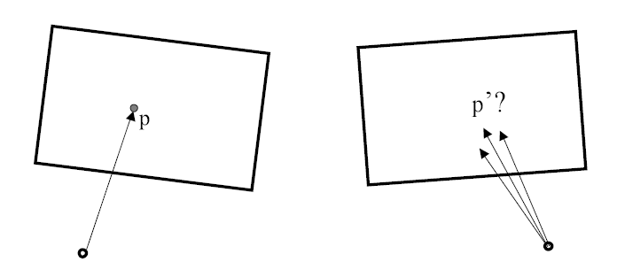
Stereo correspondence constraints
Given p in left image, where can corresponding point p’ be?

Slide 59

Stereo correspondence constraints

Slide 60

Epipolar constraint
Geometry of two views constrains where the corresponding pixel for some image point in the first view must occur in the second view.
  It must be on the line carved out by a plane connecting the world point and optical centers.
Notes:
60

Slide 61

Epipolar geometry
Epipolar Line
Epipolar Plane
Epipole
Baseline
Epipole
Notes:
61

Slide 62
Epipolar geometry: terms
Baseline: line joining the camera centers
Epipole: point of intersection of baseline with image plane
Epipolar plane: plane containing baseline and world point
Epipolar line: intersection of epipolar plane with the image plane
All epipolar lines intersect at the epipole
An epipolar plane intersects the left and right image planes in epipolar lines
Why is the epipolar constraint useful?

Slide 63

Epipolar constraint
This is useful because it reduces the correspondence problem to a 1D search along an epipolar line.
Image from Andrew Zisserman

Slide 64

Example

Slide 65
What do the epipolar lines look like?
1.
O_{l}
O_{r}
2.
O_{l}
O_{r}
Kristen Grauman

Slide 66



Example: converging cameras
Figure from Hartley & Zisserman
Notes:
66

Slide 67


Example: parallel cameras
Where are the epipoles?
Figure from Hartley & Zisserman
Notes:
67

Slide 68
Stereo image rectification
In practice, it is convenient if image scanlines (rows) are the epipolar lines.
reproject image planes onto a common
plane parallel to the line between optical centers
pixel motion is horizontal after this transformation
two homographies (3x3 transforms), one for each input image reprojection
Slide credit: Li Zhang
Notes:
68

Slide 69
Stereo image rectification: example
Source: Alyosha Efros

Slide 70


An audio camera & epipolar geometry
Adam O' Donovan, Ramani Duraiswami and Jan Neumann Microphone Arrays as Generalized Cameras for Integrated Audio Visual Processing, IEEE Conference on Computer Vision and Pattern Recognition (CVPR), Minneapolis, 2007
Spherical microphone array

Slide 71



An audio camera & epipolar geometry

Slide 72

An audio camera & epipolar geometry

Slide 73
Summary so far
Depth from stereo: main idea is to triangulate from corresponding image points.
Epipolar geometry defined by two cameras
  We’ve assumed known extrinsic parameters relating their poses
Epipolar constraint limits where points from one view will be imaged in the other
  Makes search for correspondences quicker
Terms: epipole, epipolar plane / lines, disparity, rectification, baseline

