Slide 1


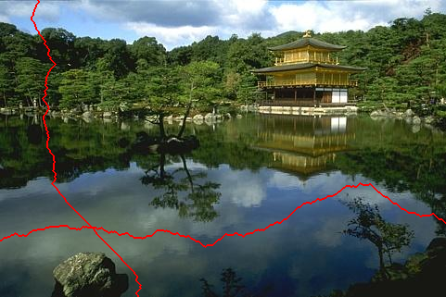
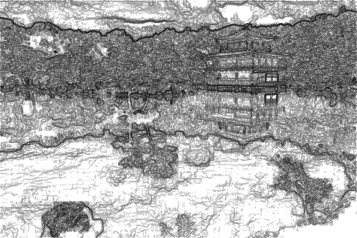
Image gradients and edges
Thurs Jan 25, 2018
Kristen Grauman
UT-Austin

Slide 2
Reminders
Piazza for assignment help
Office hours on homepage
Reminder: no laptops, phones, tablets, etc. open in class.

Slide 3
Last time
Various models for image “noise”
Linear filters and convolution useful for
  Image smoothing, removing noise
    Box filter
    Gaussian filter
    Impact of scale / width of smoothing filter
Separable filters more efficient
Median filter: a non-linear filter, edge-preserving

Slide 4
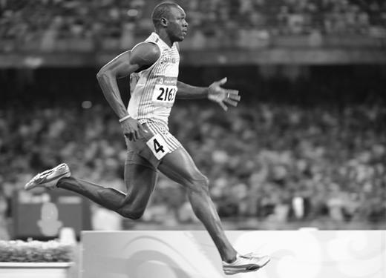
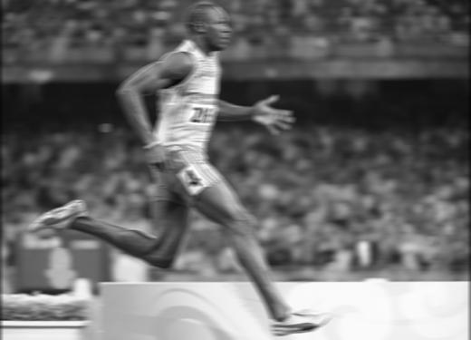
Review
Filter f = 1/9 x [ 1 1 1 1 1 1 1 1 1]
f*g=?
original image h
filtered
Slide credit: Kristen Grauman

Slide 5

Review
Filter f = 1/9 x [ 1 1 1 1 1 1 1 1 1]^{T}
f*g=?
original image h
filtered
Slide credit: Kristen Grauman

Slide 6
Image filtering
Compute a function of the local neighborhood at each pixel in the image
  Function specified by a “filter” or mask saying how to combine values from neighbors.
Uses of filtering:
  Enhance an image (denoise, resize, etc)
  Extract information (texture, edges, etc)
  Detect patterns (template matching)
Today
Adapted from Derek Hoiem

Slide 7

Edge detection
Goal: map image from 2d array of pixels to a set of curves or line segments or contours.
Why?
Main idea: look for strong gradients, post-process
Figure from J. Shotton et al., PAMI 2007

Slide 8
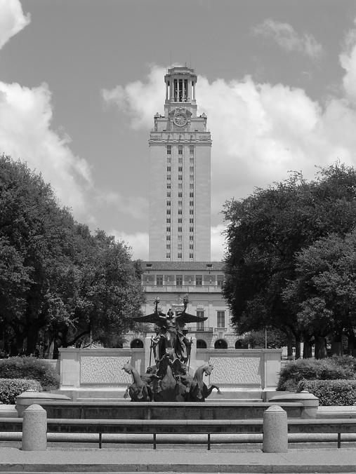
What causes an edge?
Depth discontinuity: object boundary
Reflectance change: appearance information, texture
Cast shadows
Change in surface orientation: shape
Slide credit: Kristen Grauman

Slide 9
Edges/gradients and invariance
Slide credit: Kristen Grauman

Slide 10

Derivatives and edges
An edge is a place of rapid change in the image intensity function.
intensity function
(along horizontal scanline)
image
first derivative
edges correspond to
extrema of derivative
Source: L. Lazebnik

Slide 11
Derivatives with convolution
For 2D function, f(x,y), the partial derivative is:
For discrete data, we can approximate using finite differences:
To implement above as convolution, what would be the associated filter?
Slide credit: Kristen Grauman

Slide 12
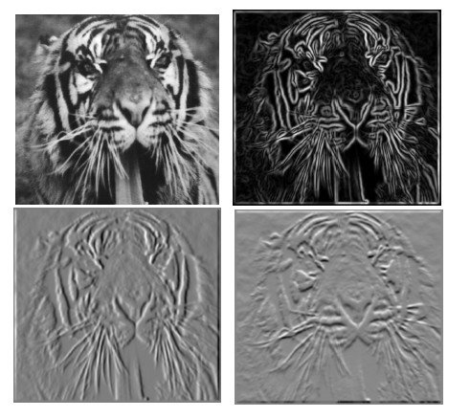
Partial derivatives of an image
?
-1 1
1 -1
-1 1
or
Which shows changes with respect to x?
(showing filters for correlation)

Slide 13





Image gradient
The gradient of an image:
The gradient points in the direction of most rapid change in intensity
The gradient direction (orientation of edge normal) is given by:
The edge strength is given by the gradient magnitude
Slide credit Steve Seitz
Notes:
13

Slide 14




Effects of noise
Consider a single row or column of the image
  Plotting intensity as a function of position gives a signal
Where is the edge?
Slide credit Steve Seitz

Slide 15



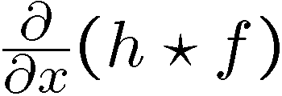

Solution: smooth first
Where is the edge?
Look for peaks in

Slide 16
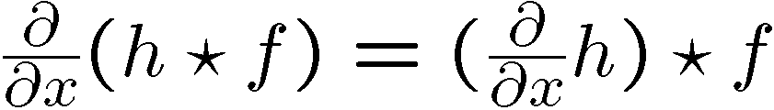
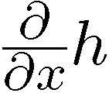
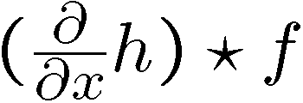

Derivative theorem of convolution
Differentiation property of convolution.
Slide credit Steve Seitz

Slide 17
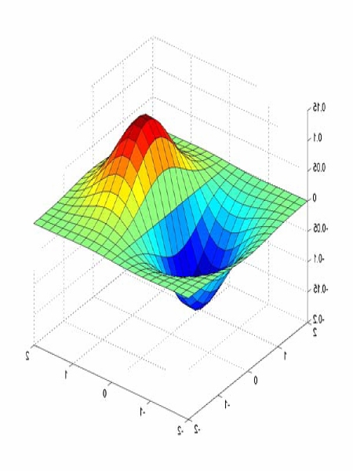
Derivative of Gaussian filters
0.0030 0.0133 0.0219 0.0133 0.0030
0.0133 0.0596 0.0983 0.0596 0.0133
0.0219 0.0983 0.1621 0.0983 0.0219
0.0133 0.0596 0.0983 0.0596 0.0133
0.0030 0.0133 0.0219 0.0133 0.0030

Slide 18


Derivative of Gaussian filters
x-direction
y-direction
Source: L. Lazebnik

Slide 19




Laplacian of Gaussian
Consider
Laplacian of Gaussian
operator
Where is the edge?
Zero-crossings of bottom graph
Slide credit: Steve Seitz

Slide 20








2D edge detection filters
Laplacian of Gaussian
Gaussian
derivative of Gaussian
is the Laplacian operator:
Slide credit: Steve Seitz
Notes:
20

Slide 21






Smoothing with a Gaussian
Recall: parameter σ is the “scale” / “width” / “spread” of the Gaussian kernel, and controls the amount of smoothing.
…
Slide credit: Kristen Grauman

Slide 22
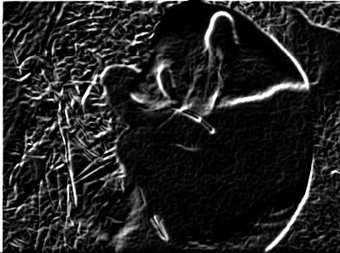
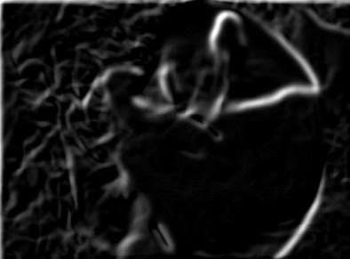
Effect of σ on derivatives
σ = 1 pixel
σ = 3 pixels
The apparent structures differ depending on Gaussian’s scale parameter.
Larger values: larger scale edges detected
Smaller values: finer features detected
Slide credit: Kristen Grauman

Slide 23
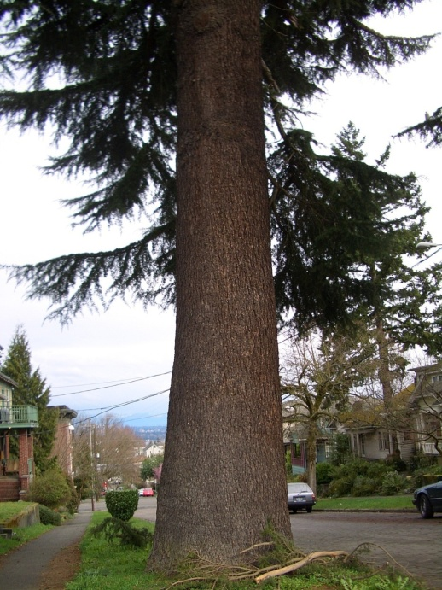
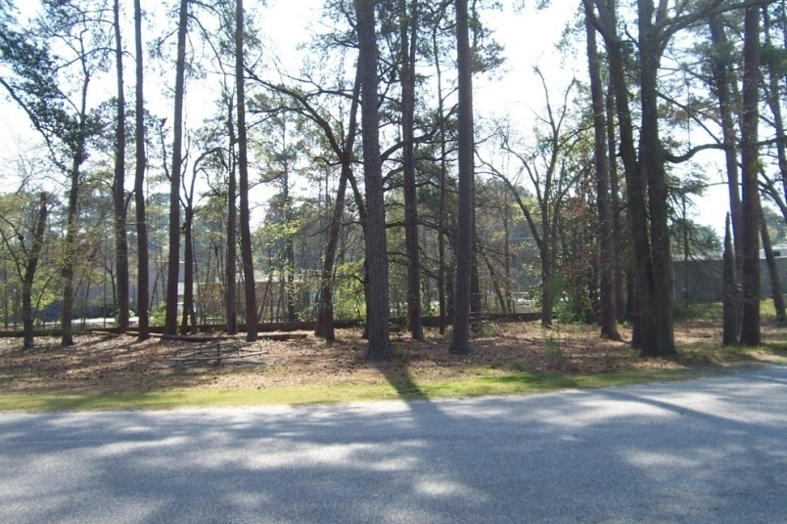
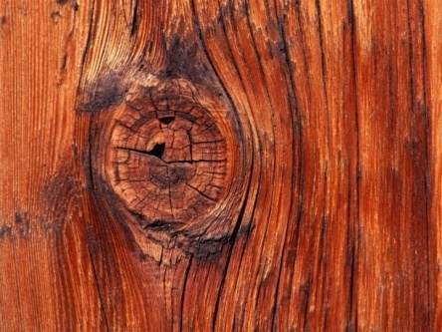
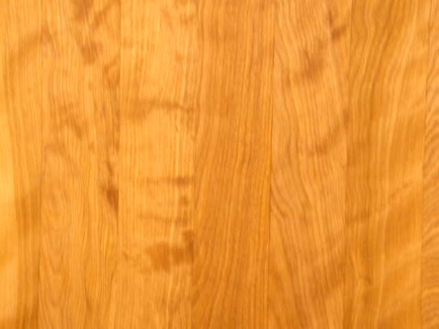
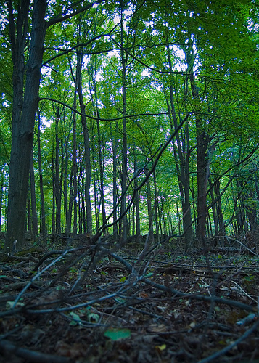
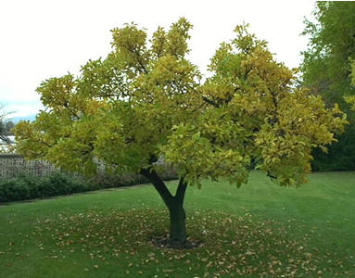
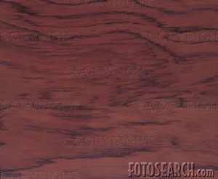
So, what scale to choose?
It depends what we’re looking for.
Slide credit: Kristen Grauman

Slide 24
Mask properties
Smoothing
  Values positive
  Sum to 1 → constant regions same as input
  Amount of smoothing proportional to mask size
  Remove “high-frequency” components; “low-pass” filter
Derivatives
  ___________ signs used to get high response in regions of high contrast
  Sum to ___ → no response in constant regions
  High absolute value at points of high contrast
Slide credit: Kristen Grauman

Slide 25
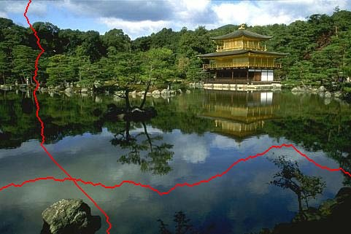
Seam carving: main idea
[Shai & Avidan, SIGGRAPH 2007]

Slide 26
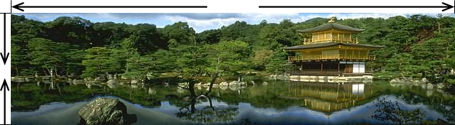
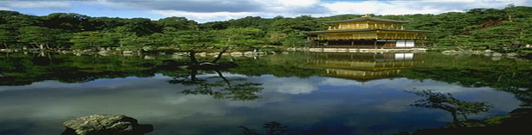
Seam carving: main idea
Content-aware resizing
Traditional resizing
[Shai & Avidan, SIGGRAPH 2007]

Slide 27

Seam carving: main idea

Slide 28



























Real image example
Slide credit: Kristen Grauman

Slide 29
Seam carving: main idea
Content-aware resizing
Intuition:
Preserve the most “interesting” content
  → Prefer to remove pixels with low gradient energy
To reduce or increase size in one dimension, remove irregularly shaped “seams”
  → Optimal solution via dynamic programming.
Slide credit: Kristen Grauman

Slide 30
Seam carving: main idea
Want to remove seams where they won’t be very noticeable:
  Measure “energy” as gradient magnitude
Choose seam based on minimum total energy path across image, subject to 8-connectedness.
Slide credit: Kristen Grauman

Slide 31
Seam carving: algorithm
s₁
s₂
s₃
s₄
s₅
Let a vertical seam s consist of h positions that form an 8-connected path.
Let the cost of a seam be:
Optimal seam minimizes this cost:
Compute it efficiently with dynamic programming.
Slide credit: Kristen Grauman

Slide 32
How to identify the minimum cost seam?
First, consider a greedy approach:
Energy matrix
(gradient magnitude)
Slide credit: Kristen Grauman

Slide 33

Seam carving: algorithm
Compute the cumulative minimum energy for all possible connected seams at each entry (i,j):
Then, min value in last row of M indicates end of the minimal connected vertical seam.
Backtrack up from there, selecting min of 3 above in M.
row i-1
j-1
j
j+1
row i
j
Energy matrix
(gradient magnitude)
M matrix:
cumulative min energy
(for vertical seams)
Slide credit: Kristen Grauman

Slide 34
Example
Energy matrix
(gradient magnitude)
M matrix
(for vertical seams)
Slide credit: Kristen Grauman

Slide 35
Example
Energy matrix
(gradient magnitude)
M matrix
(for vertical seams)
Slide credit: Kristen Grauman

Slide 36
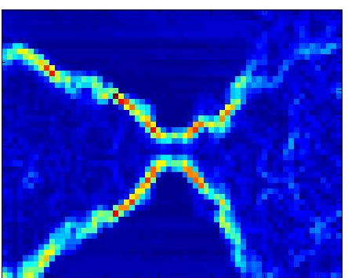

Real image example
Original Image
Energy Map
Blue = low energy
Red = high energy
Slide credit: Kristen Grauman

Slide 37
Real image example
Slide credit: Kristen Grauman

Slide 38
Other notes on seam carving
Analogous procedure for horizontal seams
Can also insert seams to increase size of image in either dimension
  Duplicate optimal seam, averaged with neighbors
Other energy functions may be plugged in
  E.g., color-based, interactive,…
Can use combination of vertical and horizontal seams

Slide 39
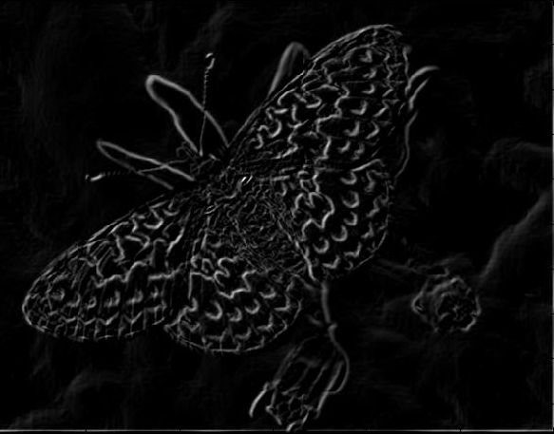
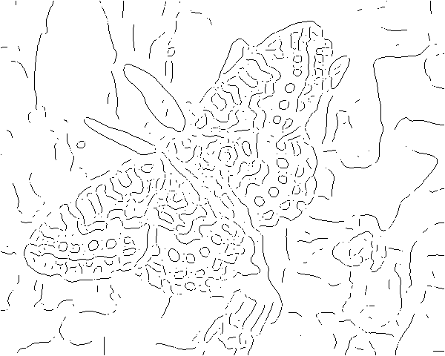
Gradients -> edges
Primary edge detection steps:
1. Smoothing: suppress noise
2. Edge enhancement: filter for contrast
3. Edge localization
  Determine which local maxima from filter output are actually edges vs. noise
    Threshold, Thin

Slide 40
Thresholding
Choose a threshold value t
Set any pixels less than t to zero (off)
Set any pixels greater than or equal to t to one (on)

Slide 41
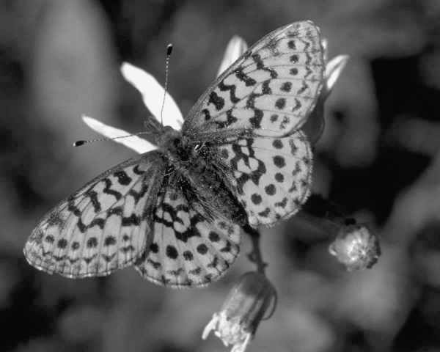
Original image

Slide 42
Gradient magnitude image

Slide 43
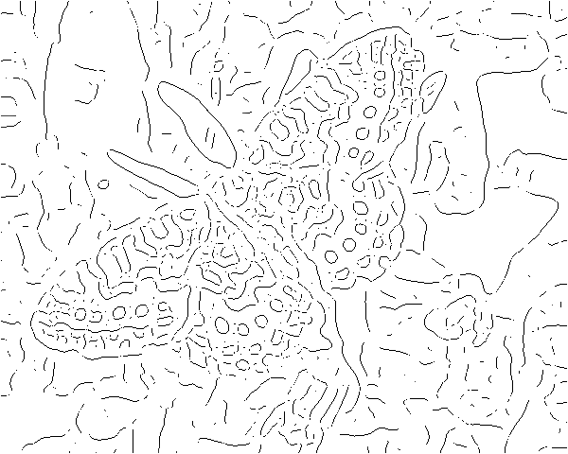
Thresholding gradient with a lower threshold

Slide 44
Thresholding gradient with a higher threshold

Slide 45
Canny edge detector
Filter image with derivative of Gaussian
Find magnitude and orientation of gradient
Non-maximum suppression:
  Thin wide “ridges” down to single pixel width
Linking and thresholding (hysteresis):
  Define two thresholds: low and high
  Use the high threshold to start edge curves and the low threshold to continue them
MATLAB: edge(image, ‘canny’);
>>help edge
Source: D. Lowe, L. Fei-Fei

Slide 46
The Canny edge detector
original image (Lena)
Slide credit: Steve Seitz

Slide 47

The Canny edge detector
norm of the gradient

Slide 48

The Canny edge detector
thresholding

Slide 49

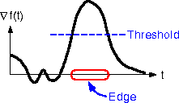
The Canny edge detector
How to turn these thick regions of the gradient into curves?
thresholding

Slide 50

Non-maximum suppression
Check if pixel is local maximum along gradient direction, select single max across width of the edge
  requires checking interpolated pixels p and r

Slide 51
The Canny edge detector
Problem: pixels along this edge didn’t survive the thresholding
thinning
(non-maximum suppression)

Slide 52
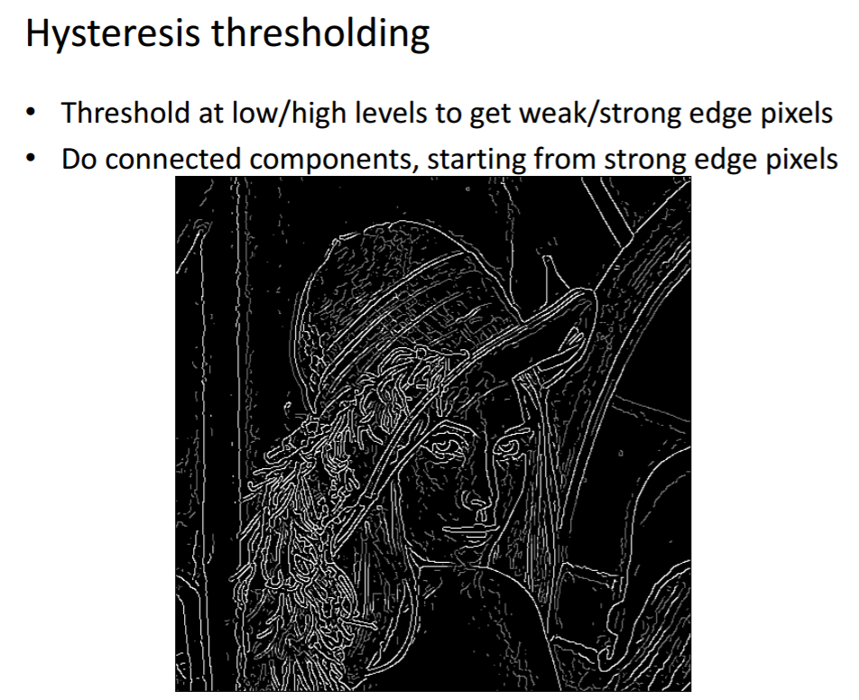
Credit: James Hays

Slide 53
Hysteresis thresholding
Use a high threshold to start edge curves, and a low threshold to continue them.
Source: Steve Seitz

Slide 54
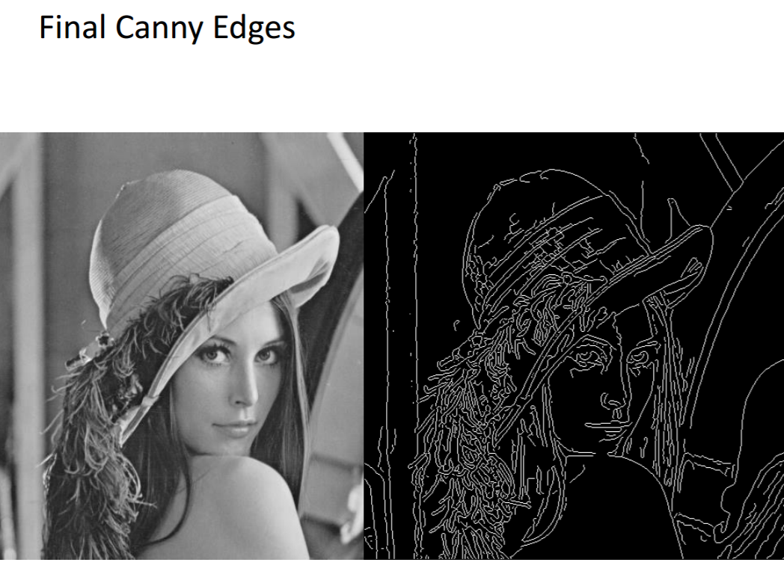
Credit: James Hays

Slide 55
Recap: Canny edge detector
Filter image with derivative of Gaussian
Find magnitude and orientation of gradient
Non-maximum suppression:
  Thin wide “ridges” down to single pixel width
Linking and thresholding (hysteresis):
  Define two thresholds: low and high
  Use the high threshold to start edge curves and the low threshold to continue them
MATLAB: edge(image, ‘canny’);
>>help edge
Source: D. Lowe, L. Fei-Fei

Slide 56
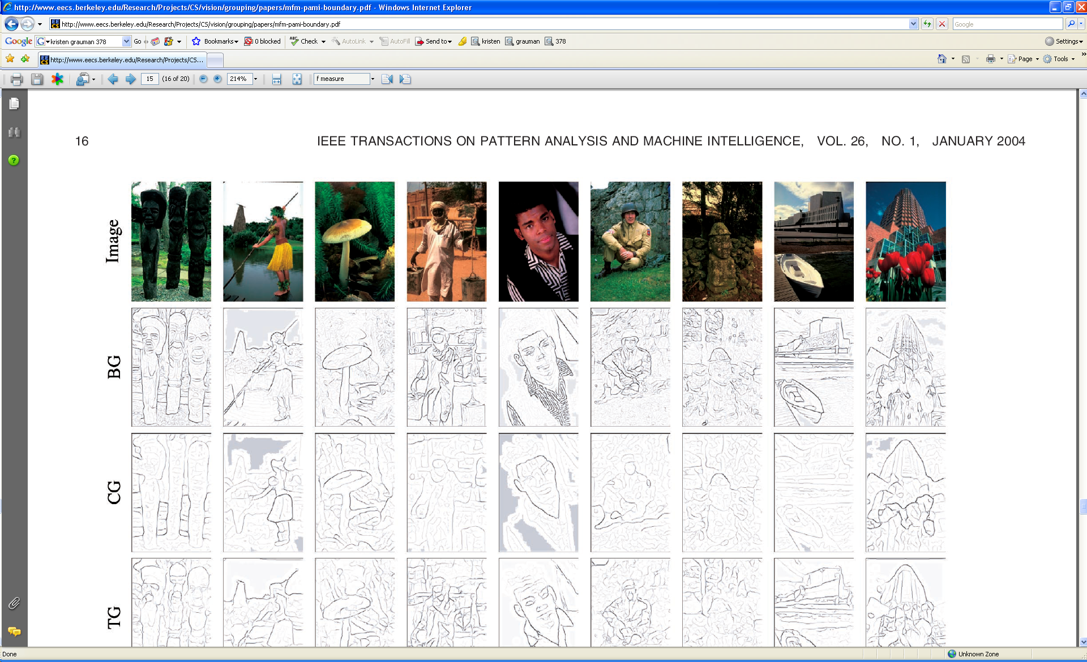
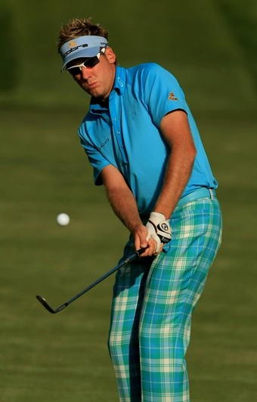
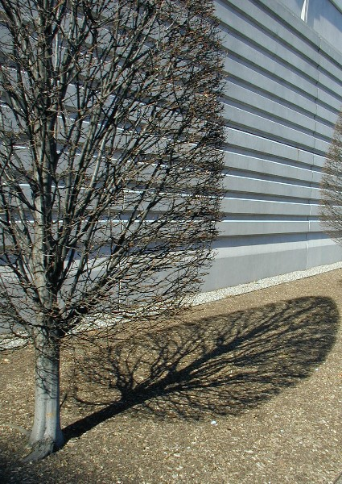
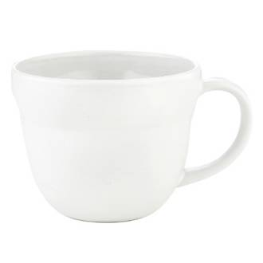
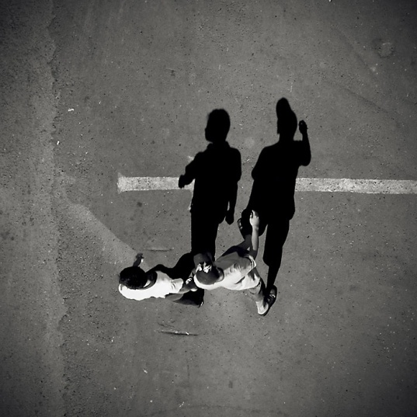
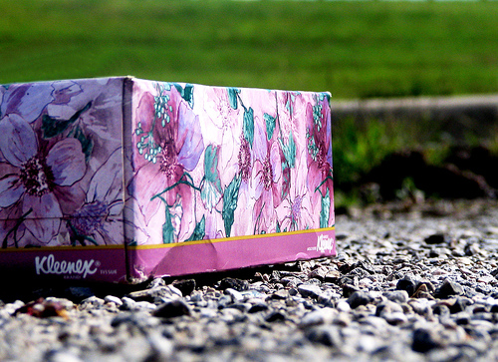
Low-level edges vs. perceived contours
Background
Texture
Shadows

Slide 57



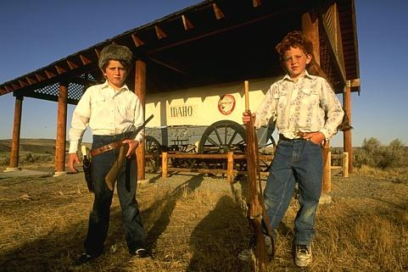


Low-level edges vs. perceived contours
image
human segmentation
gradient magnitude
Berkeley segmentation database:
http://www.eecs.berkeley.edu/Research/Projects/CS/vision/grouping/segbench/
Source: L. Lazebnik

Slide 58
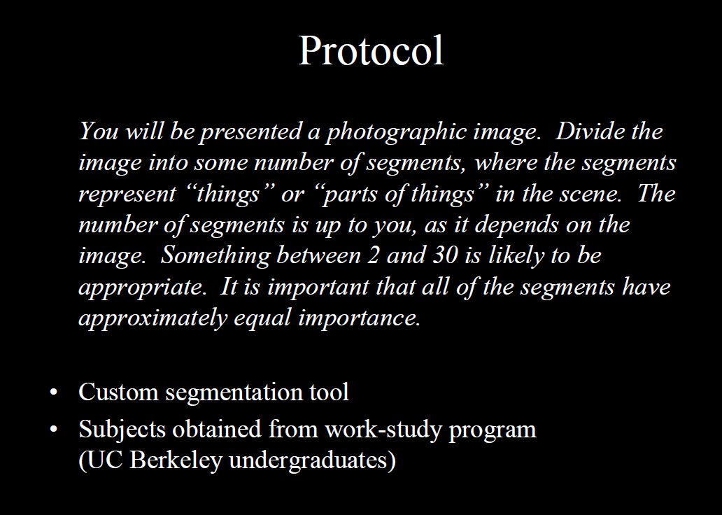
Berkeley Segmentation Data Set
David Martin, Charless Fowlkes, Doron Tal, Jitendra Malik
Credit: David Martin

Slide 59
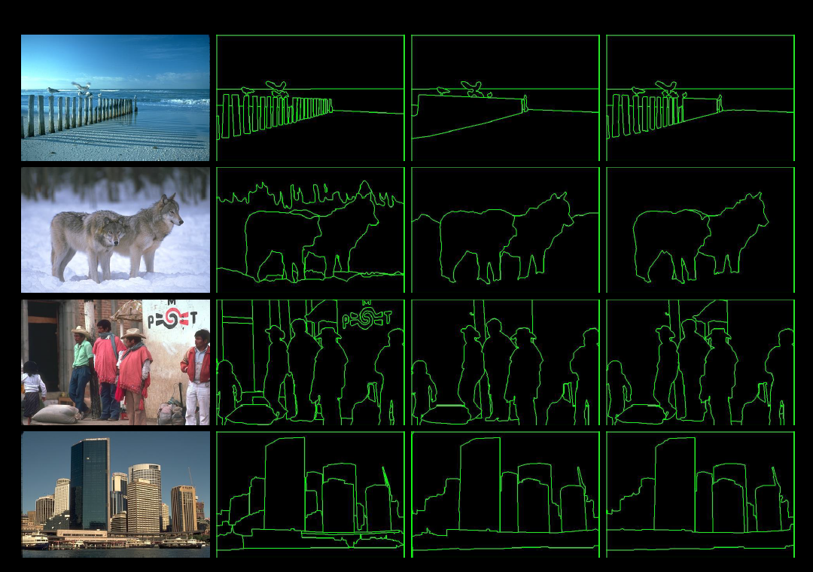

Slide 60
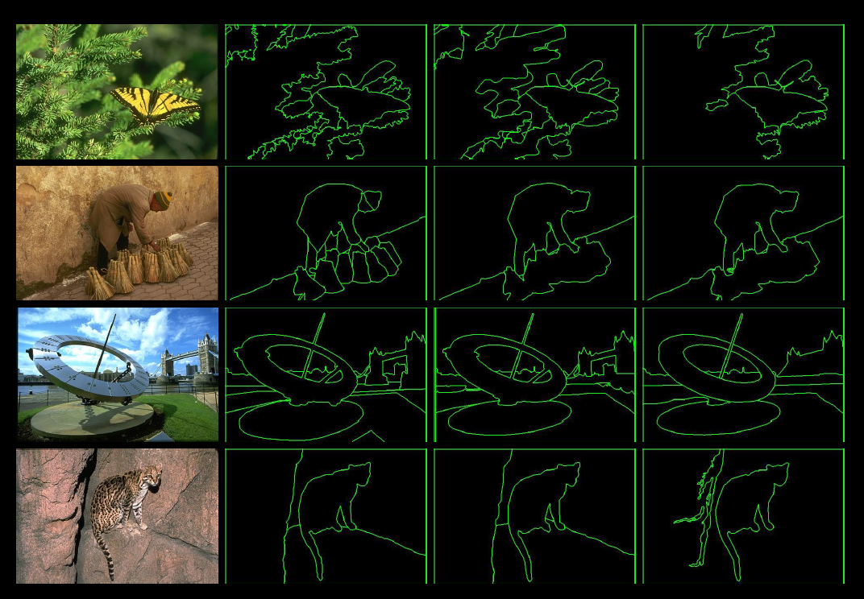

Slide 61
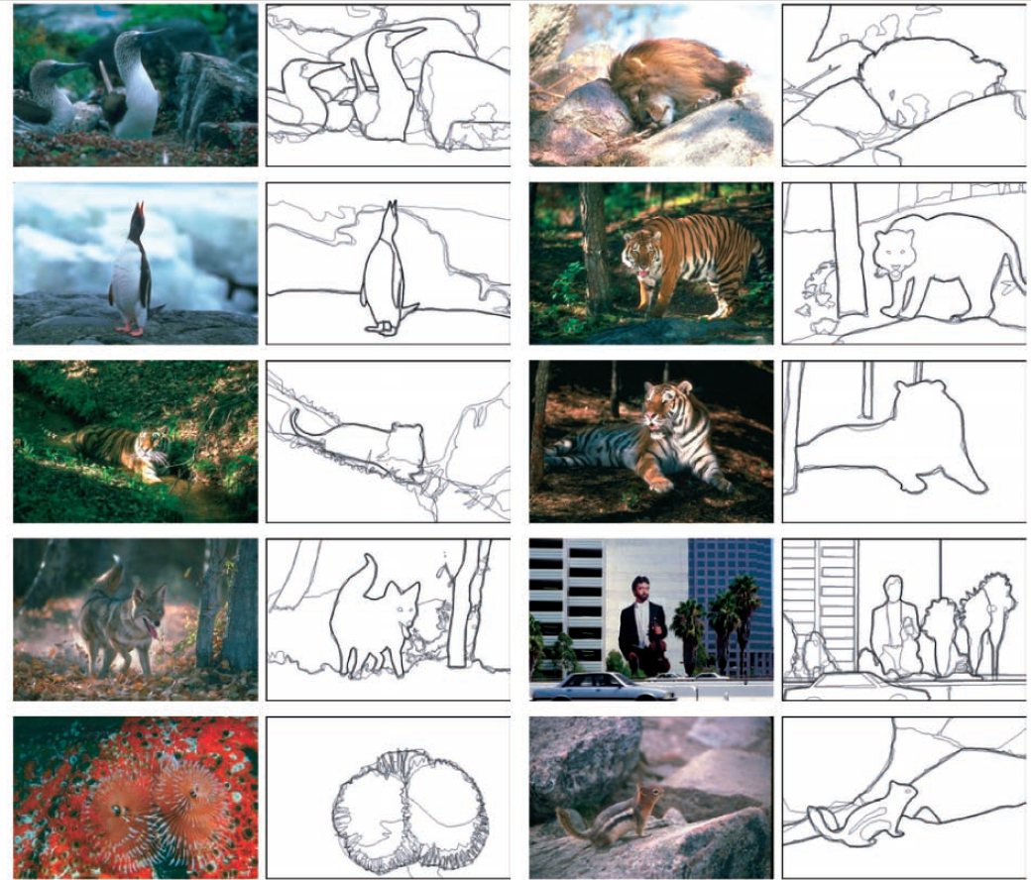
Learn from humans which combination of features is most indicative of a “good” contour?
[D. Martin et al. PAMI 2004]
Human-marked segment boundaries

Slide 62
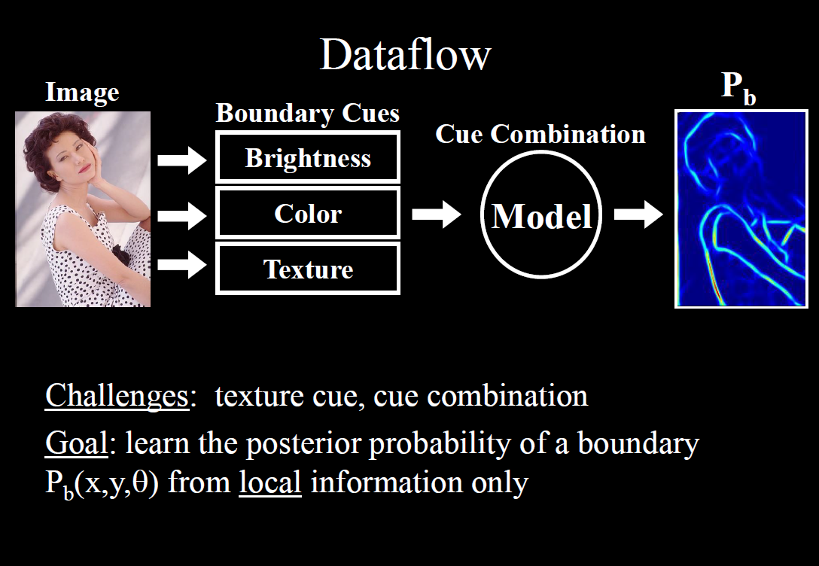

Slide 63
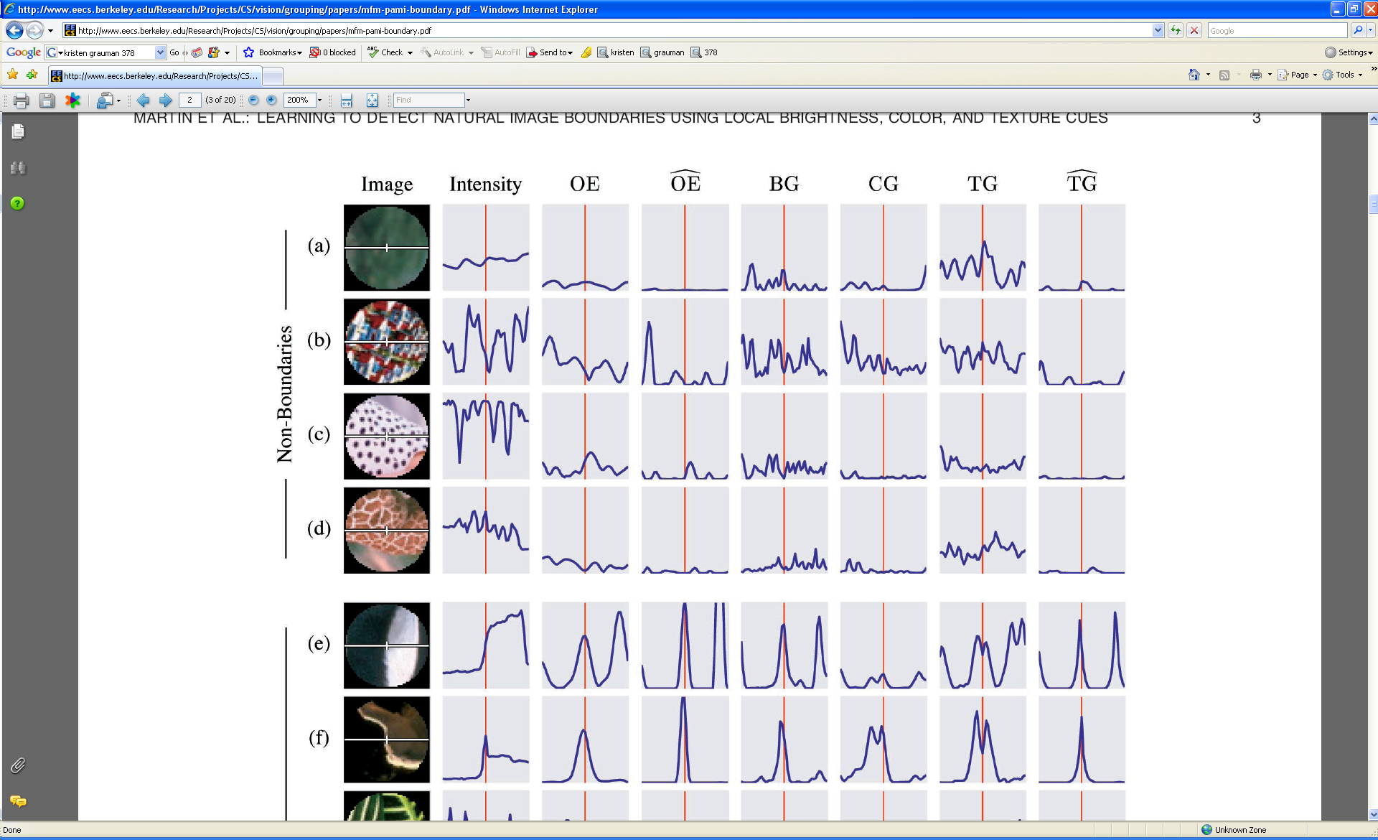
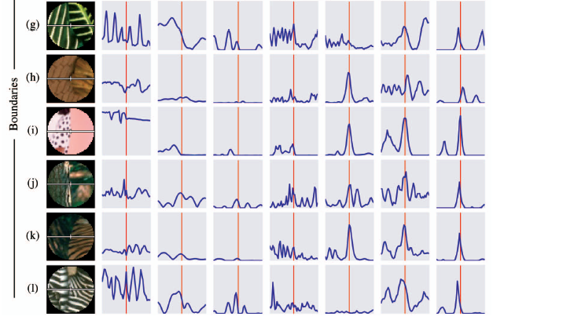
What features are responsible for perceived edges?
Feature profiles (oriented energy, brightness, color, and texture gradients) along the patch’s horizontal diameter
[D. Martin et al. PAMI 2004]
Kristen Grauman, UT-Austin

Slide 64
What features are responsible for perceived edges?
Feature profiles (oriented energy, brightness, color, and texture gradients) along the patch’s horizontal diameter
[D. Martin et al. PAMI 2004]
Kristen Grauman, UT-Austin

Slide 65
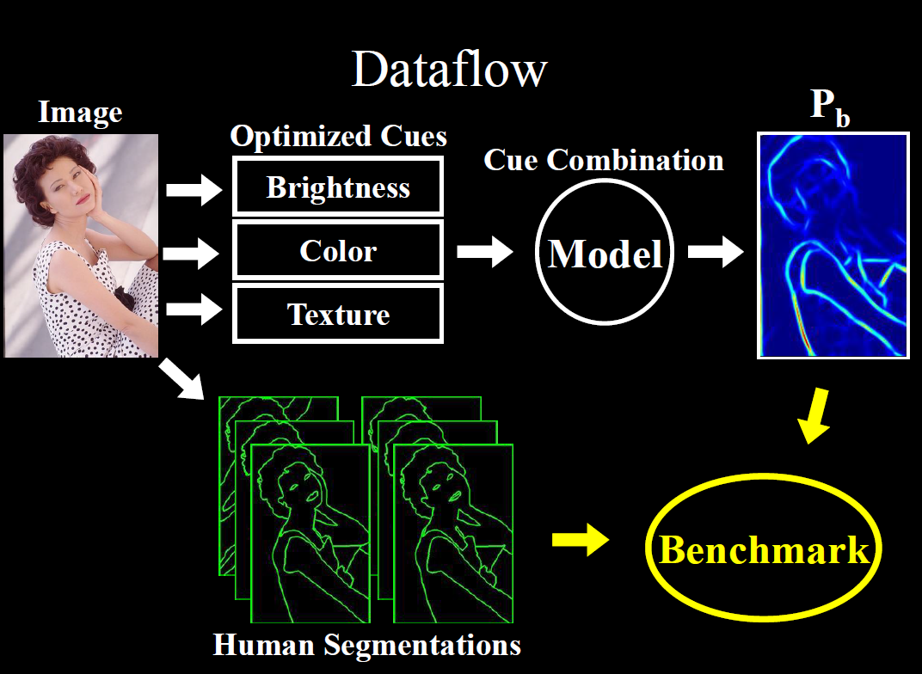
Credit: David Martin

Slide 66
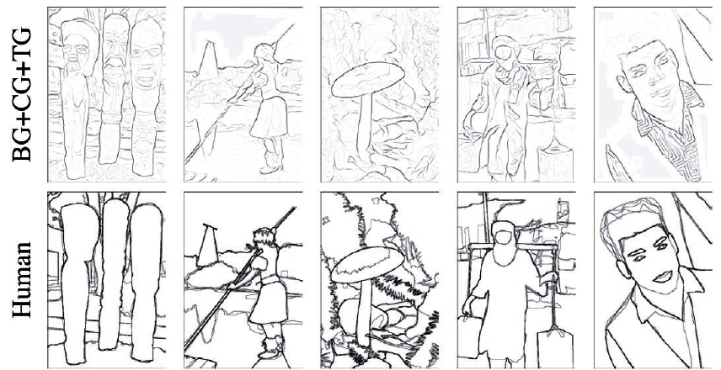
[D. Martin et al. PAMI 2004]
Kristen Grauman, UT-Austin

Slide 67
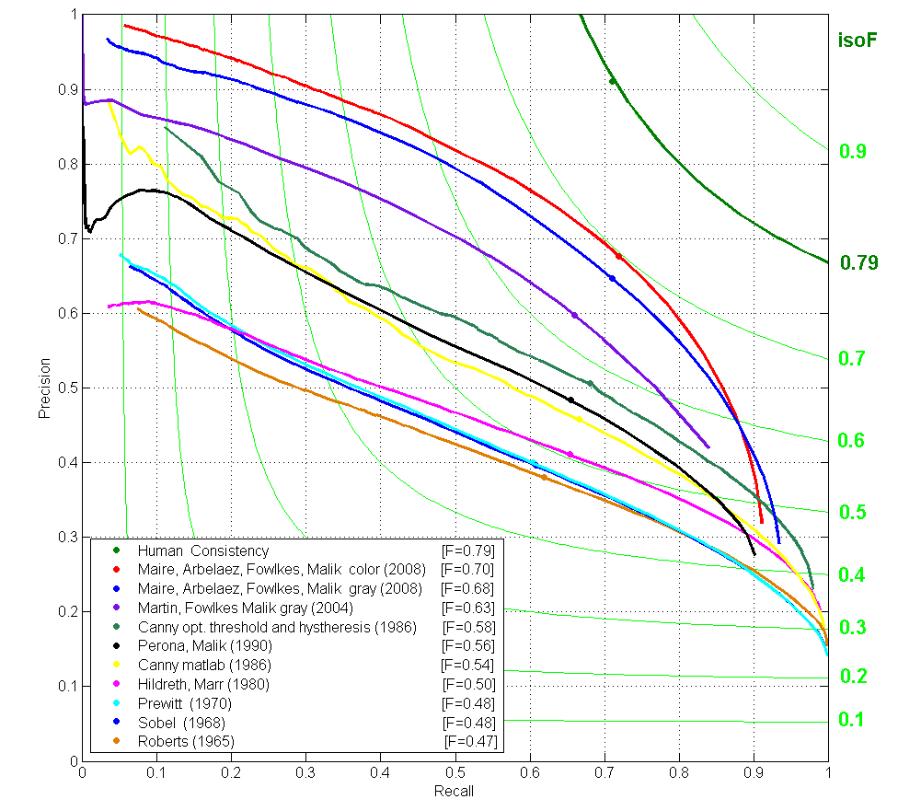
Contour Detection
Canny+opt thresholds
Human agreement
Canny
Prewitt, Sobel, Roberts
Learned with combined features
Source: Jitendra Malik: http://www.cs.berkeley.edu/~malik/malik-talks-ptrs.html

Slide 68
Recall: image filtering
Compute a function of the local neighborhood at each pixel in the image
  Function specified by a “filter” or mask saying how to combine values from neighbors.
Uses of filtering:
  Enhance an image (denoise, resize, etc)
  Extract information (texture, edges, etc)
  Detect patterns (template matching)
Adapted from Derek Hoiem

Slide 69
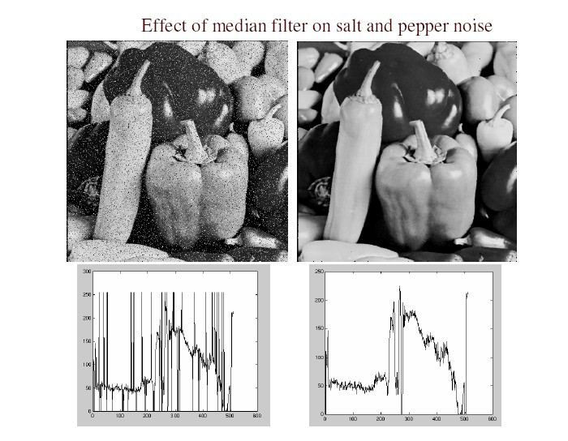
Filters for features
Map raw pixels to an intermediate representation that will be used for subsequent processing
Goal: reduce amount of data, discard redundancy, preserve what’s useful

Slide 70
Template matching
Filters as templates:
Note that filters look like the effects they are intended to find --- “matched filters”
Use normalized cross-correlation score to find a given pattern (template) in the image.
Normalization needed to control for relative brightnesses.

Slide 71


Template matching
Template (mask)
Scene
A toy example
Slide credit: Kristen Grauman

Slide 72
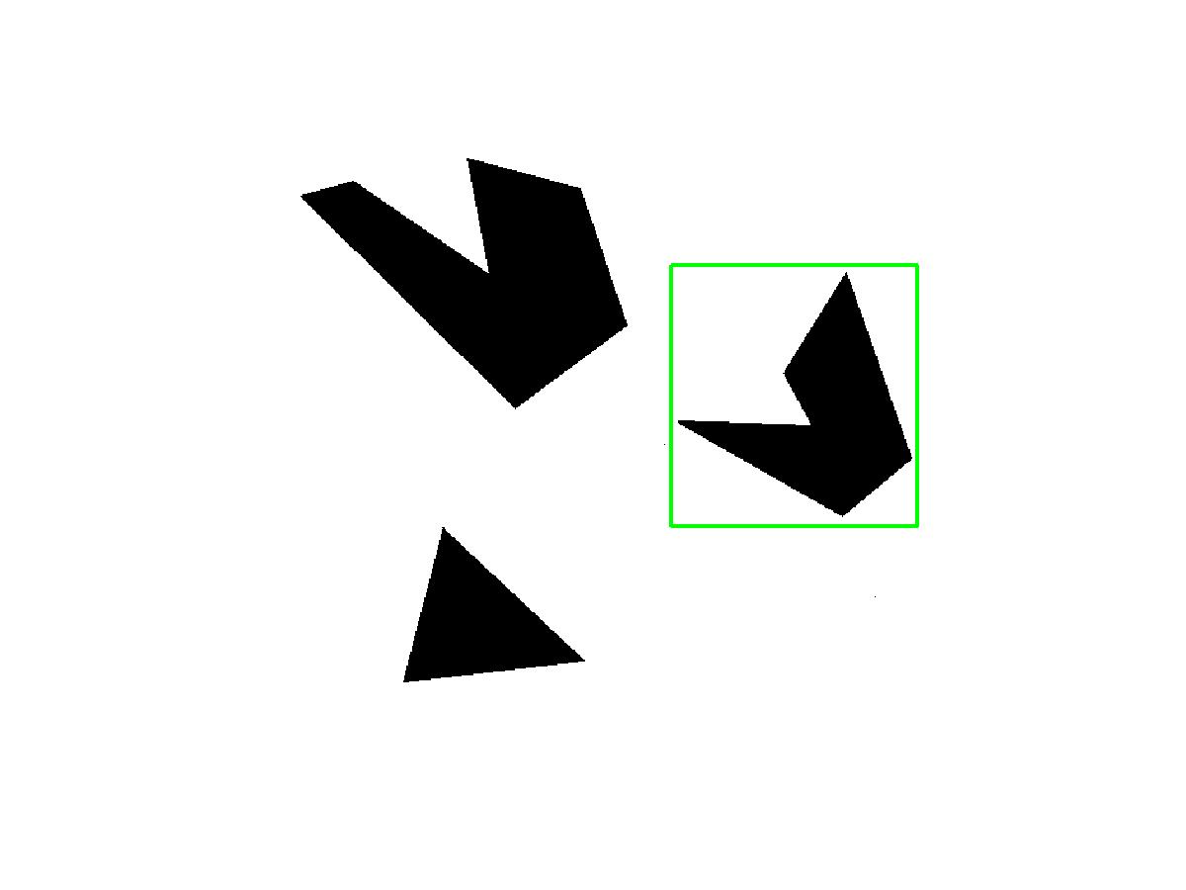
Template matching
Template
Detected template
Slide credit: Kristen Grauman

Slide 73

Template matching
Detected template
Correlation map
Slide credit: Kristen Grauman

Slide 74

Where’s Waldo?
Template
Scene
Slide credit: Kristen Grauman

Slide 75

Where’s Waldo?
Template
Detected template
Slide credit: Kristen Grauman

Slide 76

Where’s Waldo?
Detected template
Correlation map
Slide credit: Kristen Grauman

Slide 77


Template matching
Template
Scene
What if the template is not identical to some subimage in the scene?
Slide credit: Kristen Grauman

Slide 78

Template matching
Template
Detected template
Match can be meaningful, if scale, orientation, and general appearance is right.
How to find at any scale?
Slide credit: Kristen Grauman

Slide 79
Recap: Mask properties
Smoothing
  Values positive
  Sum to 1 → constant regions same as input
  Amount of smoothing proportional to mask size
  Remove “high-frequency” components; “low-pass” filter
Derivatives
  Opposite signs used to get high response in regions of high contrast
  Sum to 0 → no response in constant regions
  High absolute value at points of high contrast
Filters act as templates
  Highest response for regions that “look the most like the filter”
  Dot product as correlation
Slide credit: Kristen Grauman

Slide 80
Summary
Image gradients
Seam carving – gradients as “energy”
Gradients → edges and contours
Template matching
  Image patch as a filter

Slide 81
Coming up
A1 out tonight, due in 2 weeks

