Slide 1
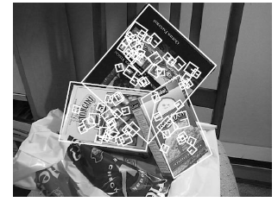
Fitting a transformation: feature-based alignment
Kristen Grauman
UT Austin
Thurs Mar 2

Slide 2
Previously
Interest point detection
  Harris corner detector
  Laplacian of Gaussian, automatic scale selection
Invariant descriptors
  Rotation according to dominant gradient direction
  Histograms for robustness to small shifts and translations (SIFT descriptor)

Slide 3
Multi-view: what’s next
Additional questions we need to address to achieve these applications:
Fitting a parametric transformation given putative matches
Dealing with outlier correspondences
Exploiting geometry to restrict locations of possible matches
Triangulation, reconstruction
Efficiency when indexing so many keypoints

Slide 4
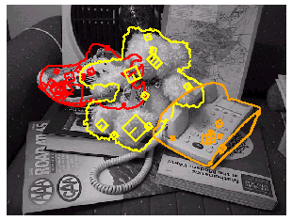
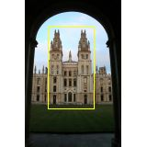
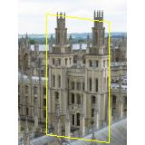
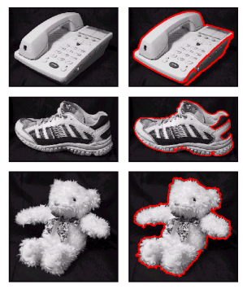
Motivation: Recognition
Figure from David Lowe

Slide 5
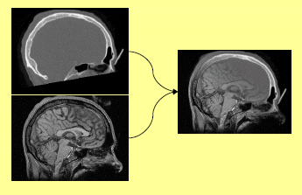
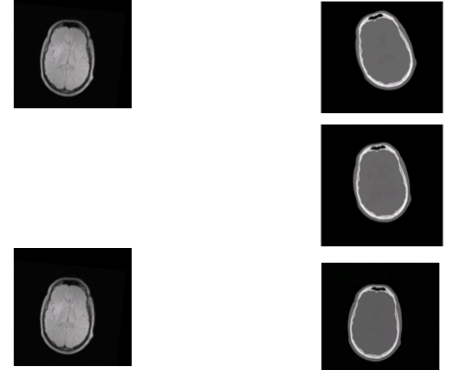
Motivation: medical image registration

Slide 6

Motivation: mosaics
Image from http://graphics.cs.cmu.edu/courses/15-463/2010_fall/

Slide 7


Coming up: robust feature-based alignment
Extract features
Source: L. Lazebnik

Slide 8
Coming up: robust feature-based alignment
Extract features
Compute putative matches
Source: L. Lazebnik

Slide 9
Coming up: robust feature-based alignment
Extract features
Compute putative matches
Loop:
  Hypothesize transformation T (small group of putative matches that are related by T)
Source: L. Lazebnik

Slide 10
Coming up: robust feature-based alignment
Extract features
Compute putative matches
Loop:
  Hypothesize transformation T (small group of putative matches that are related by T)
  Verify transformation (search for other matches consistent with T)
Source: L. Lazebnik

Slide 11

Coming up: robust feature-based alignment
Extract features
Compute putative matches
Loop:
  Hypothesize transformation T (small group of putative matches that are related by T)
  Verify transformation (search for other matches consistent with T)
Source: L. Lazebnik

Slide 12
Now
Feature-based alignment
  2D transformations
  Affine fit
  RANSAC for robust fitting

Slide 13
Alignment as fitting
Previous lectures: fitting a model to features in one image
Alignment: fitting a transformation between pairs of features (matches) in two images
M
x_{i}
Find model M that minimizes
x_{i}
x_{i}
Find transformation T
that minimizes
'
T
Adapted from: Lana Lazebnik

Slide 14




Parametric (global) warping
Examples of parametric warps:
translation
rotation
aspect
perspective
affine
Source: Alyosha Efros

Slide 15
Parametric (global) warping
T
p = (x,y)
p’ = (x’,y’)
Transformation T is a coordinate-changing machine:
p’ = T(p)
What does it mean that T is global?
  Is the same for any point p
  can be described by just a few numbers (parameters)
Let’s represent T as a matrix:
p’ = Mp
Source: Alyosha Efros

Slide 16
Scaling
Scaling a coordinate means multiplying each of its components by a scalar
Uniform scaling means this scalar is the same for all components:
× 2
Source: Alyosha Efros

Slide 17
Scaling
Non-uniform scaling: different scalars per component:
X × 2,
Y × 0.5
Source: Alyosha Efros

Slide 18
Scaling
Scaling operation:
Or, in matrix form:
scaling matrix S
Source: Alyosha Efros

Slide 19
What transformations can be represented with a 2x2 matrix?
2D Scaling?
2D Rotate around (0,0)?
2D Shear?
Source: Alyosha Efros

Slide 20
What transformations can be represented with a 2x2 matrix?
2D Mirror about Y axis?
2D Mirror over (0,0)?
2D Translation?
NO!
Source: Alyosha Efros

Slide 21
2D Linear Transformations
Only linear 2D transformations can be represented with a 2x2 matrix.
Linear transformations are combinations of …
  Scale,
  Rotation,
  Shear, and
  Mirror
Source: Alyosha Efros

Slide 22
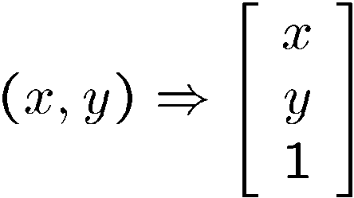
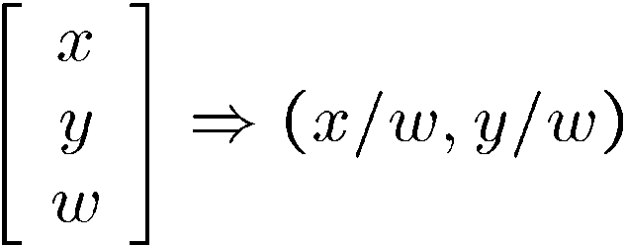
Homogeneous coordinates
To convert to homogeneous coordinates:
homogeneous image
coordinates
Converting from homogeneous coordinates

Slide 23
Homogeneous Coordinates
Q: How can we represent 2d translation as a 3x3 matrix using homogeneous coordinates?
A: Using the rightmost column:
Source: Alyosha Efros

Slide 24
Translation
Homogeneous Coordinates
t_{x} = 2
t_{y} = 1
Source: Alyosha Efros

Slide 25
Basic 2D Transformations
Basic 2D transformations as 3x3 matrices
Translate
Scale
Rotate
Shear
Source: Alyosha Efros

Slide 26
2D Affine Transformations
Affine transformations are combinations of …
  Linear transformations, and
  Translations
Parallel lines remain parallel

Slide 27
Today
Feature-based alignment
  2D transformations
  Affine fit
  RANSAC for robust fitting

Slide 28
Alignment problem
We have previously considered how to fit a model to image evidence
  e.g., a line to edge points, or a snake to a deforming contour
In alignment, we will fit the parameters of some transformation according to a set of matching feature pairs (“correspondences”).
x_{i}
'
x_{i}
T

Slide 29
Image alignment
Two broad approaches:
  Direct (pixel-based) alignment
    Search for alignment where most pixels agree
  Feature-based alignment
    Search for alignment where extracted features agree
    Can be verified using pixel-based alignment

Slide 30
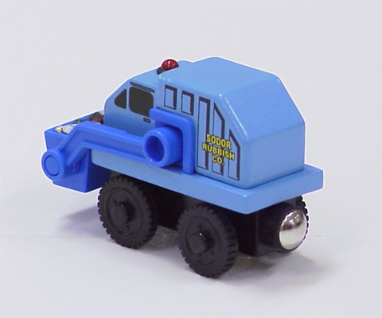

Let’s start with affine transformations
Simple fitting procedure (linear least squares)
Approximates viewpoint changes for roughly planar objects and roughly orthographic cameras
Can be used to initialize fitting for more complex models
Slide credit: Lana Lazebnik

Slide 31
Fitting an affine transformation
Assuming we know the correspondences, how do we get the transformation?

Slide 32
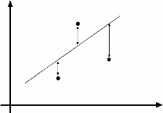
An aside: Least Squares Example
Say we have a set of data points (X1,X1’), (X2,X2’), (X3,X3’), etc. (e.g. person’s height vs. weight)
We want a nice compact formula (a line) to predict X’s from Xs: Xa + b = X’
We want to find a and b
How many (X,X’) pairs do we need?
What if the data is noisy?
Ax=B
overconstrained
Source: Alyosha Efros

Slide 33
Fitting an affine transformation
Assuming we know the correspondences, how do we get the transformation?

Slide 34
Fitting an affine transformation
How many matches (correspondence pairs) do we need to solve for the transformation parameters?
Once we have solved for the parameters, how do we compute the coordinates of the corresponding point for ?
Where do the matches come from?

Slide 35

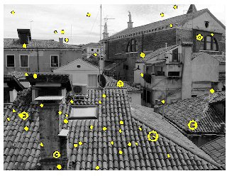
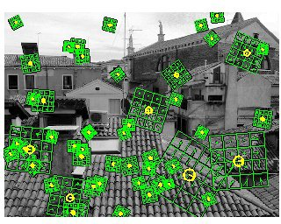
Recall: Scale Invariant Feature Transform (SIFT) descriptor [Lowe 2004]
Interest points and their scales and orientations
(random subset of 50)
SIFT descriptors
http://www.vlfeat.org/overview/sift.html
Kristen Grauman
http://www.vlfeat.org/overview/sift.html

Slide 36
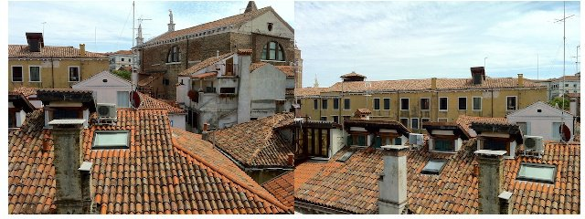
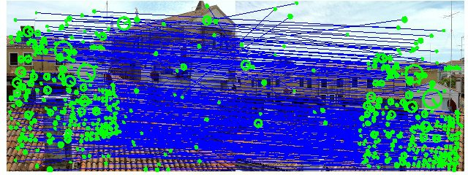
Recall: SIFT (preliminary) matches
http://www.vlfeat.org/overview/sift.html
Kristen Grauman
http://www.vlfeat.org/overview/sift.html

Slide 37
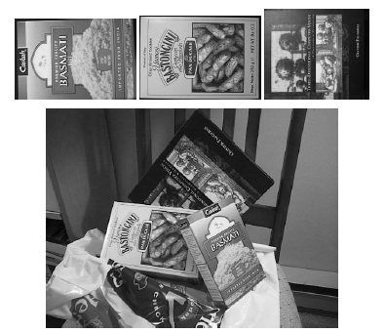
Fitting an affine transformation
Affine model approximates perspective projection of planar objects.
Figures from David Lowe, ICCV 1999

Slide 38
Today
Feature-based alignment
  2D transformations
  Affine fit
  RANSAC for robust fitting

Slide 39
Recall: SIFT (preliminary) matches
Not all of these are valid matches!
http://www.vlfeat.org/overview/sift.html
Kristen Grauman
http://www.vlfeat.org/overview/sift.html

Slide 40
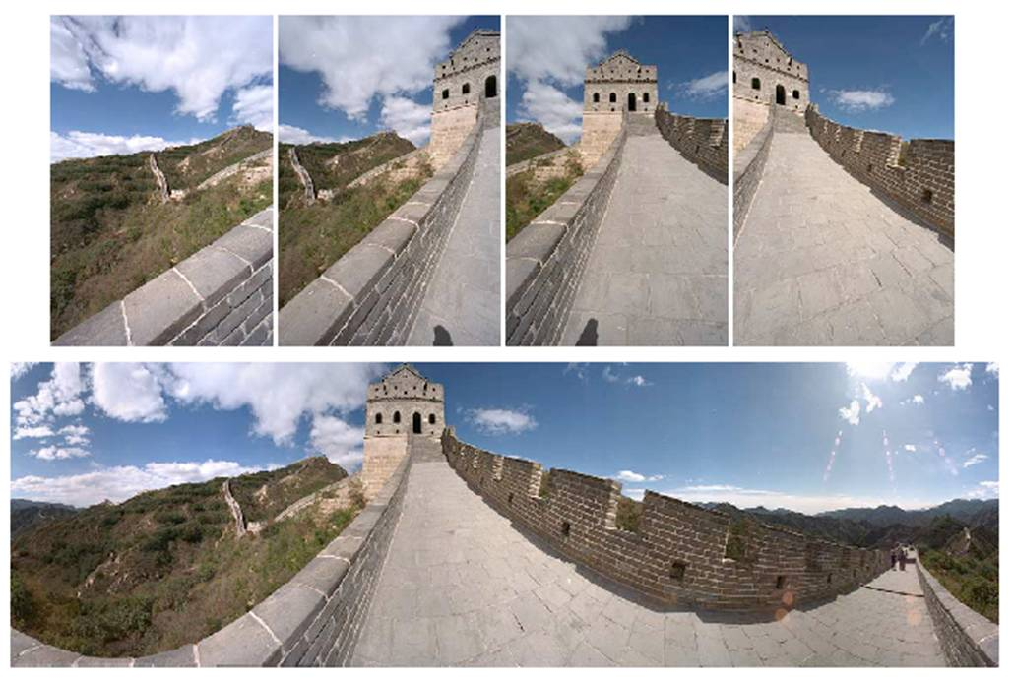
Outliers
Outliers can hurt the quality of our parameter estimates, e.g.,
  an erroneous pair of matching points from two images
  an edge point that is noise, or doesn’t belong to the line we are fitting.
Kristen Grauman

Slide 41
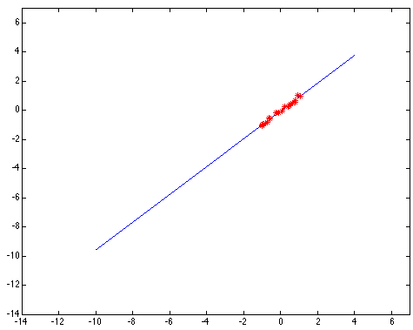
Outliers affect least squares fit
Notes:
41

Slide 42
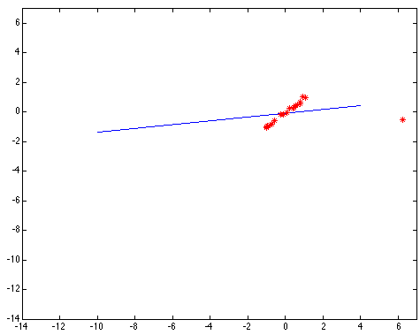
Outliers affect least squares fit
Notes:
42

Slide 43
RANSAC
RANdom Sample Consensus
Approach: we want to avoid the impact of outliers, so let’s look for “inliers”, and use those only.
Intuition: if an outlier is chosen to compute the current fit, then the resulting line (transformation) won’t have much support from rest of the points (matches).
Kristen Grauman

Slide 44
RANSAC for line fitting
Repeat N times:
Draw s points uniformly at random
Fit line to these s points
Find inliers to this line among the remaining points (i.e., points whose distance from the line is less than t)
If there are d or more inliers, accept the line and refit using all inliers
Lana Lazebnik

Slide 45
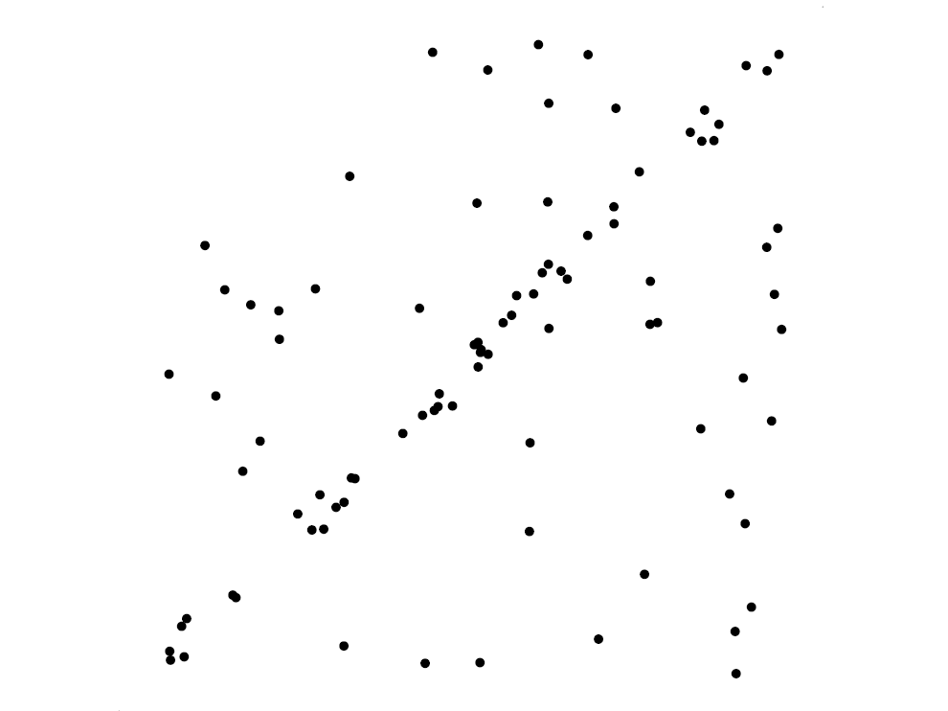
RANSAC for line fitting example
Source: R. Raguram
Lana Lazebnik

Slide 46
RANSAC for line fitting example
Least-squares fit
Source: R. Raguram
Lana Lazebnik

Slide 47
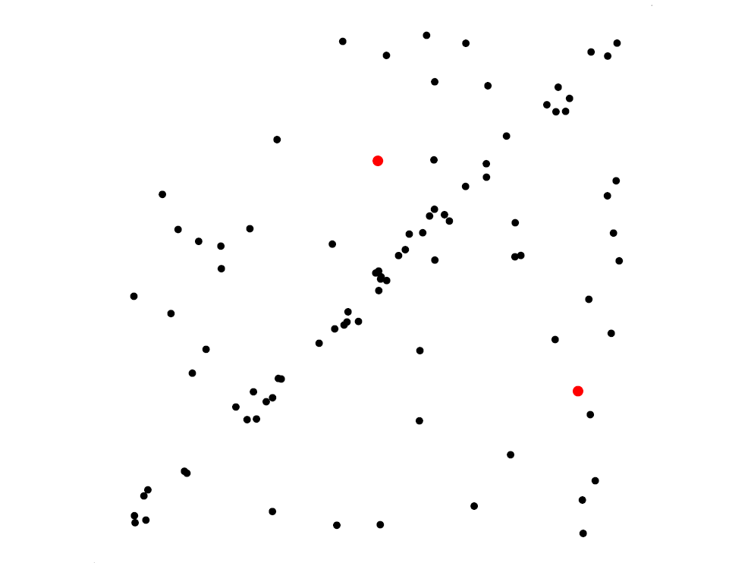
RANSAC for line fitting example
Randomly select minimal subset of points
Source: R. Raguram
Lana Lazebnik

Slide 48
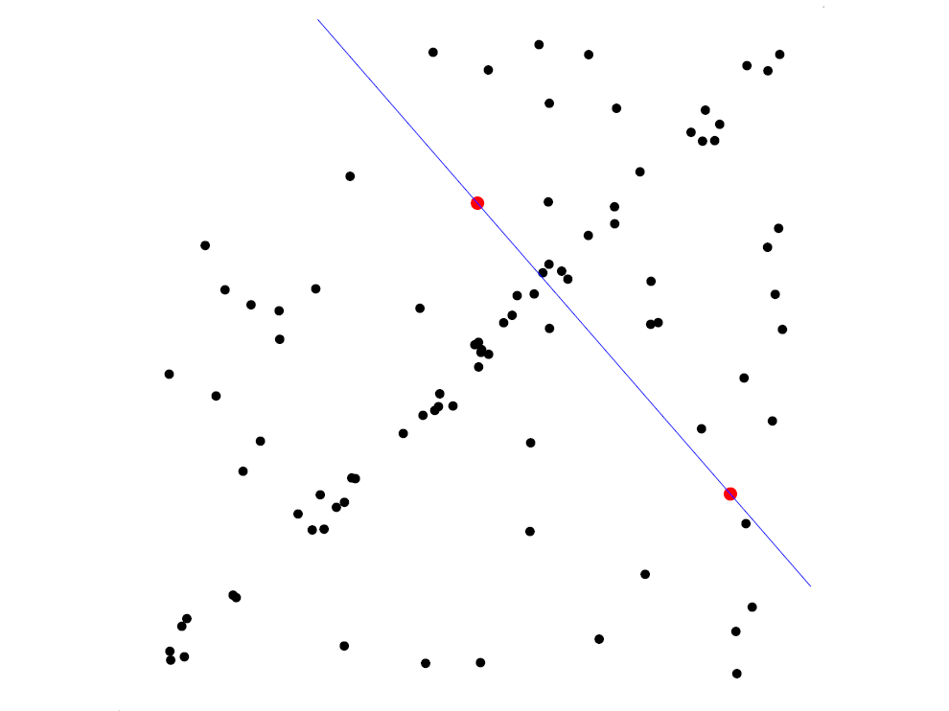
RANSAC for line fitting example
Randomly select minimal subset of points
Hypothesize a model
Source: R. Raguram
Lana Lazebnik

Slide 49
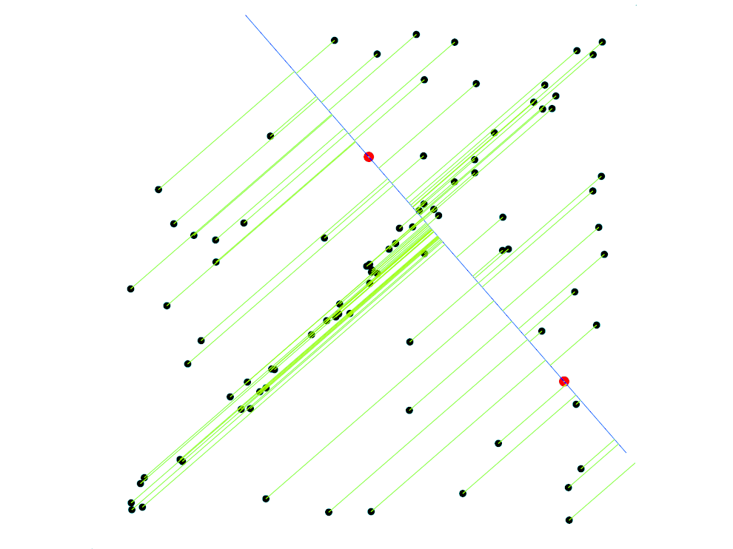
RANSAC for line fitting example
Randomly select minimal subset of points
Hypothesize a model
Compute error function
Source: R. Raguram
Lana Lazebnik

Slide 50
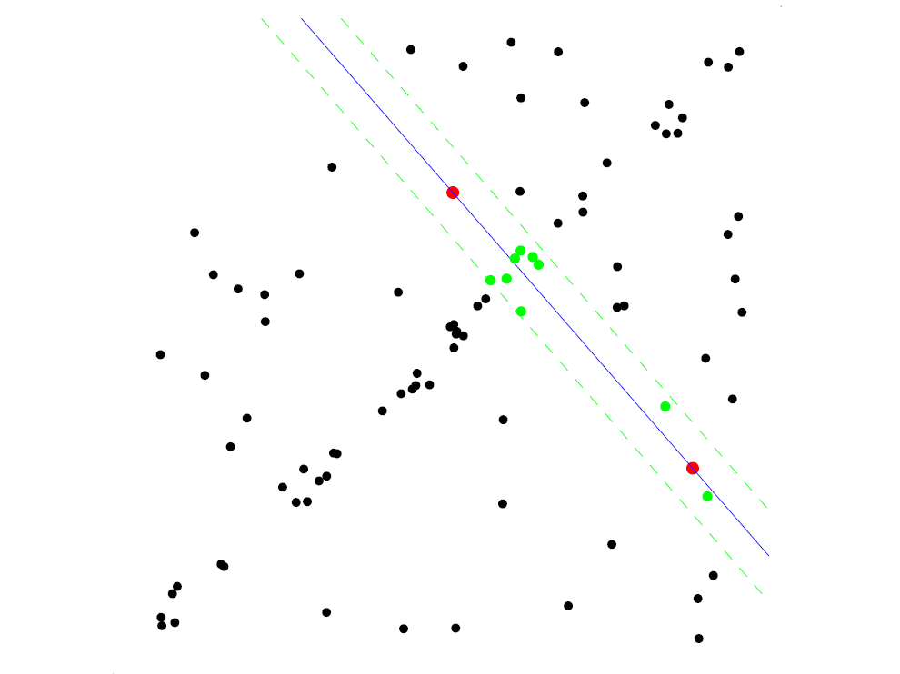
RANSAC for line fitting example
Randomly select minimal subset of points
Hypothesize a model
Compute error function
Select points consistent with model
Source: R. Raguram
Lana Lazebnik

Slide 51
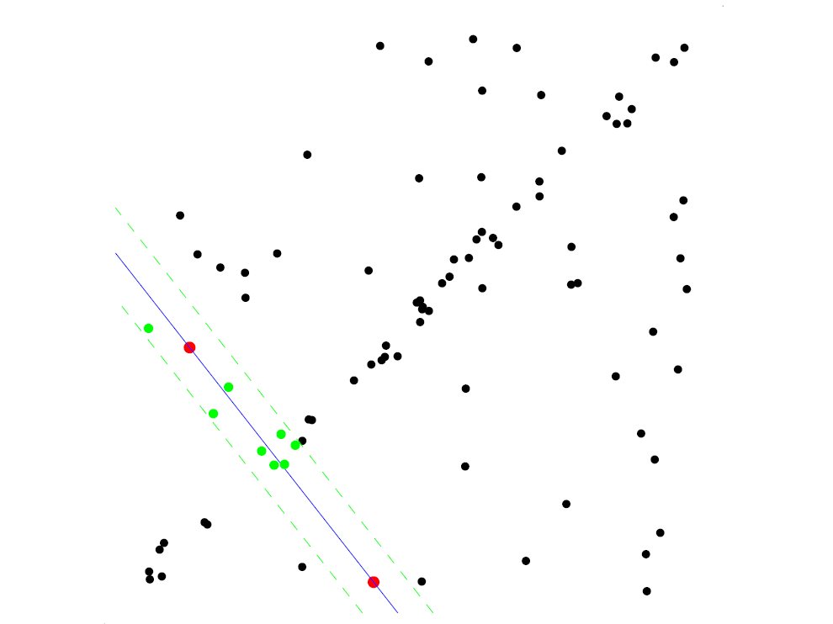
RANSAC for line fitting example
Randomly select minimal subset of points
Hypothesize a model
Compute error function
Select points consistent with model
Repeat hypothesize-and-verify loop
Source: R. Raguram
Lana Lazebnik

Slide 52
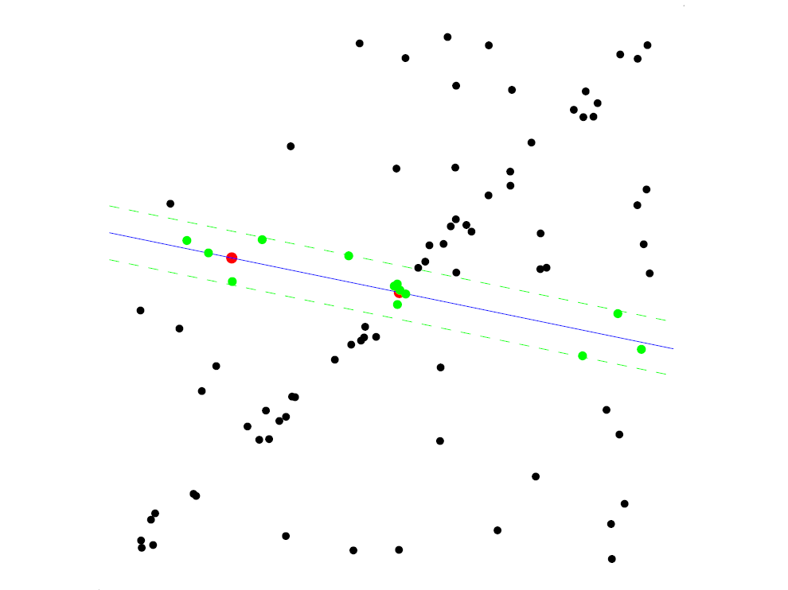
RANSAC for line fitting example
Randomly select minimal subset of points
Hypothesize a model
Compute error function
Select points consistent with model
Repeat hypothesize-and-verify loop
Source: R. Raguram
Lana Lazebnik

Slide 53
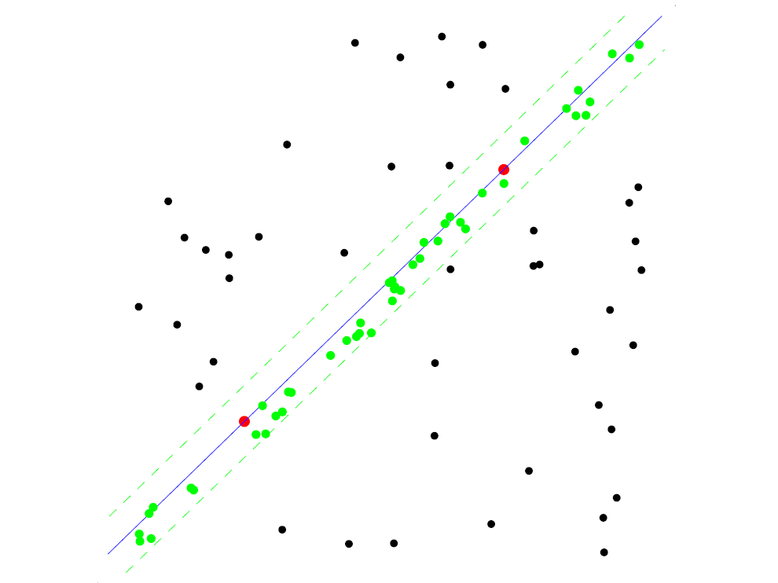
RANSAC for line fitting example
Uncontaminated sample
Randomly select minimal subset of points
Hypothesize a model
Compute error function
Select points consistent with model
Repeat hypothesize-and-verify loop
Source: R. Raguram
Lana Lazebnik

Slide 54
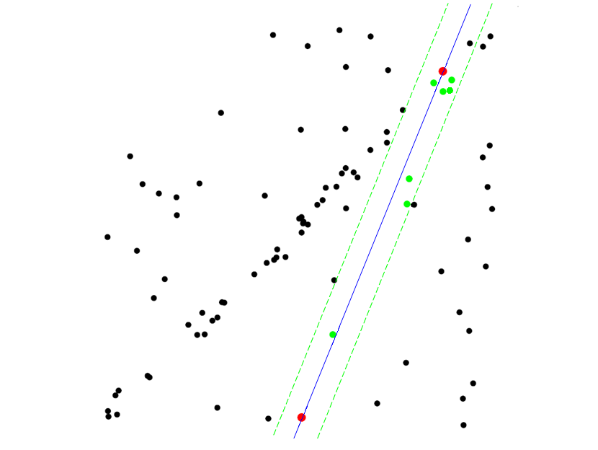
RANSAC for line fitting example
Randomly select minimal subset of points
Hypothesize a model
Compute error function
Select points consistent with model
Repeat hypothesize-and-verify loop
Source: R. Raguram
Lana Lazebnik
Notes:
54

Slide 55
How many trials for RANSAC?
To ensure good chance of finding true inliers, need sufficient number of trials, S.
Let p be probability that any given match is valid
Let P be to the total prob of success after S trials.
Likelihood in one trial that all k random samples are inliers is p^{k}
Likelihood that all S trials will fail is
1-P = (1-p^{k})^{S}
Required minimum number of trials is
S = log(1-P) / log(1-p^{k})
Kristen Grauman

Slide 56
How many trials for RANSAC?
To ensure good chance of finding true inliers, need sufficient number of trials, S.
Let p be probability that any given match is valid
Let P be to the total prob of success after S trials.
Likelihood in one trial that all k random samples are inliers is p^{k}
Likelihood that all S trials will fail is
1-P = (1-p^{k})^{S}
Required minimum number of trials is
S = log(1-P) / log(1-p^{k})
k | p | S
3 | 0.5 | 35
6 | 0.6 | 97
6 | 0.5 | 293
Kristen Grauman

Slide 57
RANSAC song – danielwedge.com
When you have outliers you may face much frustration
if you include them in a model fitting operation.
But if your model's fit to a sample set of minimal size,
the probability of the set being outlier-free will rise.
Brute force tests of all sets will cause computational constipation.
N random samples
will provide an example
of a fitted model uninfluenced by outliers. No need to test all combinations!
Each random trial should have its own unique sample set
and make sure that the sets you choose are not degenerate.
N, the number of sets, to choose is based on the probability
of a point being an outlier, and of finding a set that's outlier free.
Updating N as you go will minimise the time spent.
So if you gamble
that N samples are ample
to fit a model to your set of points, it's likely that you will win the bet.
Select the set that boasts
that its number of inliers is the most (you're almost there).
Fit a new model just to those inliers and discard the rest,
an estimated model for your data is now possessed!
This marks the end point of your model fitting quest

Slide 58
That is an example fitting a model
(line)…
What about fitting a transformation (translation)?

Slide 59
RANSAC: General form
RANSAC loop:
Randomly select a seed group on which to base transformation estimate (e.g., a group of matches)
Compute transformation from seed group
Find inliers to this transformation
If the number of inliers is sufficiently large, re-compute estimate of transformation on all of the inliers
Keep the transformation with the largest number of inliers

Slide 60

RANSAC example: Translation
Putative matches
Source: Rick Szeliski

Slide 61
RANSAC example: Translation
Select one match, count inliers

Slide 62
RANSAC example: Translation
Select one match, count inliers

Slide 63
RANSAC example: Translation
Find “average” translation vector

Slide 64
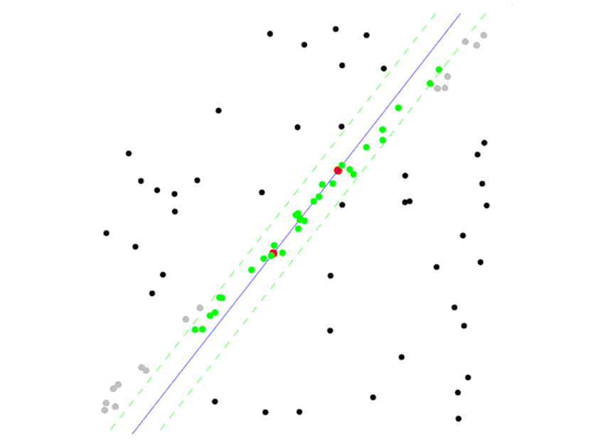
RANSAC pros and cons
Pros
  Simple and general
  Applicable to many different problems
  Often works well in practice
Cons
  Parameters to tune
  Doesn’t work well for low inlier ratios (too many iterations,
  or can fail completely)
  Can’t always get a good initialization
  of the model based on the minimum
  number of samples
Slide credit: Lana Lazebnik

Slide 65
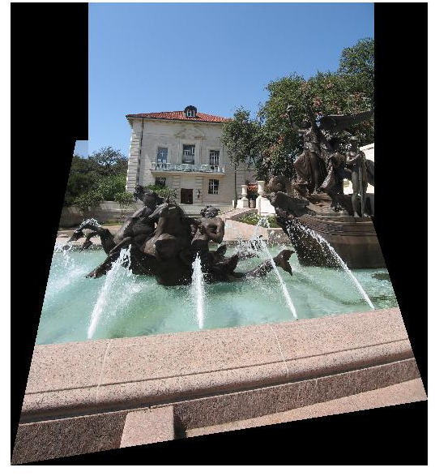
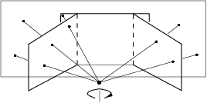
Coming up: alignment and image stitching

