Slide 1
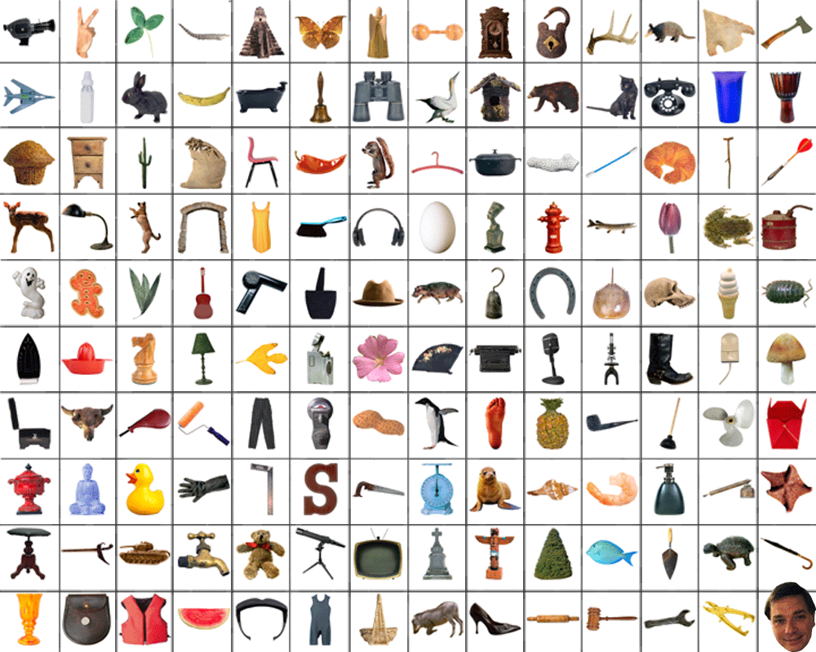
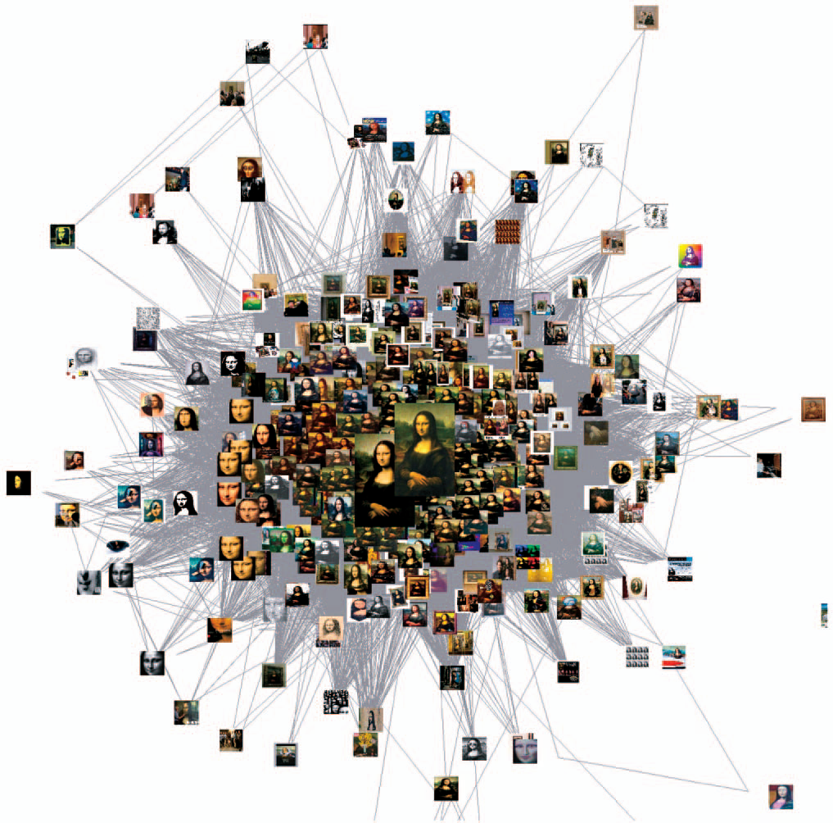
Mining, and
Intro to Categorization
Tues April 11
Kristen Grauman
UT Austin

Slide 2
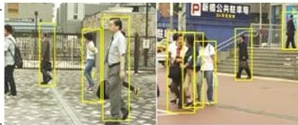
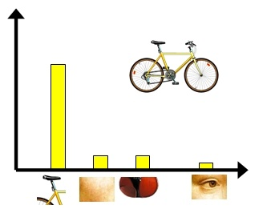
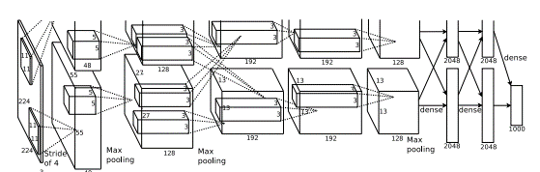
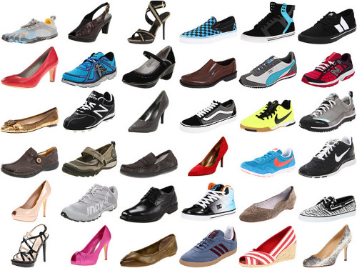
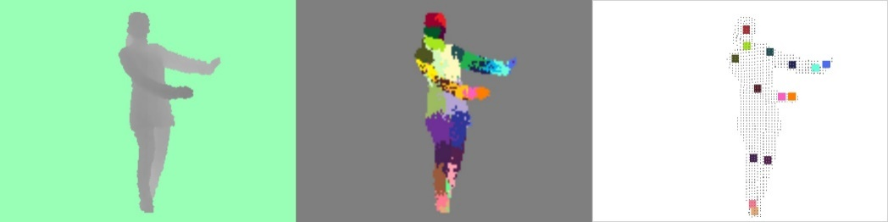
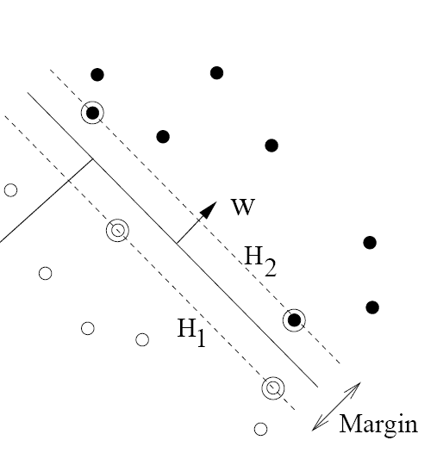
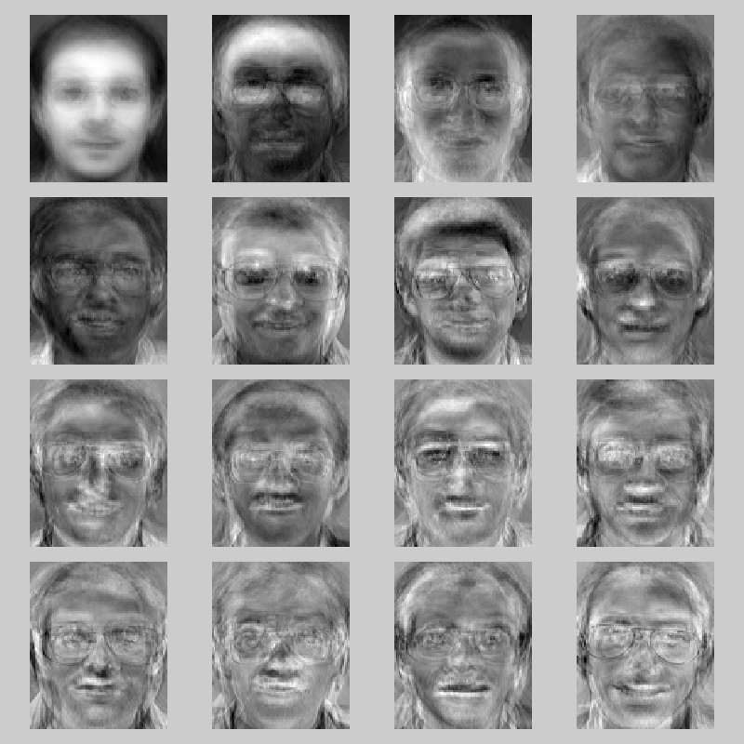
Recognition and learning
Recognizing categories (objects, scenes, activities, attributes…), learning techniques

Slide 3
Last time
Instance recognition wrap up:
  Spatial verification
  Sky mapping example
  Query expansion

Slide 4
Review questions
Does an inverted file index sacrifice accuracy in bag-of-words image retrieval? Why or why not?
Name a pro and con of query expansion.
Why does a single SIFT match cast a 4D vote for the Generalized Hough spatial verification model?
What does a perfect precision recall curve look like?

Slide 5
Today
Discovering visual patterns
  Randomized hashing algorithms
  Mining large-scale image collections
Introduction to visual categorization

Slide 6
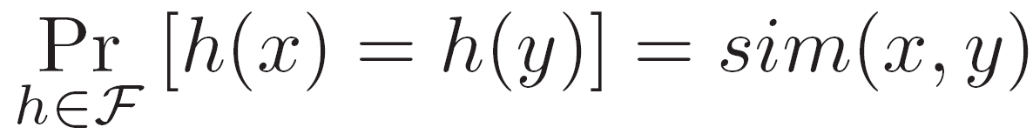
Locality Sensitive Hashing (LSH)
[Indyk and Motwani ‘98, Gionis et al.’99, Charikar ‘02, Andoni et al. ‘04]
N
Guarantees approximate near neighbors in sub-linear time, given appropriate hash functions.
h
r₁…r_{k}
X_{i}
<< N
Q
110101
h
Q
r₁…r_{k}
110111
111101
Kristen Grauman
Notes:
6
6

Slide 7
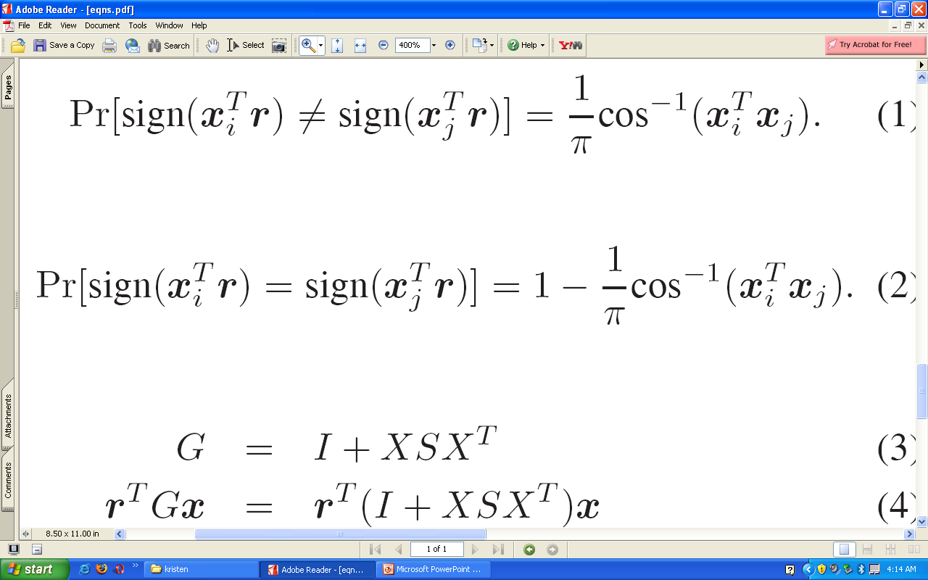
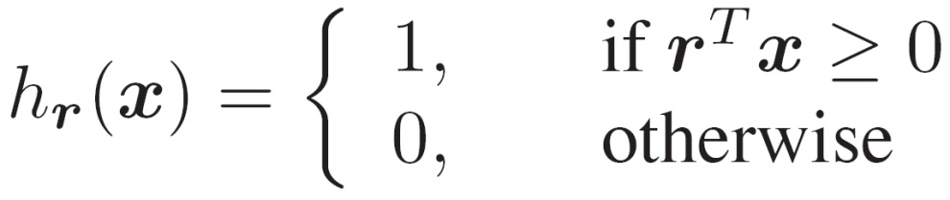
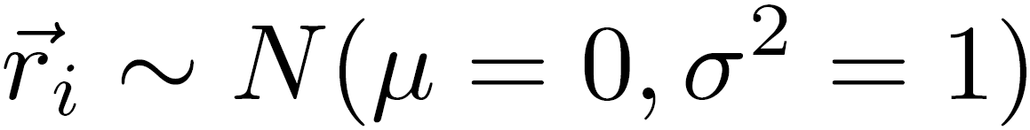
LSH function example:
inner product similarity
The probability that a random hyperplane separates two unit vectors depends on the angle between them:
Corresponding hash function:
High dot product:
unlikely to split
Lower dot product: likely to split
for
[Goemans and Williamson 1995, Charikar 2004]
Kristen Grauman
Notes:
7
7

Slide 8
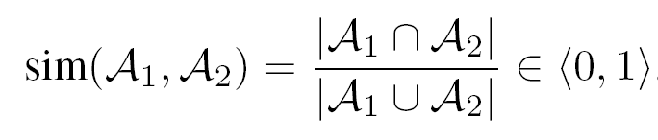
LSH function example:
Min-hash for set overlap similarity
[Broder, 1999]
A₁ ∩ A₂
A₁
A₂
A₁ U A₂
Kristen Grauman

Slide 9
LSH function example:
Min-hash for set overlap similarity
Vocabulary
Set A
Set B
Set C
A
B
C
D
E
F
A
B
C
B
C
D
A
E
F
Random orderings
min-Hash
f₁:
3
0.41
6
0.90
2
0.22
5
0.59
4
0.75
1
0.07
C
C
F
~ Un (0,1)
f₂:
1
2
6
3
5
4
B
A
0.19
0.31
0.94
0.55
0.88
0.63
A
~ Un (0,1)
f₃:
3
2
1
6
4
5
C
C
A
f₄:
4
3
5
6
1
2
B
B
E
overlap (A,B) = 3/4 (1/2)
overlap (A,C) = 1/4 (1/5)
overlap (B,C) = 0 (0)
Slide credit: Ondrej Chum
[Broder, 1999]

Slide 10
LSH function example:
Min-hash for set overlap similarity
A:
A
E
J
Q
R
V
Y
B:
A
C
E
Q
V
Z
Ordering by f₁
Ordering by f₂
A U B:
A
C
E
J
Q
R
V
Y
Z
h1(A)
A
h1(B)
A
P(h(A) = h(B)) =
|A ∩ B|
|A U B|
h2(A)
Q
h2(B)
C
Slide credit: Ondrej Chum
[Broder, 1999]

Slide 11
Multiple hash functions and tables
Generate k such hash functions, concatenate outputs into hash key:
To increase recall, search multiple independently generated hash tables
  Search/rank the union of collisions in each table, or
  Require that two examples in at least T of the tables to consider them similar.
110101
110111
111101
TABLE 1
110101
110111
111101
TABLE 2
110100
111111
111001
Kristen Grauman

Slide 12

Mining for common visual patterns
In addition to visual search, want to be able to summarize, mine, and rank the large collection as a whole.
What is common?
What is unusual?
What co-occurs?
Which exemplars are most representative?
Kristen Grauman

Slide 13
Mining for common visual patterns
In addition to visual search, want to be able to summarize, mine, and rank the large collection as a whole.
We’ll look at a few examples:
Connected component clustering via hashing
  [Geometric Min-hash, Chum et al. 2009]
Visual Rank to choose “image authorities”
  [Jing and Baluja, 2008]
Frequent item-set mining with spatial patterns
  [Quack et al., 2007]
Kristen Grauman

Slide 14
Connected component clustering with hashing
Detect seed pairs via hash collisions
Hash to related images
Compute connected components of the graph
Contrast with frequently used quadratic-time clustering algorithms
Slide credit: Ondrej Chum

Slide 15
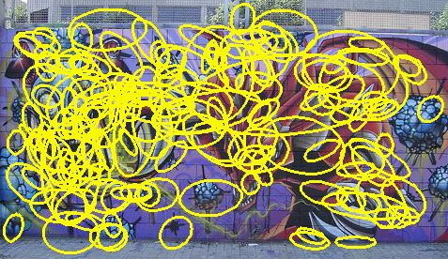
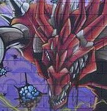
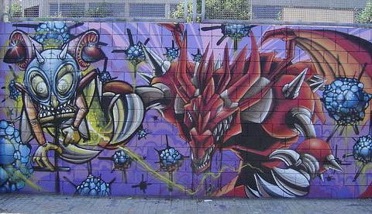
Geometric Min-hash
[Chum, Perdoch, Matas, CVPR 2009]
F
B
E
Main idea: build spatial relationships into the hash key construction:
  Select first hash output according to min hash (“central word”)
  Then append subsequent hash outputs from within its neighborhood
Figure from Ondrej Chum

Slide 16
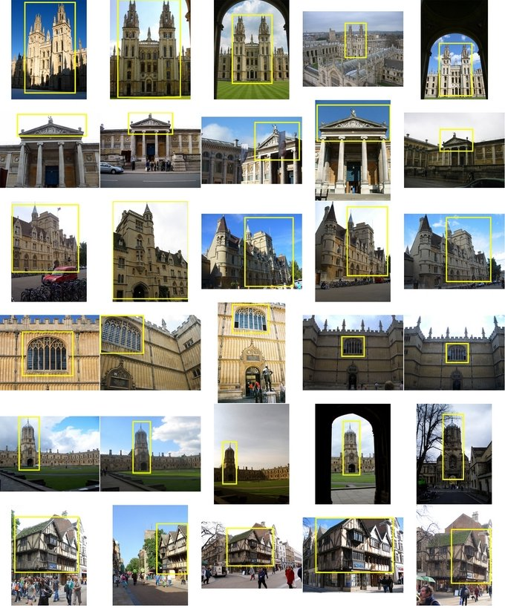
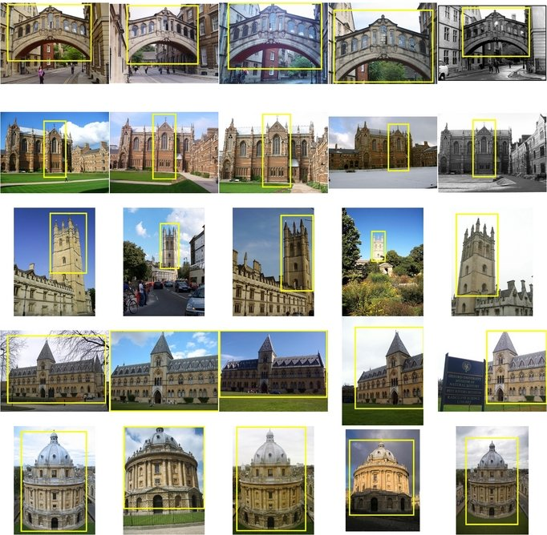
Results:
Geometric Min-hash clustering
[Chum, Perdoch, Matas, CVPR 2009]
All Soul's
Hertford
Ashmolean
Keble
Balliol
Magdalen
Bodleian
Pitt Rivers
Christ Church
Radcliffe Camera
Cornmarket
100 000 Images downloaded from FLICKR
Includes 11 Oxford Landmarks with manually labeled ground truth
Slide credit: Ondrej Chum

Slide 17
Results:
Geometric Min-hash clustering
[Chum, Perdoch, Matas, CVPR 2009]
Discovering small objects
Slide credit: Ondrej Chum

Slide 18
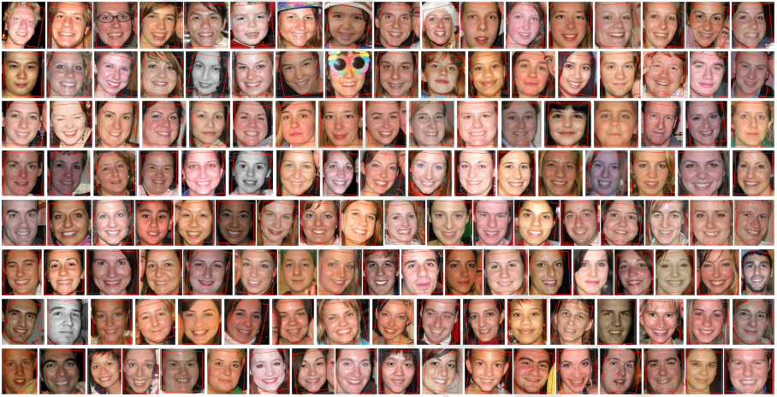
Results:
Geometric Min-hash clustering
[Chum, Perdoch, Matas, CVPR 2009]
Discovering small objects
Slide credit: Ondrej Chum

Slide 19
Mining for common visual patterns
In addition to visual search, want to be able to summarize, mine, and rank the large collection as a whole.
We’ll look briefly at a few recent examples:
Connected component clustering via hashing [Geometric Min-hash, Chum et al. 2009]
Visual Rank to choose “image authorities” [Jing and Baluja, 2008]
Frequent item-set mining with spatial patterns [Quack et al., 2007]

Slide 20
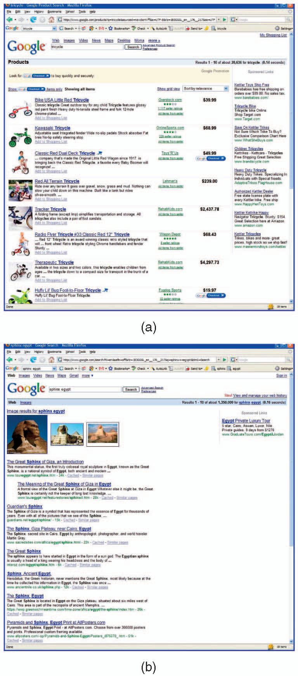
Visual Rank: motivation
Goal: select small set of “best” images to display among millions of candidates
Product search
Mixed-type search
Kristen Grauman

Slide 21
Visual Rank
[Jing and Baluja, PAMI 2008]
Compute relative “authority” of an image based on random walk principle.
  Application of PageRank to visual data
Main ideas:
  Graph weights = number of matched local features between two images
  Exploit text search to narrow scope of each graph
  Use LSH to make similarity computations efficient
Kristen Grauman

Slide 22
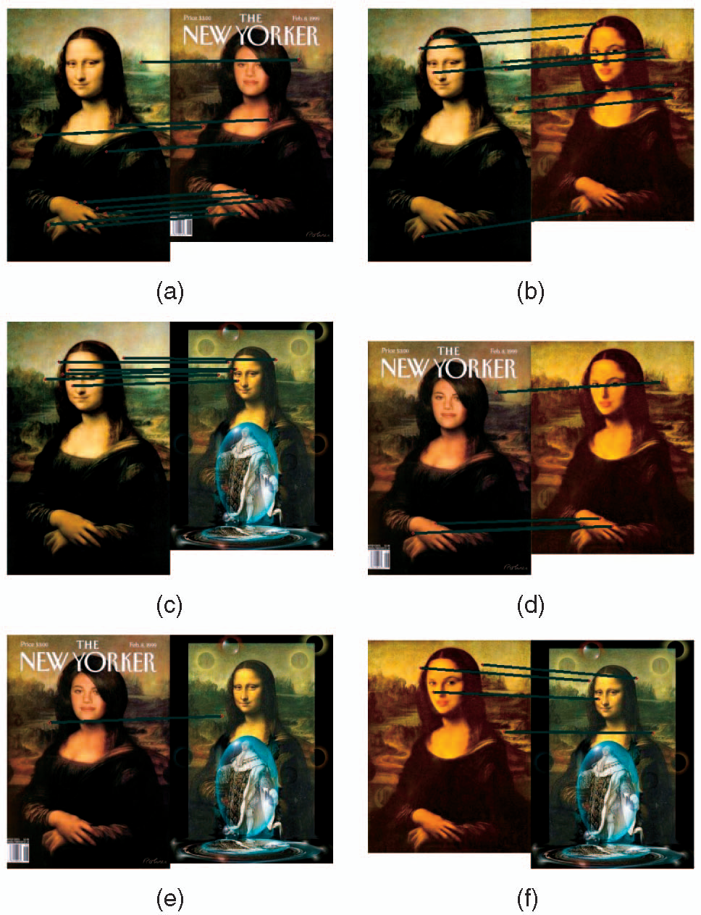
Results: Visual Rank
[Jing and Baluja, PAMI 2008]
Highest visual rank!
Original has more matches to rest
Similarity graph generated from top 1,000 text search results of “Mona-Lisa”
Kristen Grauman

Slide 23
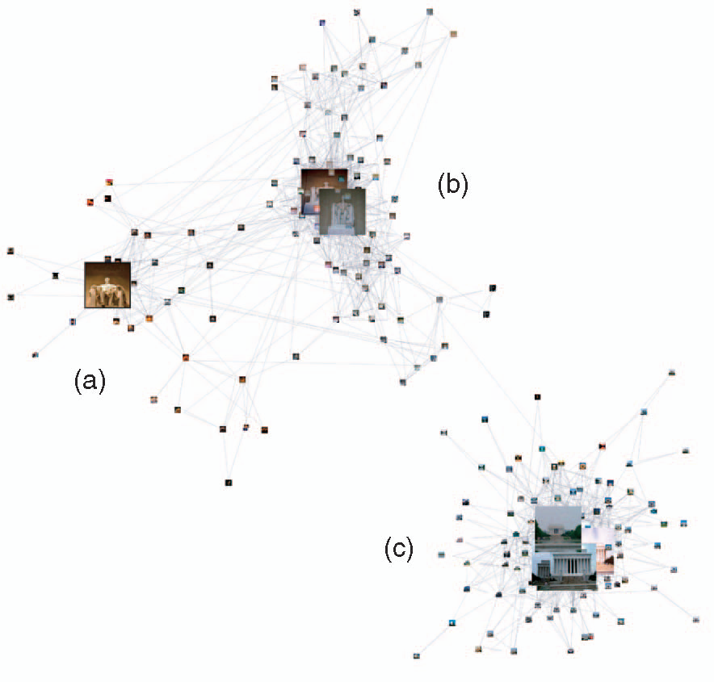
Results: Visual Rank
[Jing and Baluja, PAMI 2008]
Similarity graph generated from top 1,000 text search results of “Lincoln Memorial”.
Note the diversity of the high-ranked images.
Kristen Grauman

Slide 24
Mining for common visual patterns
In addition to visual search, want to be able to summarize, mine, and rank the large collection as a whole.
We’ll look briefly at a few recent examples:
Connected component clustering via hashing [Geometric Min-hash, Chum et al. 2009]
Visual Rank to choose “image authorities” [Jing and Baluja, 2008]
Frequent item-set mining with spatial patterns [Quack et al., 2007]

Slide 25

Frequent item-sets
Kristen Grauman

Slide 26
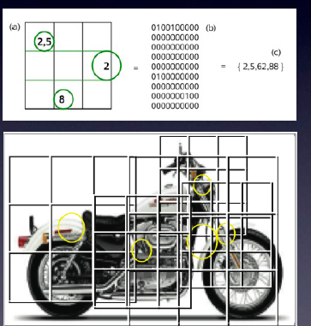
Frequent item-set mining
for spatial visual patterns
[Quack, Ferrari, Leibe, Van Gool, CIVR 2006, ICCV 2007]
What configurations of local features frequently occur in large collection?
Main idea: Identify item-sets (visual word layouts) that often occur in transactions (images)
Efficient algorithms from data mining (e.g., Apriori algorithm, Agrawal 1993)
Kristen Grauman

Slide 27
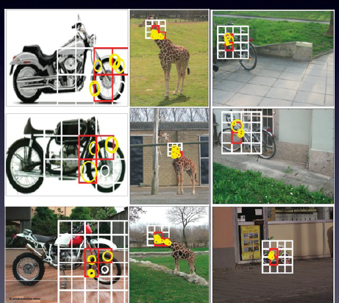
Frequent item-set mining
for spatial visual patterns
[Quack, Ferrari, Leibe, Van Gool, CIVR 2006, ICCV 2007]
Kristen Grauman

Slide 28
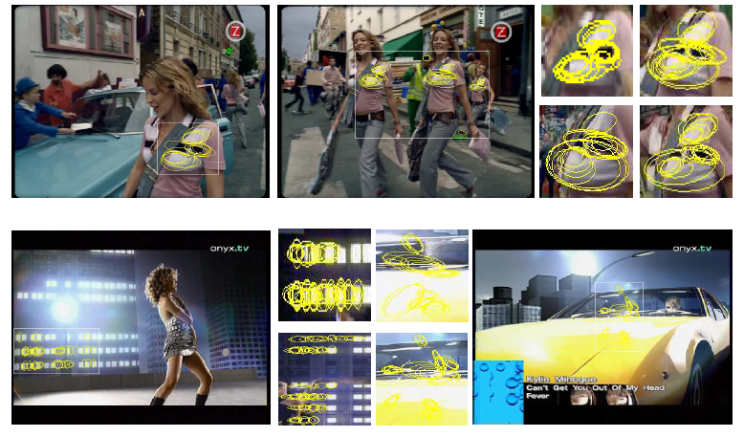
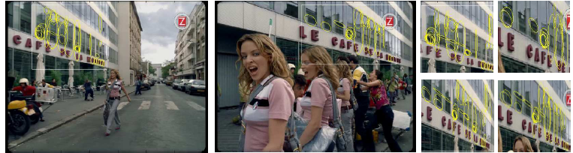
Frequent item-set mining
for spatial visual patterns
[Quack, Ferrari, Leibe, Van Gool, CIVR 2006, ICCV 2007]
Two example itemset clusters
Kristen Grauman

Slide 29
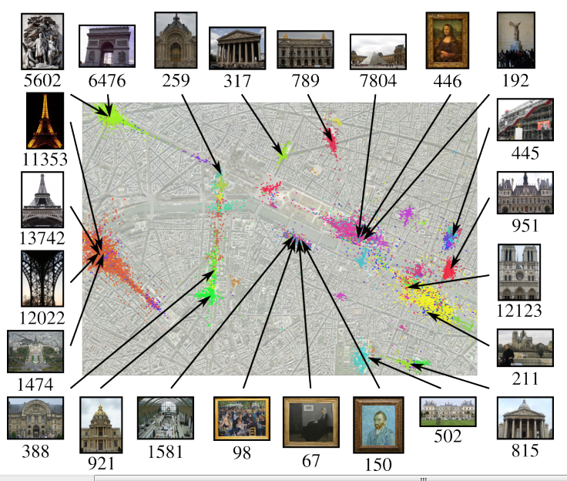
Discovering favorite views
Discovering Favorite Views of Popular Places with Iconoid Shift. T. Weyand and B. Leibe. ICCV 2011.
Kristen Grauman

Slide 30
Today
Discovering visual patterns
  Randomized hashing algorithms
  Mining large-scale image collections
Introduction to visual categorization

Slide 31
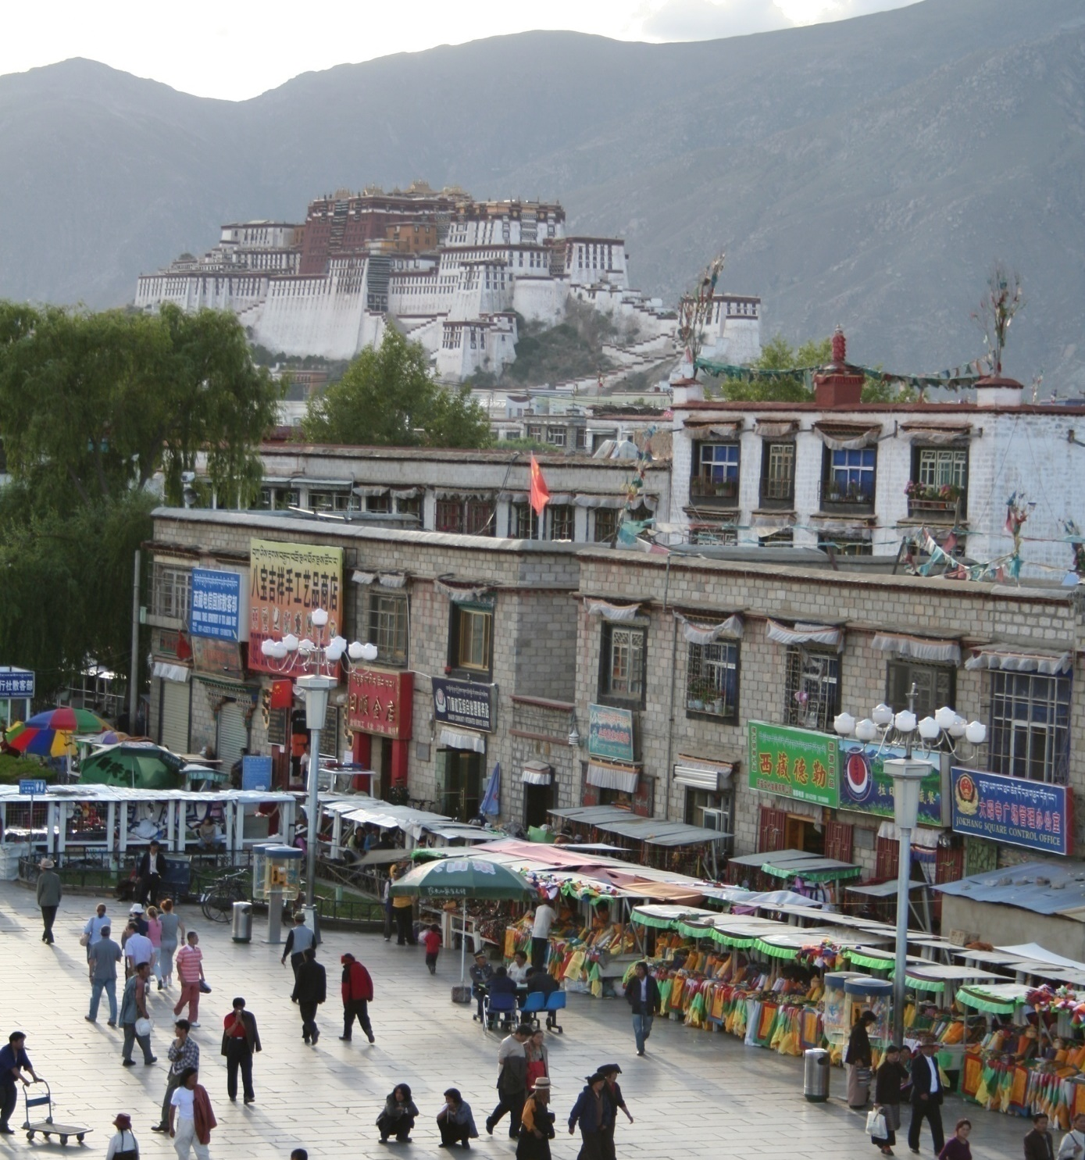
What does recognition involve?
Fei-Fei Li

Slide 32
Detection: are there people?

Slide 33
Activity: What are they doing?

Slide 34
Object categorization
mountain
tree
building
banner
street lamp
vendor
people

Slide 35
Instance recognition
Potala Palace
A particular sign

Slide 36
Scene and context categorization
outdoor
city
…

Slide 37
Attribute recognition
gray
made of fabric
crowded
flat

Slide 38
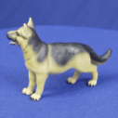
Object Categorization
“Fido”
German
shepherd
dog
animal
living
being
K. Grauman, B. Leibe
Task Description
  “Given a small number of training images of a category, recognize a-priori unknown instances of that category and assign the correct category label.”
Which categories are feasible visually?

Slide 39
Visual Object Categories
Basic Level Categories in human categorization
[Rosch 76, Lakoff 87]
  The highest level at which category members have similar perceived shape
  The highest level at which a single mental image reflects the entire category
  The level at which human subjects are usually fastest at identifying category members
  The first level named and understood by children
  The highest level at which a person uses similar motor actions for interaction with category members
K. Grauman, B. Leibe

Slide 40
Visual Object Categories
…
animal
Abstract
levels
…
…
quadruped
…
Basic level
dog
cat
cow
German
shepherd
Doberman
Individual
level
…
“Fido”
…
K. Grauman, B. Leibe
Basic-level categories in humans seem to be defined predominantly visually.
There is evidence that humans (usually)
start with basic-level categorization
before doing identification.
  ⇒ Basic-level categorization is easier
  and faster for humans than object
  identification!
  How does this transfer to automatic
  classification algorithms?

Slide 41
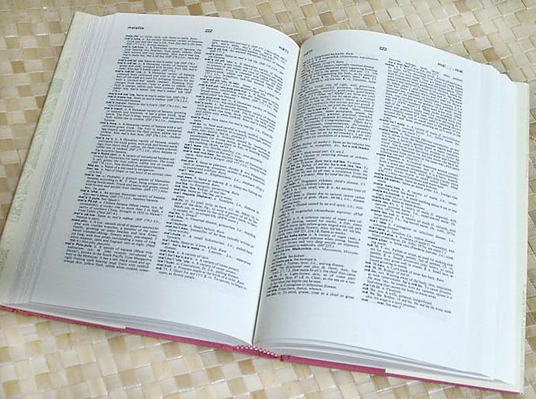

How many object categories are there?
~10,000 to 30,000
Biederman 1987
Source: Fei-Fei Li, Rob Fergus, Antonio Torralba.
Notes:
41

Slide 42
~10,000 to 30,000
Notes:
42

Slide 43
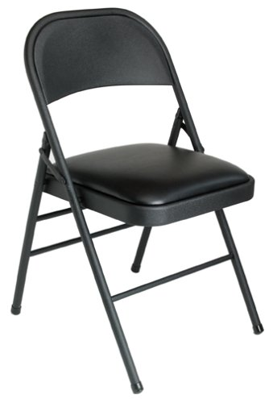
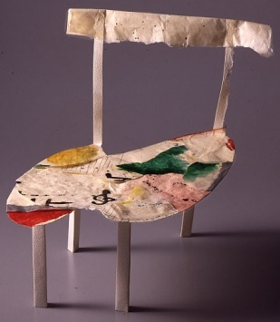
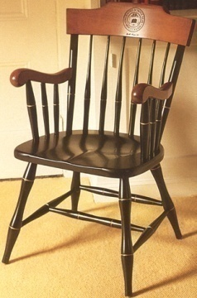
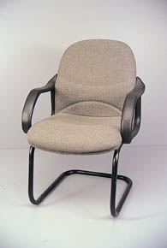
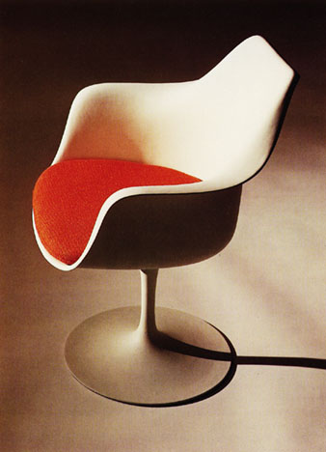
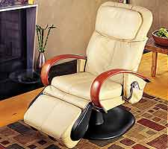
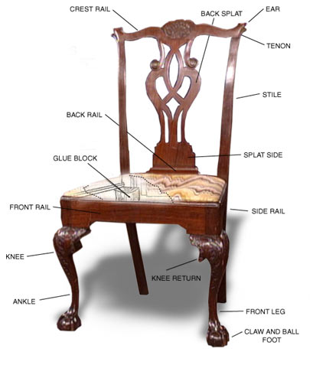
Other Types of Categories
K. Grauman, B. Leibe
Functional Categories
  e.g. chairs = “something you can sit on”

Slide 44
Why recognition?
  Recognition a fundamental part of perception
    e.g., robots, autonomous agents
  Organize and give access to visual content
    Connect to information
    Detect trends and themes
Notes:
44

Slide 45
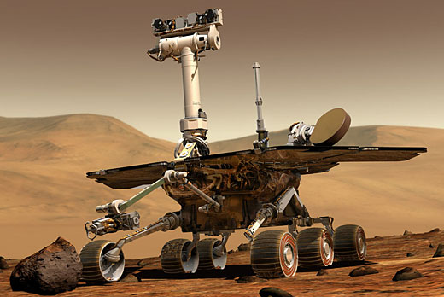
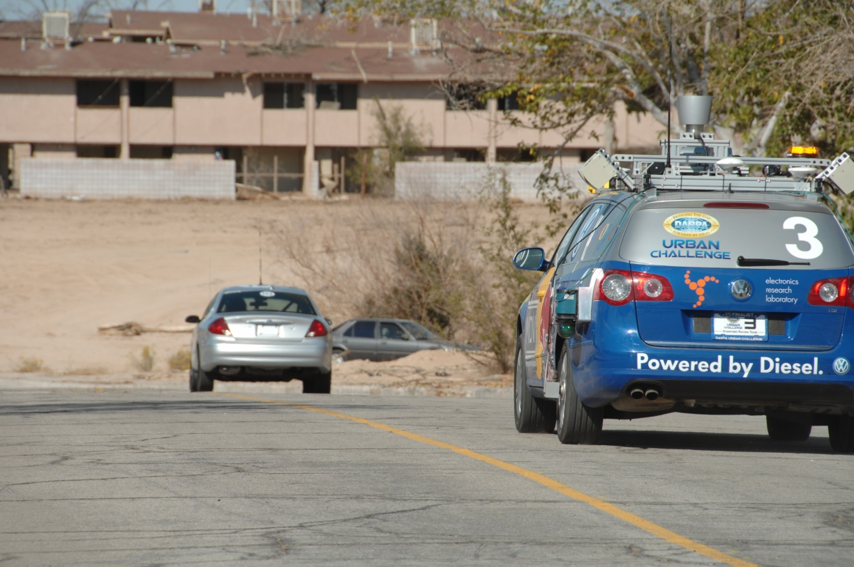
Autonomous agents able to detect objects
Slide credit: Kristen Grauman
http://www.darpa.mil/grandchallenge/gallery.asp

Slide 46
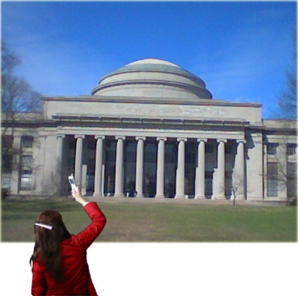
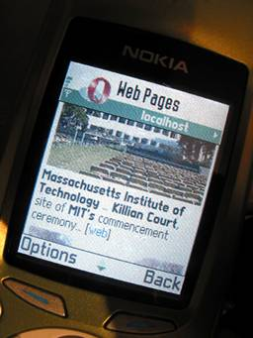
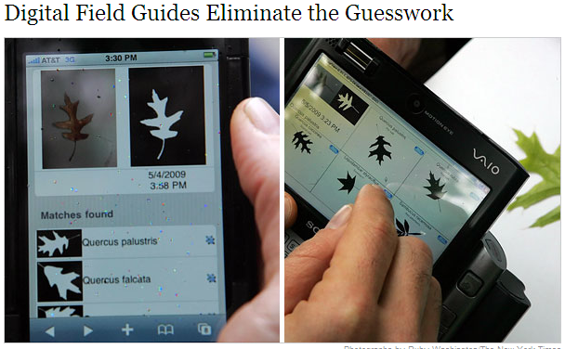

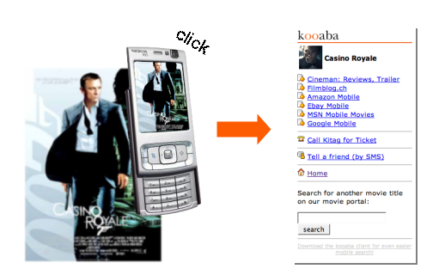
Posing visual queries
Yeh et al., MIT
Belhumeur et al.
Kooaba, Bay & Quack et al.
Slide credit: Kristen Grauman

Slide 47

Finding visually similar objects
Slide credit: Kristen Grauman
Notes:
47

Slide 48
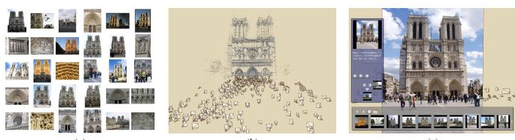
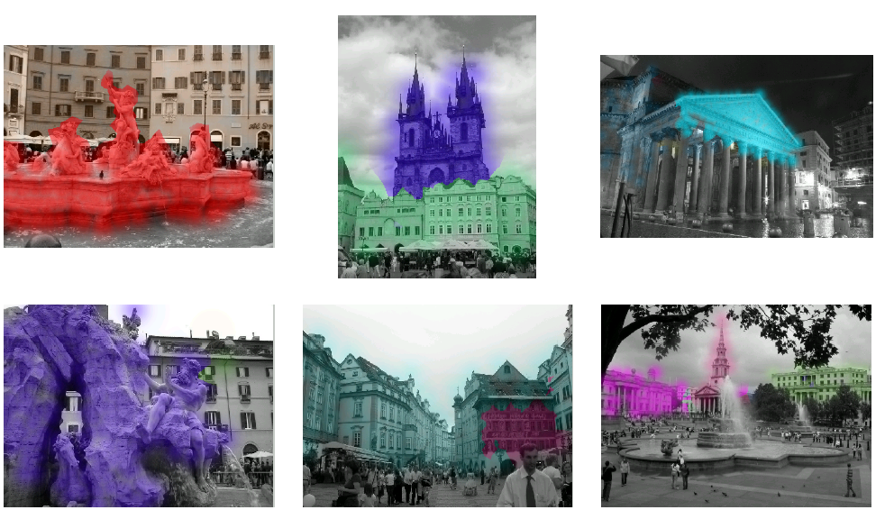
Exploring community photo collections
Snavely et al.
Slide credit: Kristen Grauman
Simon & Seitz
Notes:
48

Slide 49
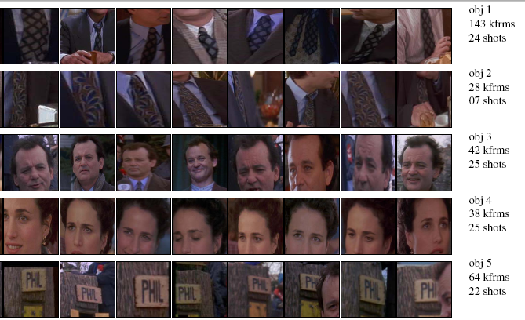
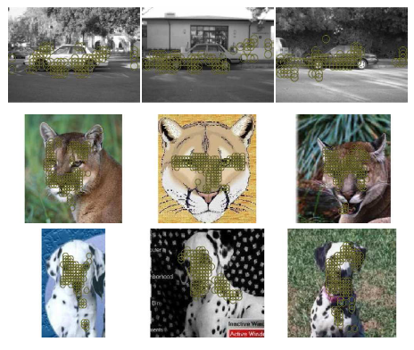
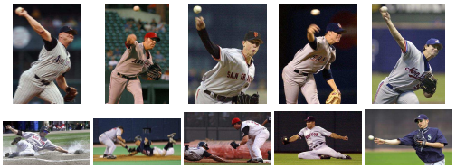
Discovering visual patterns
Objects
Sivic & Zisserman
Lee & Grauman
Categories
Actions
Wang et al.
Slide credit: Kristen Grauman

Slide 50
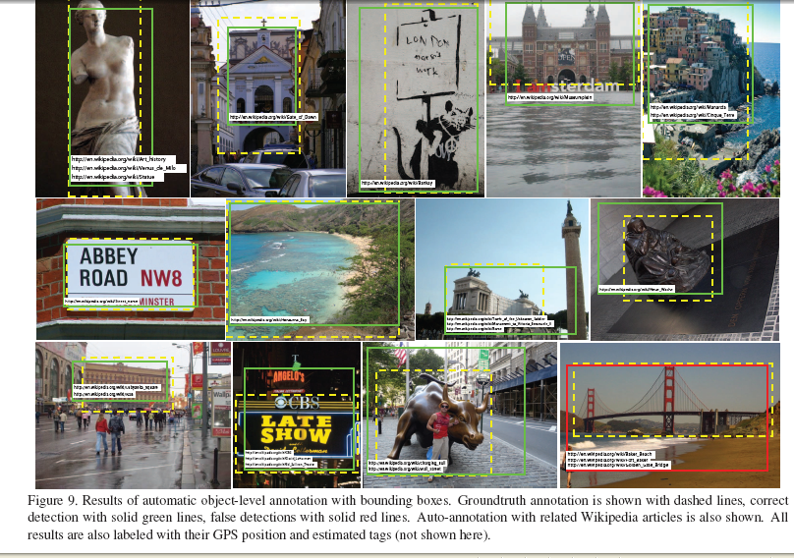

Auto-annotation
Gammeter et al.
T. Berg et al.
Slide credit: Kristen Grauman

Slide 51







Challenges: robustness
Illumination
Object pose
Clutter
Occlusions
Intra-class appearance
Viewpoint
Slide credit: Kristen Grauman

Slide 52


Challenges:
context and human experience
Context cues
Slide credit: Kristen Grauman

Slide 53







Challenges:
context and human experience
Context cues
Function
Dynamics
Slide credit: Kristen Grauman
Video credit: J. Davis

Slide 54
Challenges: complexity
Millions of pixels in an image
30,000 human recognizable object categories
30+ degrees of freedom in the pose of articulated objects (humans)
Billions of images online
82 years to watch all videos uploaded to YouTube per day!
…
About half of the cerebral cortex in primates is devoted to processing visual information [Felleman and van Essen 1991]
Slide credit: Kristen Grauman

Slide 55




























Challenges: learning with minimal supervision
Less
More
Unlabeled, multiple objects
Classes labeled, some clutter
Cropped to object, parts and classes labeled
Slide credit: Kristen Grauman

Slide 56

Slide from Pietro Perona, 2004 Object Recognition workshop

Slide 57

Slide from Pietro Perona, 2004 Object Recognition workshop

Slide 58



What kinds of things work best today?
Reading license plates, zip codes, checks
Frontal face detection
Recognizing flat, textured objects (like books, CD covers, posters)
Fingerprint recognition

Slide 59

What kinds of things work best today?

Slide 60


Progress charted by datasets
Roberts 1963
COIL
1963
…
1996
Slide credit: Kristen Grauman

Slide 61





Progress charted by datasets
MIT-CMU Faces
INRIA Pedestrians
UIUC Cars
1963
…
1996
2000
Slide credit: Kristen Grauman

Slide 62


Progress charted by datasets
MSRC 21 Objects
Caltech-101
Caltech-256
1963
…
1996
2000
2005
Slide credit: Kristen Grauman

Slide 63







Progress charted by datasets
ImageNet
80M Tiny Images
PASCAL VOC
Birds-200
Faces in the Wild
…
1996
2000
2005
2007
2013
1963
2008
Slide credit: Kristen Grauman

Slide 64
Evolution of methods
Hand-crafted models
3D geometry
Hypothesize and align
Hand-crafted features
Learned models
Data-driven
“End-to-end” learning of features and models*,**
* Labeled data availability
** Architecture design decisions, parameters.

Slide 65

Next
Sliding window object detection (Faces!)

Slide 66

Supervised classification
Given a collection of labeled examples, come up with a function that will predict the labels of new examples.
How good is some function we come up with to do the classification?
Depends on
  Mistakes made
  Cost associated with the mistakes
“four”
“nine”
?
Training examples
Novel input

Slide 67
Supervised classification
Given a collection of labeled examples, come up with a function that will predict the labels of new examples.
Consider the two-class (binary) decision problem
  L(4→9): Loss of classifying a 4 as a 9
  L(9→4): Loss of classifying a 9 as a 4
Risk of a classifier s is expected loss:
We want to choose a classifier so as to minimize this total risk

Slide 68
Supervised classification
Optimal classifier will minimize total risk.
At decision boundary, either choice of label yields same expected loss.
Feature value x
If we choose class “four” at boundary, expected loss is:
If we choose class “nine” at boundary, expected loss is:

Slide 69
Supervised classification
Optimal classifier will minimize total risk.
At decision boundary, either choice of label yields same expected loss.
Feature value x
So, best decision boundary is at point x where
To classify a new point, choose class with lowest expected loss; i.e., choose “four” if

Slide 70
Supervised classification
Optimal classifier will minimize total risk.
At decision boundary, either choice of label yields same expected loss.
P(4 | x)
P(9 | x)
Feature value x
So, best decision boundary is at point x where
To classify a new point, choose class with lowest expected loss; i.e., choose “four” if

Slide 71





Probability
Basic probability
  X is a random variable
  P(X) is the probability that X achieves a certain value
  or
  Conditional probability: P(X | Y)
    probability of X given that we already know Y
called a PDF
  probability distribution/density function
continuous X
discrete X
Source: Steve Seitz

Slide 72

Example: learning skin colors
We can represent a class-conditional density using a histogram (a “non-parametric” distribution)
Percentage of skin pixels in each bin
P(x|skin)
Feature x = Hue
P(x|not skin)
Feature x = Hue

Slide 73

Example: learning skin colors
We can represent a class-conditional density using a histogram (a “non-parametric” distribution)
P(x|skin)
Feature x = Hue
Now we get a new image, and want to label each pixel as skin or non-skin.
What’s the probability we care about to do skin detection?
P(x|not skin)
Feature x = Hue

Slide 74
Bayes rule
posterior
likelihood
prior
Where does the prior come from?
Why use a prior?

Slide 75


Example: classifying skin pixels
Now for every pixel in a new image, we can estimate probability that it is generated by skin.
Brighter pixels → higher probability of being skin
Classify pixels based on these probabilities

Slide 76

Example: classifying skin pixels
Gary Bradski, 1998

Slide 77


Example: classifying skin pixels
Using skin color-based face detection and pose estimation as a video-based interface
Gary Bradski, 1998

Slide 78
Supervised classification
Want to minimize the expected misclassification
Two general strategies
  Use the training data to build representative probability model; separately model class-conditional densities and priors (generative)
  Directly construct a good decision boundary, model the posterior (discriminative)

Slide 79

General classification
This same procedure applies in more general circumstances
  More than two classes
  More than one dimension
Example: face detection
  Here, X is an image region
    dimension = # pixels
    each face can be thought
    of as a point in a high
    dimensional space
H. Schneiderman, T. Kanade. "A Statistical Method for 3D Object Detection Applied to Faces and Cars". IEEE Conference on Computer Vision and Pattern Recognition (CVPR 2000)
http://www-2.cs.cmu.edu/afs/cs.cmu.edu/user/hws/www/CVPR00.pdf
H. Schneiderman and T.Kanade
Source: Steve Seitz

Slide 80
Next
Sliding window object detection (Faces!)

