Slide 1
SVM wrap-up
and
Neural Networks
Tues April 25
Kristen Grauman
UT Austin

Slide 2
Last time
Supervised classification continued
  Nearest neighbors (wrap up)
  Support vector machines
    HoG pedestrians example
    Understanding classifier mistakes with iHoG
    Kernels
    Multi-class from binary classifiers

Slide 3
Today
Support vector machines (wrap-up)
  Pyramid match kernels
Evaluation
  Scoring an object detector
  Scoring a multi-class recognition system
Intro to (deep) neural networks

Slide 4
Recall: Linear classifiers

Slide 5
Recall: Linear classifiers
Find linear function to separate positive and negative examples
Which line
is best?

Slide 6
Recall: Support Vector Machines (SVMs)
Discriminative classifier based on optimal separating line (for 2d case)
Maximize the margin between the positive and negative training examples

Slide 7
Recall: Form of SVM solution
Solution:
b = y_{i} – w·x_{i} (for any support vector)
Classification function:
If f(x) < 0, classify as negative,
if f(x) > 0, classify as positive
C. Burges, A Tutorial on Support Vector Machines for Pattern Recognition, Data Mining and Knowledge Discovery, 1998

Slide 8
Nonlinear SVMs
The kernel trick: instead of explicitly computing the lifting transformation φ(x), define a kernel function K such that
K(x_{i} , x_{jj}) = φ(x_{i} ) · φ(x_{j})
This gives a nonlinear decision boundary in the original feature space:

Slide 9
SVMs: Pros and cons
Pros
  Kernel-based framework is very powerful, flexible
  Often a sparse set of support vectors – compact at test time
  Work very well in practice, even with small training sample sizes
Cons
  No “direct” multi-class SVM, must combine two-class SVMs
  Can be tricky to select best kernel function for a problem
  Computation, memory
    During training time, must compute matrix of kernel values for every pair of examples
    Learning can take a very long time for large-scale problems
Adapted from Lana Lazebnik

Slide 10
Review questions
What are tradeoffs between the one vs. one and one vs. all paradigms for multi-class classification?
What roles do kernels play within support vector machines?
What can we expect the training images associated with support vectors to look like?
What is hard negative mining?

Slide 11
Scoring a sliding window detector
If prediction and ground truth are bounding boxes, when do we have a correct detection?
Kristen Grauman

Slide 12
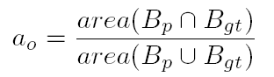
Scoring a sliding window detector
We’ll say the detection is correct (a “true positive”) if the intersection of the bounding boxes, divided by their union, is > 50%.
Kristen Grauman

Slide 13
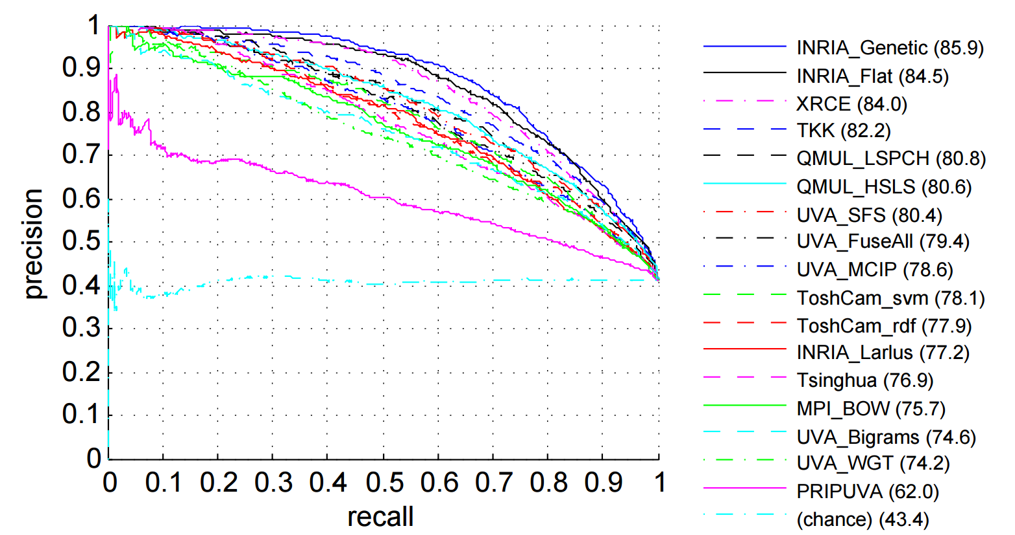
Scoring an object detector
If the detector can produce a confidence score on the detections, then we can plot its precision vs. recall as a threshold on the confidence is varied.
Average Precision (AP): mean precision across recall levels.

Slide 14
Recalll: Examples of kernel functions
Linear:
Gaussian RBF:
Histogram intersection:
Kernels go beyond vector space data
Kernels also exist for “structured” input spaces like sets, graphs, trees…

Slide 15
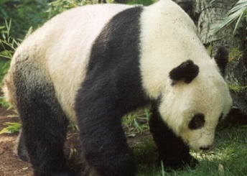
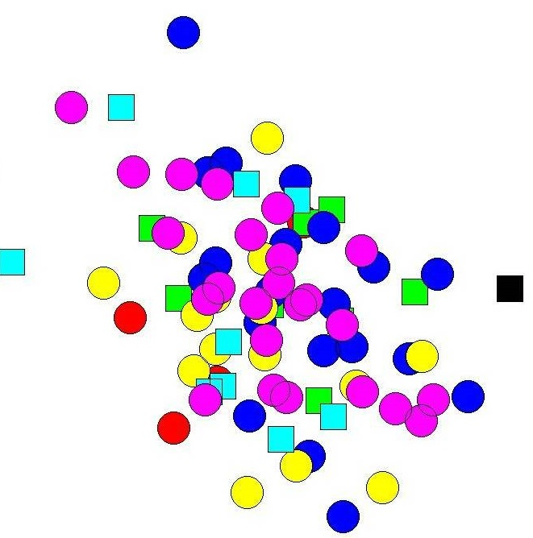
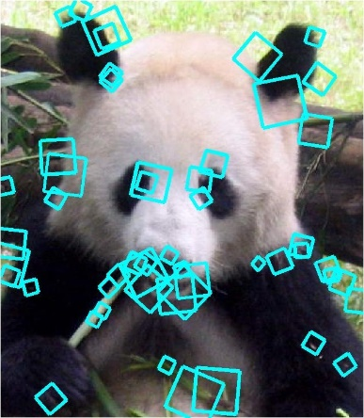
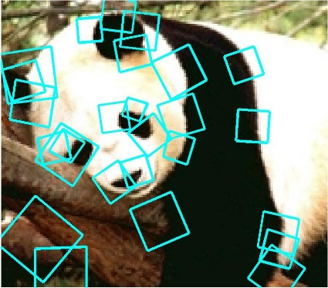

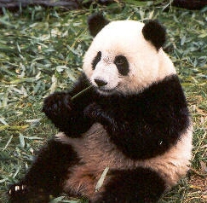
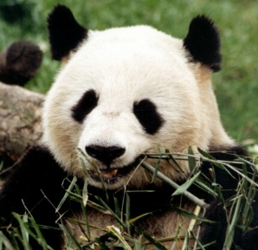
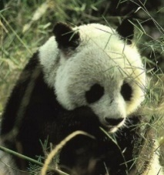







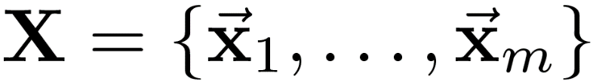
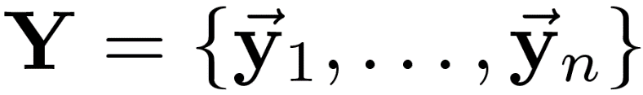
Discriminative classification with sets of features?
Each instance is unordered set of vectors
Varying number of vectors per instance
Slide credit: Kristen Grauman

Slide 16

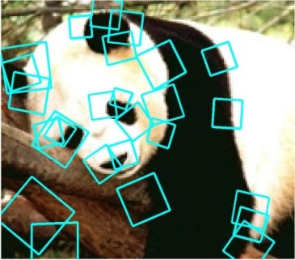


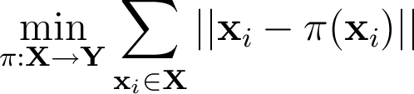
Partially matching sets of features
Optimal match: O(m³)
Greedy match: O(m² log m)
Pyramid match: O(m)
(m=num pts)
We introduce an approximate matching kernel that makes it practical to compare large sets of features based on their partial correspondences.
  [Previous work: Indyk & Thaper, Bartal, Charikar, Agarwal & Varadarajan, …]
Slide credit: Kristen Grauman

Slide 17
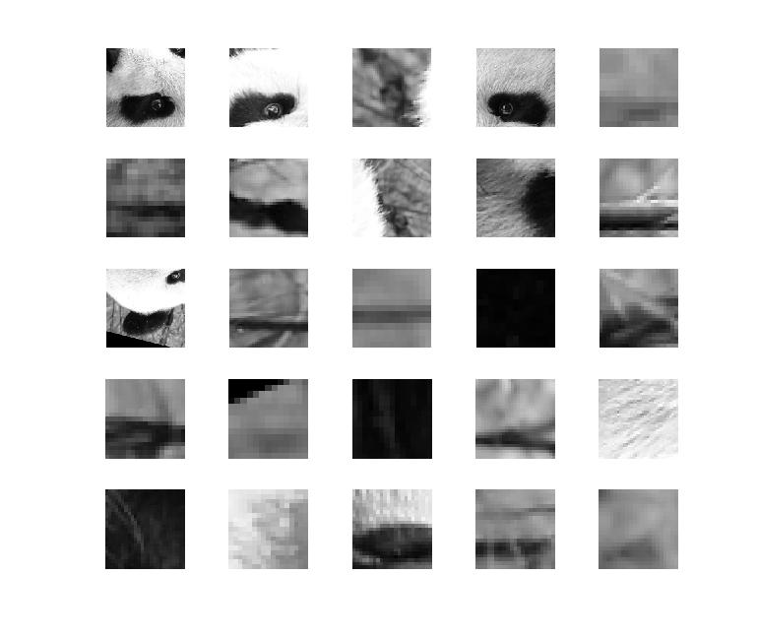
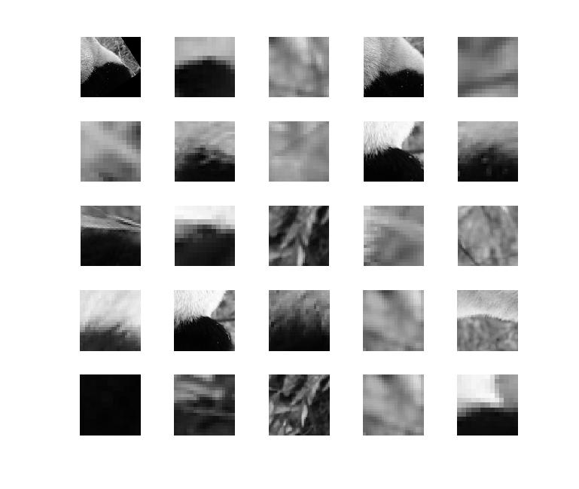
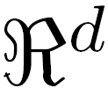
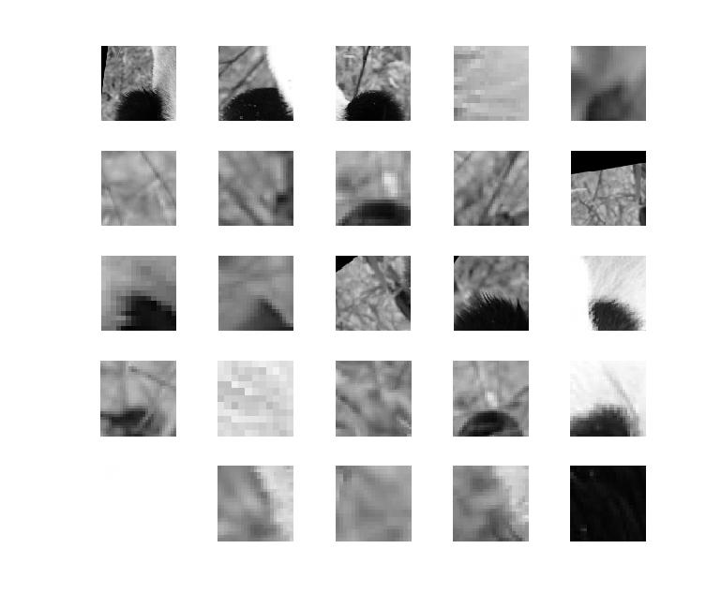
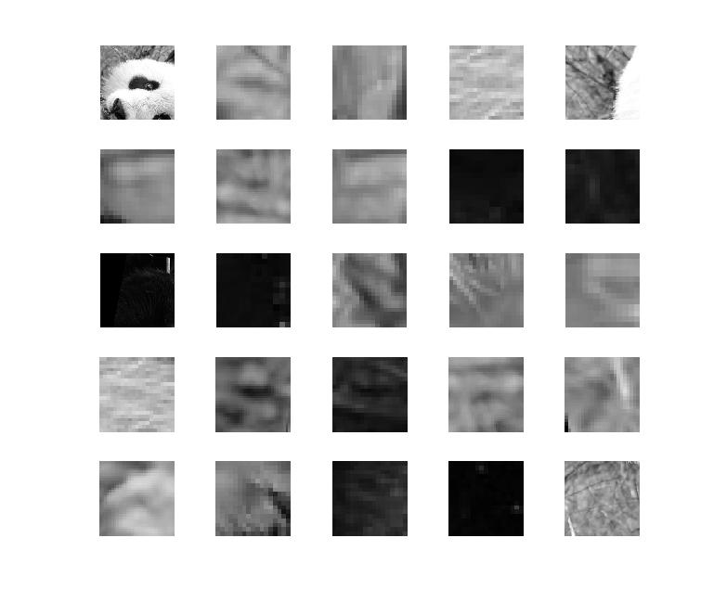
Pyramid match: main idea
Feature space partitions serve to “match” the local descriptors within successively wider regions.
descriptor space
Slide credit: Kristen Grauman

Slide 18


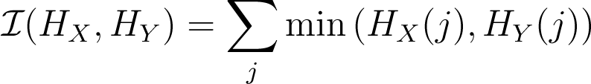

Pyramid match: main idea
Histogram intersection counts number of possible matches at a given partitioning.
Slide credit: Kristen Grauman

Slide 19
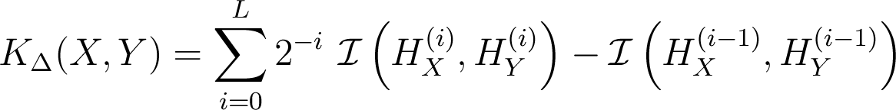
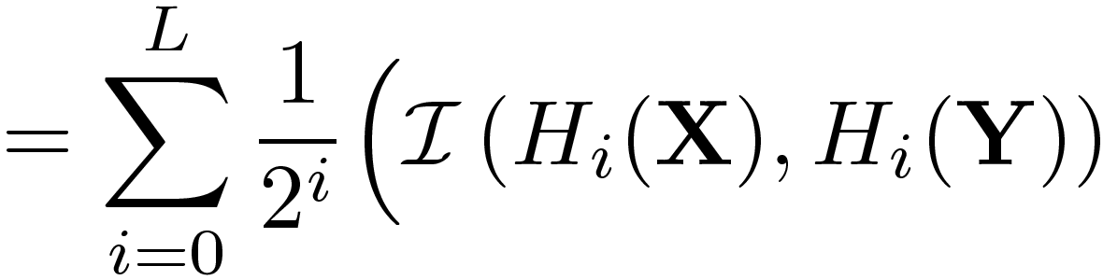
Pyramid match
measures difficulty of a match at level
number of newly matched pairs at level
For similarity, weights inversely proportional to bin size (or may be learned)
Normalize these kernel values to avoid favoring large sets
[Grauman & Darrell, ICCV 2005]
Slide credit: Kristen Grauman

Slide 20
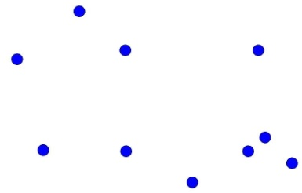
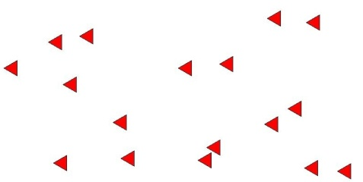





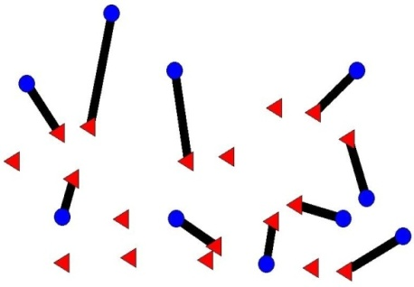

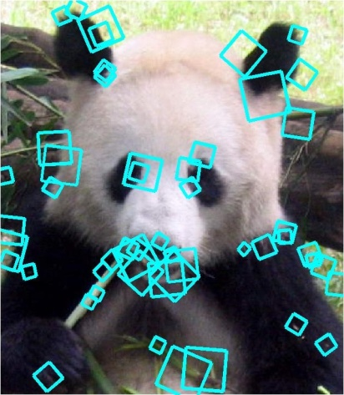



Pyramid match
Optimal match: O(m³)
Pyramid match: O(mL)
optimal partial matching
The Pyramid Match Kernel: Efficient Learning with Sets of Features. K. Grauman and T. Darrell. Journal of Machine Learning Research (JMLR), 8 (Apr): 725--760, 2007.

Slide 21

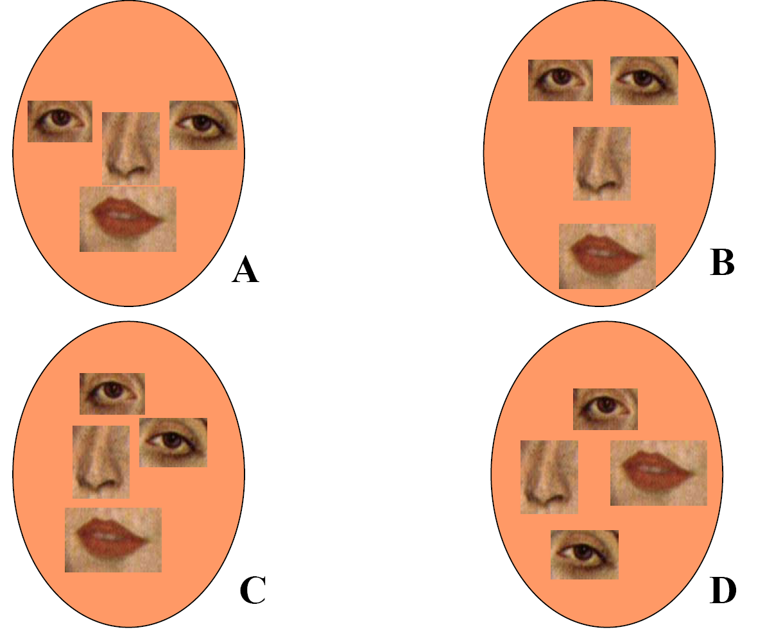
BoW Issue:
No spatial layout preserved!
Too much?
Too little?
Slide credit: Kristen Grauman

Slide 22
Spatial pyramid match
Make a pyramid of bag-of-words histograms.
Provides some loose (global) spatial layout information
[Lazebnik, Schmid & Ponce, CVPR 2006]

Slide 23
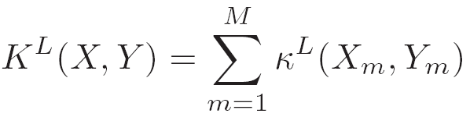
Spatial pyramid match
Make a pyramid of bag-of-words histograms.
Provides some loose (global) spatial layout information
Sum over PMKs computed in image coordinate space, one per word.
[Lazebnik, Schmid & Ponce, CVPR 2006]

Slide 24
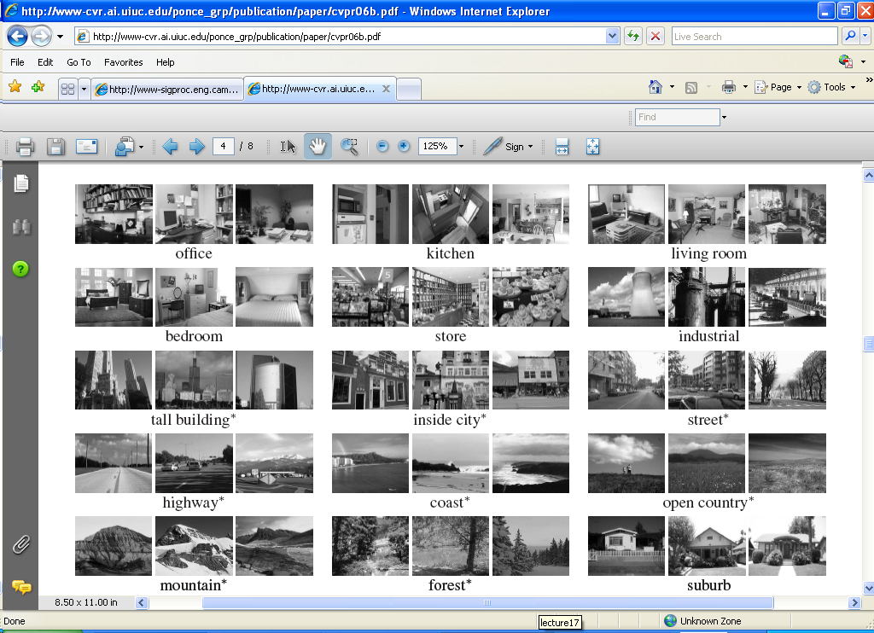
Spatial pyramid match
Can capture scene categories well---texture-like patterns but with some variability in the positions of all the local pieces.

Slide 25
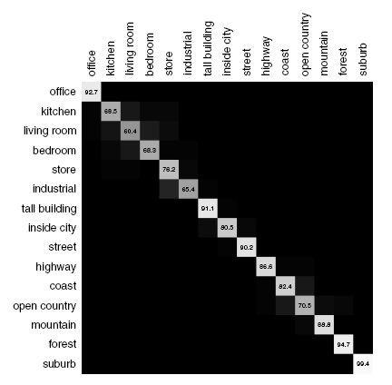
Spatial pyramid match
Can capture scene categories well---texture-like patterns but with some variability in the positions of all the local pieces.
Sensitive to global shifts of the view
Confusion table

Slide 26
Summary: Past week
Object recognition as classification task
  Boosting (face detection ex)
  Support vector machines and HOG (person detection ex)
    Pyramid match kernels
    Hoggles visualization for understanding classifier mistakes
  Nearest neighbors and global descriptors (scene rec ex)
  Sliding window search paradigm
    Pros and cons
    Speed up with attentional cascade
Evaluation
  Detectors: Intersection over union, precision recall
  Classifiers: Confusion matrix

Slide 27
Today
Support vector machines (wrap-up)
  Pyramid match kernels
Evaluation
  Scoring an object detector
  Scoring a multi-class recognition system
Intro to (deep) neural networks

Slide 28




Traditional Image Categorization: Training phase
Training Images
Training
Training Labels
Image Features
Classifier Training
Trained Classifier
Slide credit: Jia-Bin Huang

Slide 29

Traditional Image Categorization: Testing phase
Training Images
Training
Training Labels
Image Features
Classifier Training
Trained Classifier
Testing
Image Features
Trained Classifier
Prediction
Outdoor
Test Image
Slide credit: Jia-Bin Huang

Slide 30
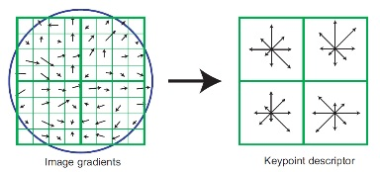
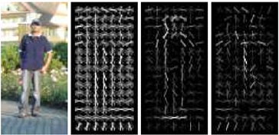
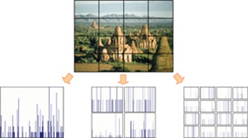
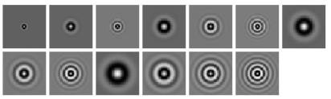
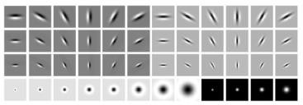
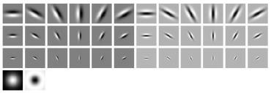
Features have been key
SIFT [Lowe IJCV 04]
HOG [Dalal and Triggs CVPR 05]
SPM [Lazebnik et al. CVPR 06]
Textons
and many others:
SURF, MSER, LBP, Color-SIFT, Color histogram, GLOH, …..

Slide 31
Learning a Hierarchy of Feature Extractors
  Each layer of hierarchy extracts features from output of previous layer
  All the way from pixels → classifier
  Layers have the (nearly) same structure
  Train all layers jointly
  Image/video
  Labels
Image/Video
Pixels
Layer 1
Layer 2
Layer 3
Simple
Classifier
Slide: Rob Fergus

Slide 32
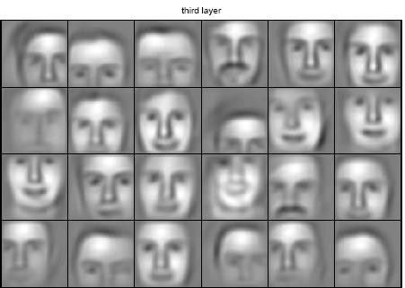
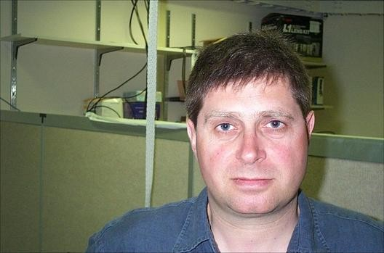
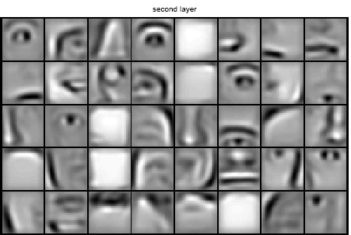
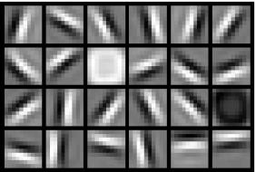
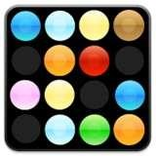
Learning Feature Hierarchy
Goal: Learn useful higher-level features from images
Feature representation
3rd layer “Objects”
Input data
2nd layer “Object parts”
1st layer “Edges”
Lee et al., ICML 2009; CACM 2011
Pixels
Slide: Rob Fergus

Slide 33
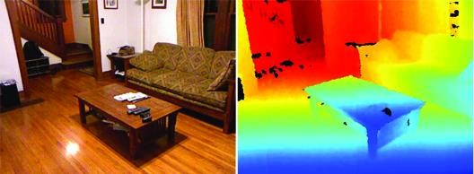
Learning Feature Hierarchy
Better performance
Other domains (unclear how to hand engineer):
  Kinect
  Video
  Multi spectral
Feature computation time
  Dozens of features now regularly used [e.g., MKL]
  Getting prohibitive for large datasets (10’s sec /image)
Slide: R. Fergus

Slide 34
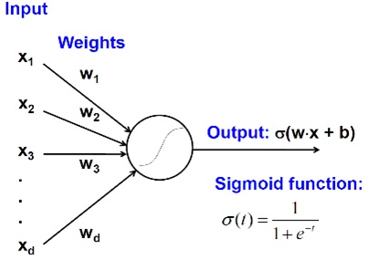
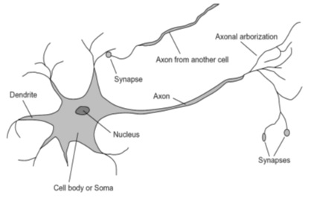
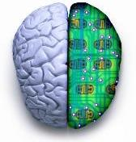
Biological neuron and Perceptrons
A biological neuron
An artificial neuron (Perceptron)
- a linear classifier
Slide credit: Jia-Bin Huang

Slide 35
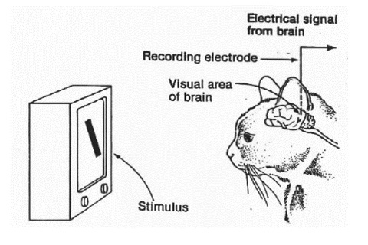
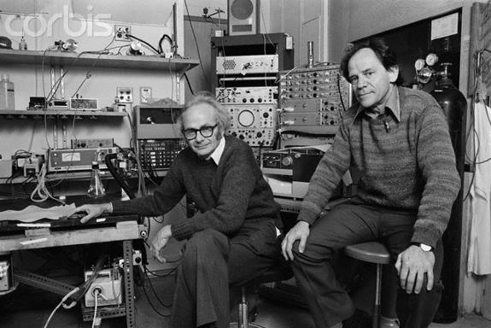
Simple, Complex and Hypercomplex cells
David H. Hubel and Torsten Wiesel
Suggested a hierarchy of feature detectors in the visual cortex, with higher level features responding to patterns of activation in lower level cells, and propagating activation upwards to still higher level cells.
David Hubel's Eye, Brain, and Vision
Slide credit: Jia-Bin Huang

Slide 36
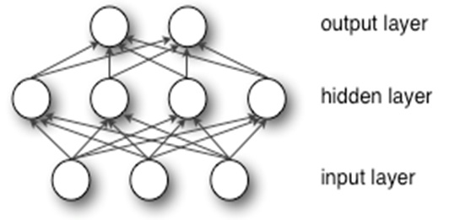
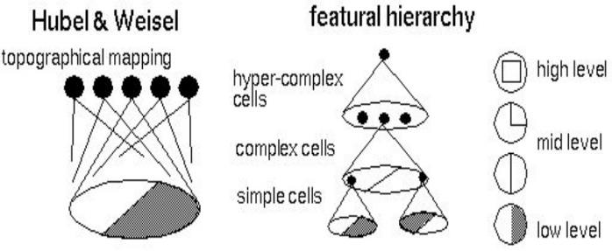
Hubel/Wiesel Architecture and Multi-layer Neural Network
Hubel and Weisel’s architecture
Multi-layer Neural Network
- A non-linear classifier
Slide credit: Jia-Bin Huang

Slide 37
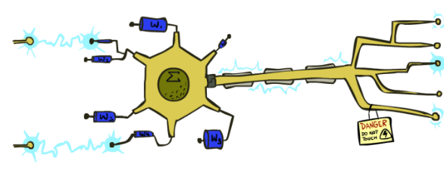
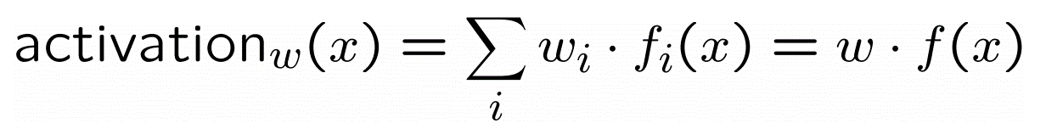

Neuron: Linear Perceptron
Inputs are feature values
Each feature has a weight
Sum is the activation
If the activation is:
  Positive, output +1
  Negative, output -1
Slide credit: Pieter Abeel and Dan Klein

Slide 38


Multi-layer Neural Network
A non-linear classifier
Training: find network weights w to minimize the error between true training labels $y_{i}$and estimated labels $f_{w }\left(x_{i}\right)$
Minimization can be done by gradient descent provided $f$ is differentiable
This training method is called
back-propagation
Slide credit: Jia-Bin Huang

Slide 39

Two-layer perceptron network
Slide credit: Pieter Abeel and Dan Klein

Slide 40

Two-layer perceptron network
Slide credit: Pieter Abeel and Dan Klein

Slide 41


Two-layer perceptron network
Slide credit: Pieter Abeel and Dan Klein

Slide 42



Learning w
Training examples
Objective: a misclassification loss
Procedure:
  Gradient descent / hill climbing
Slide credit: Pieter Abeel and Dan Klein

Slide 43


Hill climbing
Simple, general idea:
  Start wherever
  Repeat: move to the best neighboring state
  If no neighbors better than current, quit
  Neighbors = small perturbations of w
What’s bad?
  Complete?
  Optimal?
Slide credit: Pieter Abeel and Dan Klein

Slide 44

Two-layer perceptron network
Slide credit: Pieter Abeel and Dan Klein

Slide 45

Two-layer perceptron network
Slide credit: Pieter Abeel and Dan Klein

Slide 46

Two-layer neural network
Slide credit: Pieter Abeel and Dan Klein

Slide 47
Neural network properties
Theorem (Universal function approximators): A two-layer network with a sufficient number of neurons can approximate any continuous function to any desired accuracy
Practical considerations:
  Can be seen as learning the features
  Large number of neurons
    Danger for overfitting
  Hill-climbing procedure can get stuck in bad local optima
Approximation by Superpositions of Sigmoidal Function,1989
Slide credit: Pieter Abeel and Dan Klein

Slide 48
Recap
Pyramid match kernels:
  Example of structured input data for kernel-based classifiers (SVM)
Neural networks / multi-layer perceptrons
  View of neural networks as learning hierarchy of features

Slide 49
Coming up
Convolutional neural networks for image classification

