Slide 1


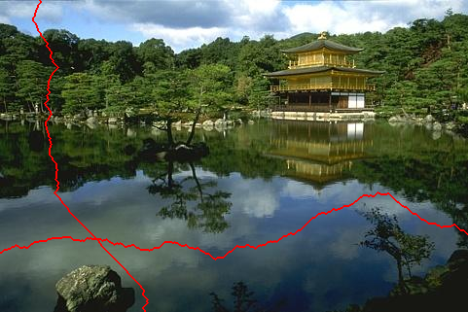
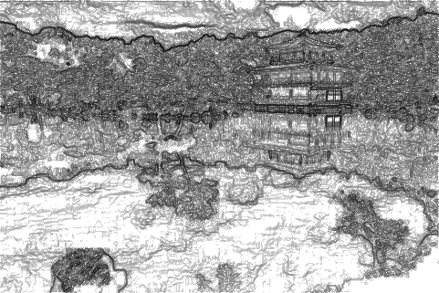
Image gradients and edges
Tues Jan 24, 2017
Kristen Grauman
UT-Austin

Slide 2
Announcements
Slides are posted for lecture the night before
Office hours on homepage
  Tues 11-12 + appointment (me)
  Tues 3-4 and Wed 4-5 (Nick)
  Mon 2:30-3:30 and Thurs 3:30-4:30 (Paul)
Reminder: no laptops, phones, tablets, etc. open in class.
Class is 100% full with registered students. Please reserve chairs for those on the roster.

Slide 3
Last time
Various models for image “noise”
Linear filters and convolution useful for
  Image smoothing, removing noise
    Box filter
    Gaussian filter
    Impact of scale / width of smoothing filter
Separable filters more efficient
Median filter: a non-linear filter, edge-preserving

Slide 4
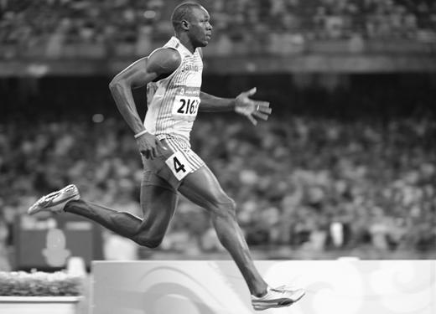
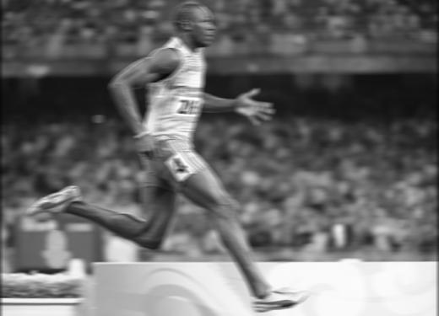
Review
Filter f = 1/9 x [ 1 1 1 1 1 1 1 1 1]
f*g=?
original image h
filtered
Kristen Grauman, UT Austin

Slide 5

Review
Filter f = 1/9 x [ 1 1 1 1 1 1 1 1 1]^{T}
f*g=?
original image h
filtered
Kristen Grauman, UT Austin

Slide 6
Image filtering
Compute a function of the local neighborhood at each pixel in the image
  Function specified by a “filter” or mask saying how to combine values from neighbors.
Uses of filtering:
  Enhance an image (denoise, resize, etc)
  Extract information (texture, edges, etc)
  Detect patterns (template matching)
Today
Adapted from Derek Hoiem

Slide 7

Edge detection
Goal: map image from 2d array of pixels to a set of curves or line segments or contours.
Why?
Main idea: look for strong gradients, post-process
Figure from J. Shotton et al., PAMI 2007
Kristen Grauman, UT Austin

Slide 8
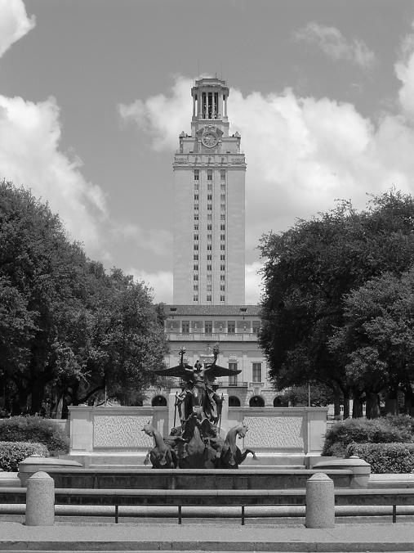
What causes an edge?
Depth discontinuity: object boundary
Reflectance change: appearance information, texture
Cast shadows
Change in surface orientation: shape
Kristen Grauman, UT Austin

Slide 9
Edges/gradients and invariance
Kristen Grauman, UT Austin

Slide 10

Derivatives and edges
An edge is a place of rapid change in the image intensity function.
intensity function
(along horizontal scanline)
image
first derivative
edges correspond to
extrema of derivative
Source: L. Lazebnik

Slide 11
Derivatives with convolution
For 2D function, f(x,y), the partial derivative is:
For discrete data, we can approximate using finite differences:
To implement above as convolution, what would be the associated filter?
Kristen Grauman, UT Austin

Slide 12
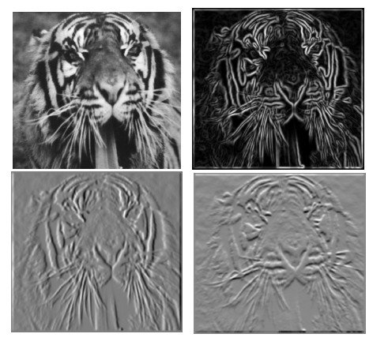
Partial derivatives of an image
?
-1 1
1 -1
-1 1
or
Which shows changes with respect to x?
(showing filters for correlation)

Slide 13





Image gradient
The gradient of an image:
The gradient points in the direction of most rapid change in intensity
The gradient direction (orientation of edge normal) is given by:
The edge strength is given by the gradient magnitude
Slide credit Steve Seitz
Notes:
13

Slide 14




Effects of noise
Consider a single row or column of the image
  Plotting intensity as a function of position gives a signal
Where is the edge?
Slide credit Steve Seitz

Slide 15



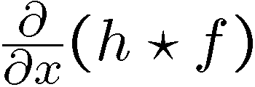

Solution: smooth first
Where is the edge?
Look for peaks in

Slide 16
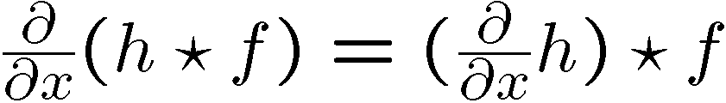
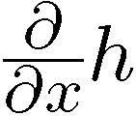
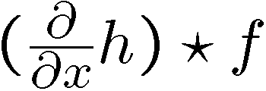

Derivative theorem of convolution
Differentiation property of convolution.
Slide credit Steve Seitz

Slide 17
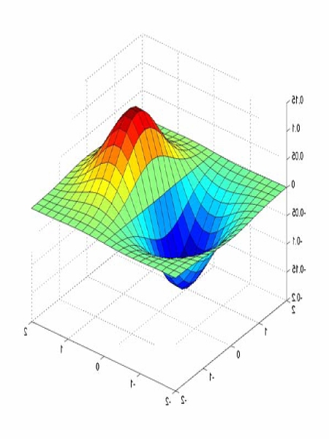
Derivative of Gaussian filters
0.0030 0.0133 0.0219 0.0133 0.0030
0.0133 0.0596 0.0983 0.0596 0.0133
0.0219 0.0983 0.1621 0.0983 0.0219
0.0133 0.0596 0.0983 0.0596 0.0133
0.0030 0.0133 0.0219 0.0133 0.0030

Slide 18


Derivative of Gaussian filters
x-direction
y-direction
Source: L. Lazebnik

Slide 19




Laplacian of Gaussian
Consider
Laplacian of Gaussian
operator
Where is the edge?
Zero-crossings of bottom graph
Slide credit: Steve Seitz

Slide 20








2D edge detection filters
Laplacian of Gaussian
Gaussian
derivative of Gaussian
is the Laplacian operator:
Slide credit: Steve Seitz
Notes:
20

Slide 21






Smoothing with a Gaussian
Recall: parameter σ is the “scale” / “width” / “spread” of the Gaussian kernel, and controls the amount of smoothing.
…
Kristen Grauman, UT Austin

Slide 22
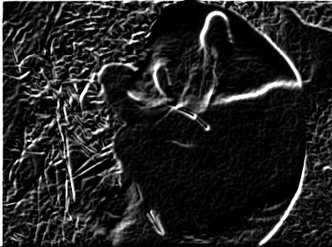
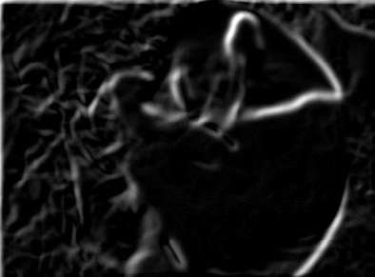
Effect of σ on derivatives
σ = 1 pixel
σ = 3 pixels
The apparent structures differ depending on Gaussian’s scale parameter.
Larger values: larger scale edges detected
Smaller values: finer features detected
Kristen Grauman, UT Austin

Slide 23
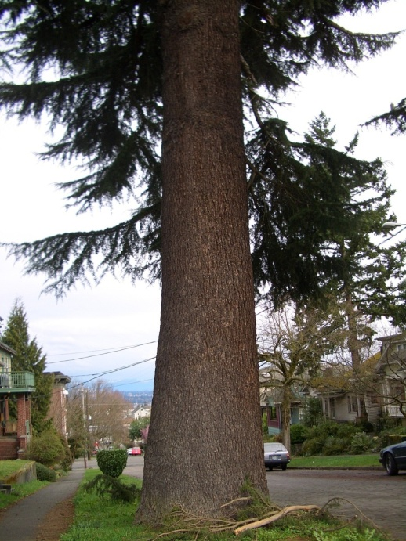
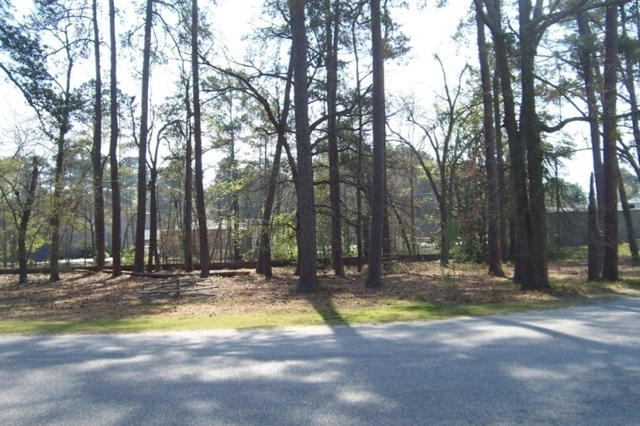
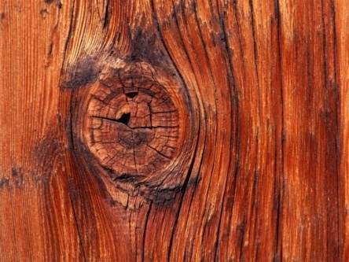
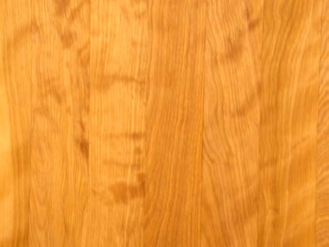
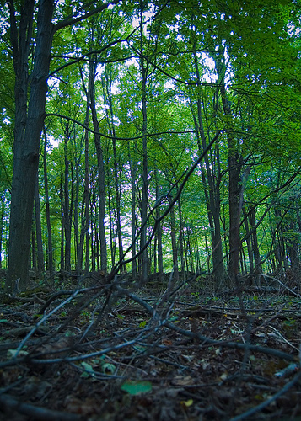
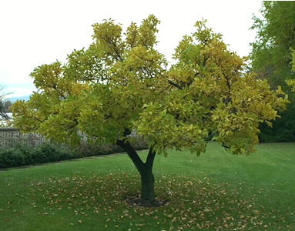
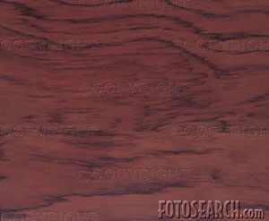
So, what scale to choose?
It depends what we’re looking for.
Kristen Grauman, UT Austin

Slide 24
Mask properties
Smoothing
  Values positive
  Sum to 1 → constant regions same as input
  Amount of smoothing proportional to mask size
  Remove “high-frequency” components; “low-pass” filter
Derivatives
  ___________ signs used to get high response in regions of high contrast
  Sum to ___ → no response in constant regions
  High absolute value at points of high contrast
Kristen Grauman, UT Austin

Slide 25
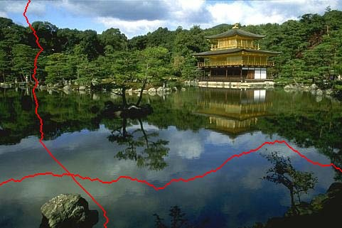
Seam carving: main idea
[Shai & Avidan, SIGGRAPH 2007]

Slide 26
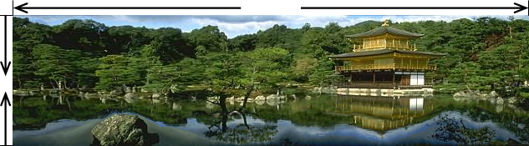
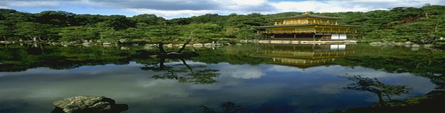
Seam carving: main idea
Content-aware resizing
Traditional resizing
[Shai & Avidan, SIGGRAPH 2007]

Slide 27



























Real image example
Kristen Grauman, UT Austin

Slide 28
Seam carving: main idea
Content-aware resizing
Intuition:
Preserve the most “interesting” content
  → Prefer to remove pixels with low gradient energy
To reduce or increase size in one dimension, remove irregularly shaped “seams”
  → Optimal solution via dynamic programming.
Kristen Grauman, UT Austin

Slide 29
Seam carving: main idea
Want to remove seams where they won’t be very noticeable:
  Measure “energy” as gradient magnitude
Choose seam based on minimum total energy path across image, subject to 8-connectedness.
Kristen Grauman, UT Austin

Slide 30
Seam carving: algorithm
s₁
s₂
s₃
s₄
s₅
Let a vertical seam s consist of h positions that form an 8-connected path.
Let the cost of a seam be:
Optimal seam minimizes this cost:
Compute it efficiently with dynamic programming.

Slide 31
How to identify the minimum cost seam?
First, consider a greedy approach:
Energy matrix
(gradient magnitude)
Kristen Grauman, UT Austin

Slide 32

Seam carving: algorithm
Compute the cumulative minimum energy for all possible connected seams at each entry (i,j):
Then, min value in last row of M indicates end of the minimal connected vertical seam.
Backtrack up from there, selecting min of 3 above in M.
row i-1
j-1
j
j+1
row i
j
Energy matrix
(gradient magnitude)
M matrix:
cumulative min energy
(for vertical seams)
Kristen Grauman, UT Austin

Slide 33
Example
Energy matrix
(gradient magnitude)
M matrix
(for vertical seams)
Kristen Grauman, UT Austin

Slide 34
Example
Energy matrix
(gradient magnitude)
M matrix
(for vertical seams)
Kristen Grauman, UT Austin

Slide 35
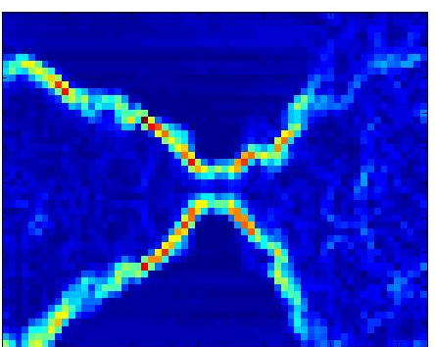

Real image example
Original Image
Energy Map
Blue = low energy
Red = high energy
Kristen Grauman, UT Austin

Slide 36
Real image example
Kristen Grauman, UT Austin

Slide 37
Other notes on seam carving
Analogous procedure for horizontal seams
Can also insert seams to increase size of image in either dimension
  Duplicate optimal seam, averaged with neighbors
Other energy functions may be plugged in
  E.g., color-based, interactive,…
Can use combination of vertical and horizontal seams
Kristen Grauman, UT Austin

Slide 38
Summary
Image gradients
Seam carving – gradients as “energy”
Gradients → edges and contours
Template matching
  Image patch as a filter
  Chamfer matching
    Distance transform

Slide 39
Coming up
A1 out tonight, due in 2 weeks
Thursday: binary image analysis
Friday: A0 due

