Slide 1
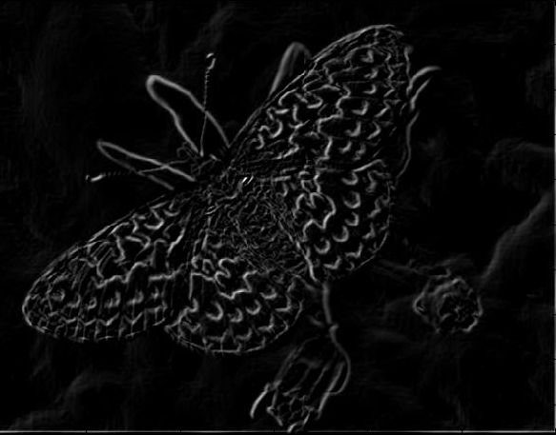
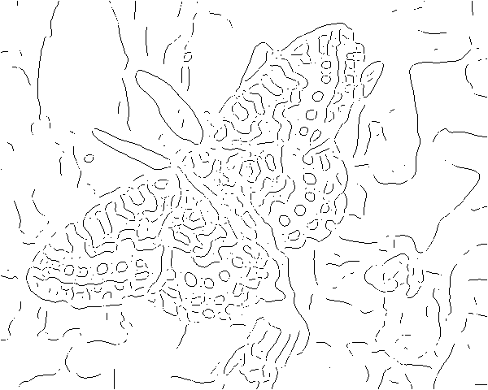
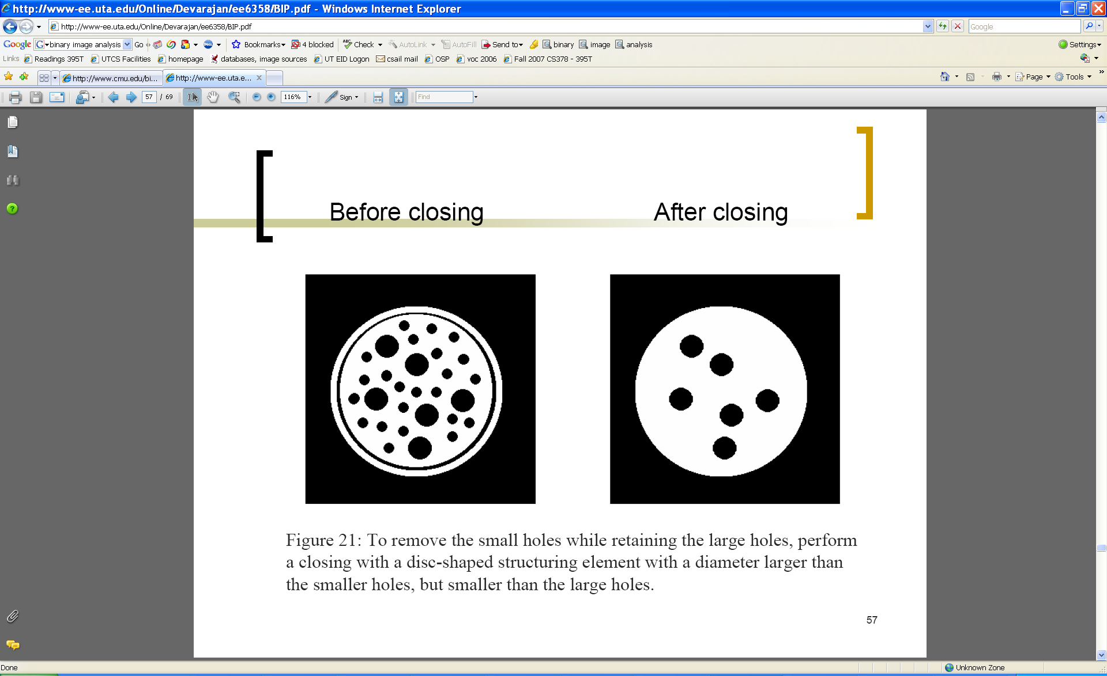
Edges and Binary Image Analysis
Thurs Jan 26
Kristen Grauman
UT Austin

Slide 2
Today
Edge detection and matching
  process the image gradient to find curves/contours
  comparing contours
Binary image analysis
  blobs and regions

Slide 3
Gradients -> edges
Primary edge detection steps:
1. Smoothing: suppress noise
2. Edge enhancement: filter for contrast
3. Edge localization
  Determine which local maxima from filter output are actually edges vs. noise
    Threshold, Thin
Kristen Grauman, UT-Austin

Slide 4
Thresholding
Choose a threshold value t
Set any pixels less than t to zero (off)
Set any pixels greater than or equal to t to one (on)

Slide 5
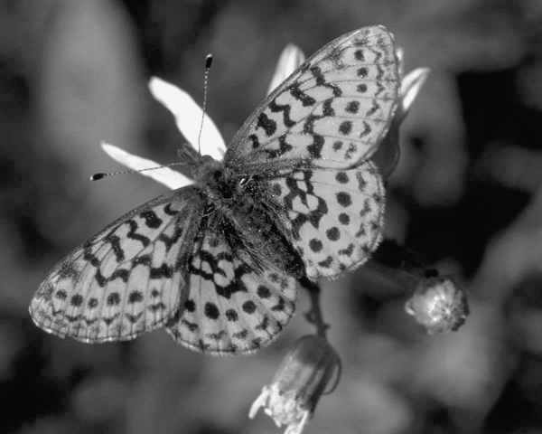
Original image

Slide 6
Gradient magnitude image

Slide 7
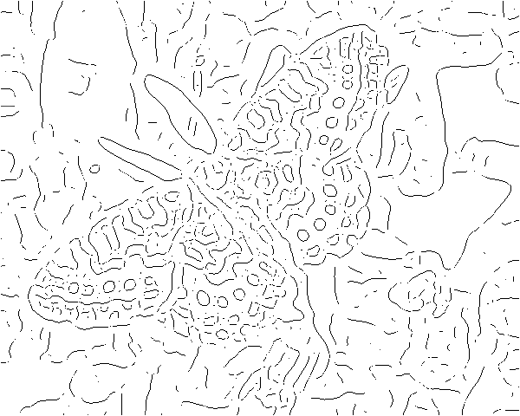
Thresholding gradient with a lower threshold

Slide 8
Thresholding gradient with a higher threshold

Slide 9
Canny edge detector
Filter image with derivative of Gaussian
Find magnitude and orientation of gradient
Non-maximum suppression:
  Thin wide “ridges” down to single pixel width
Linking and thresholding (hysteresis):
  Define two thresholds: low and high
  Use the high threshold to start edge curves and the low threshold to continue them
MATLAB: edge(image, ‘canny’);
>>help edge
Source: D. Lowe, L. Fei-Fei

Slide 10

The Canny edge detector
original image (Lena)
Slide credit: Steve Seitz

Slide 11

The Canny edge detector
norm of the gradient

Slide 12

The Canny edge detector
thresholding

Slide 13

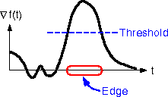
The Canny edge detector
How to turn these thick regions of the gradient into curves?
thresholding

Slide 14

Non-maximum suppression
Check if pixel is local maximum along gradient direction, select single max across width of the edge
  requires checking interpolated pixels p and r

Slide 15

The Canny edge detector
Problem: pixels along this edge didn’t survive the thresholding
thinning
(non-maximum suppression)

Slide 16
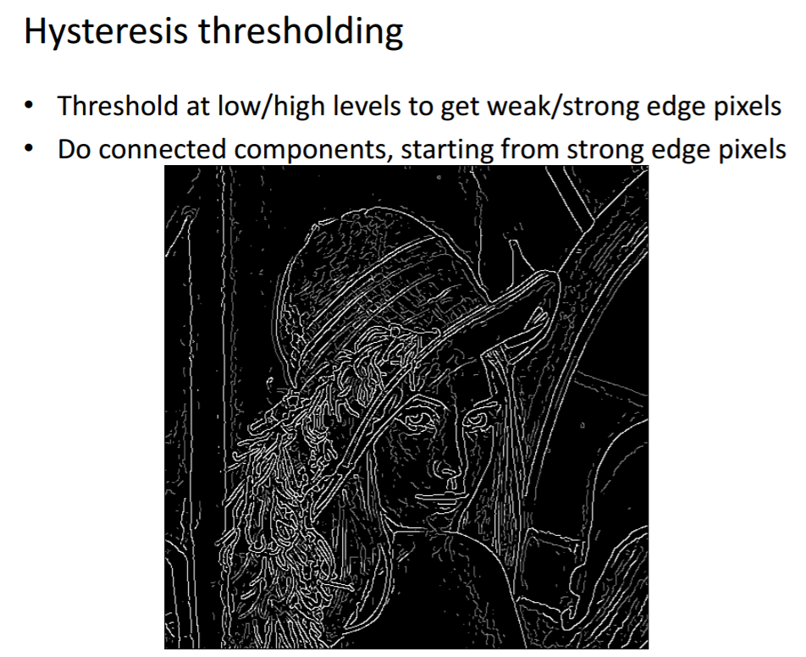
Credit: James Hays

Slide 17
Hysteresis thresholding
Use a high threshold to start edge curves, and a low threshold to continue them.
Source: Steve Seitz

Slide 18
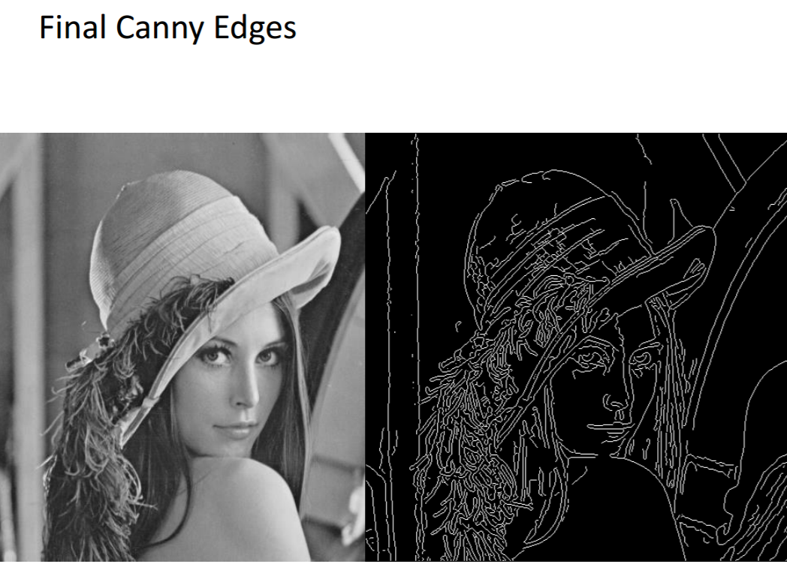
Credit: James Hays

Slide 19
Recap: Canny edge detector
Filter image with derivative of Gaussian
Find magnitude and orientation of gradient
Non-maximum suppression:
  Thin wide “ridges” down to single pixel width
Linking and thresholding (hysteresis):
  Define two thresholds: low and high
  Use the high threshold to start edge curves and the low threshold to continue them
MATLAB: edge(image, ‘canny’);
>>help edge
Source: D. Lowe, L. Fei-Fei

Slide 20
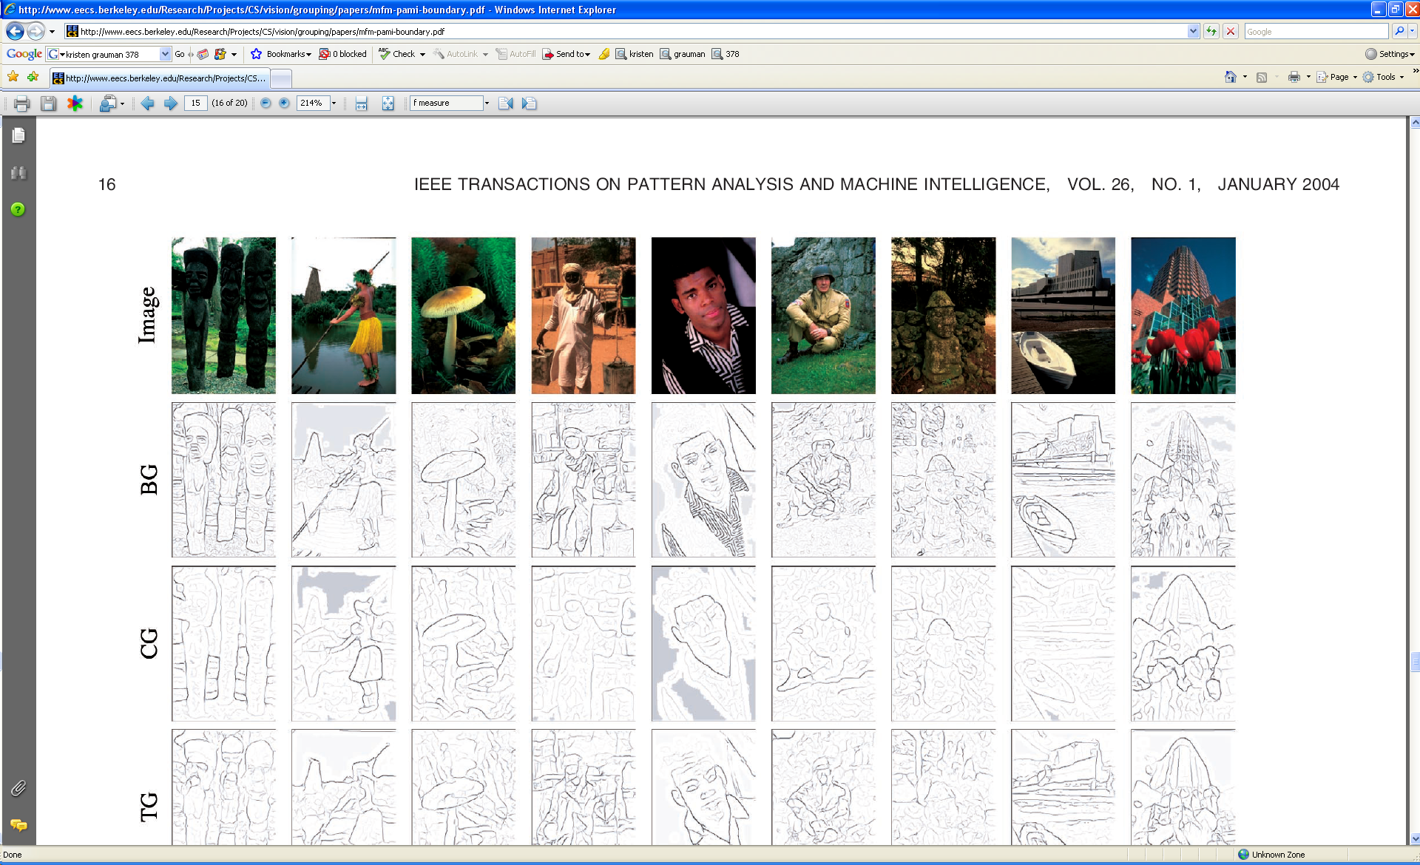
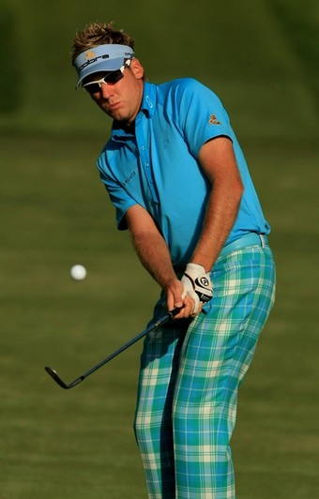
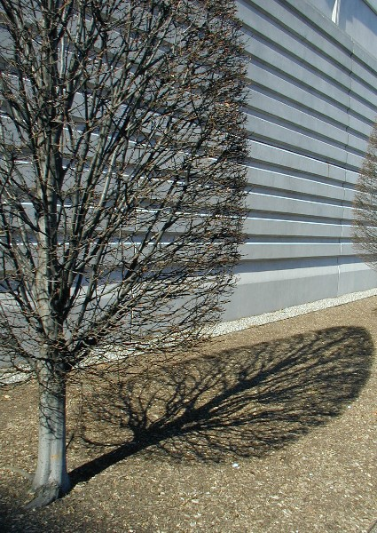

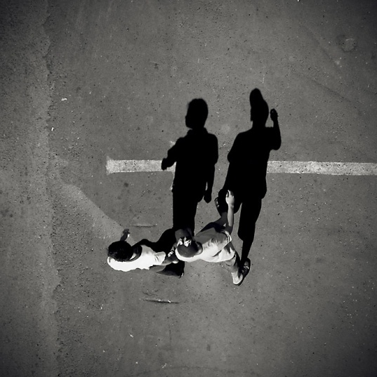
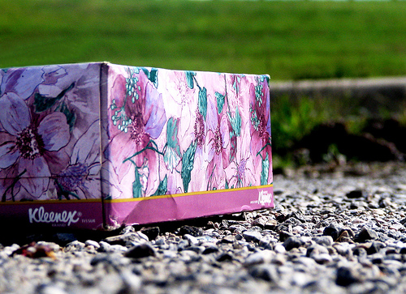
Low-level edges vs. perceived contours
Background
Texture
Shadows

Slide 21



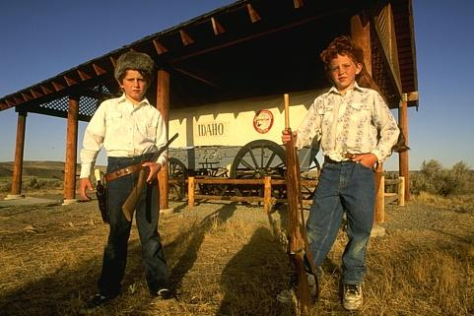


Low-level edges vs. perceived contours
image
human segmentation
gradient magnitude
Berkeley segmentation database:
http://www.eecs.berkeley.edu/Research/Projects/CS/vision/grouping/segbench/
Source: L. Lazebnik

Slide 22
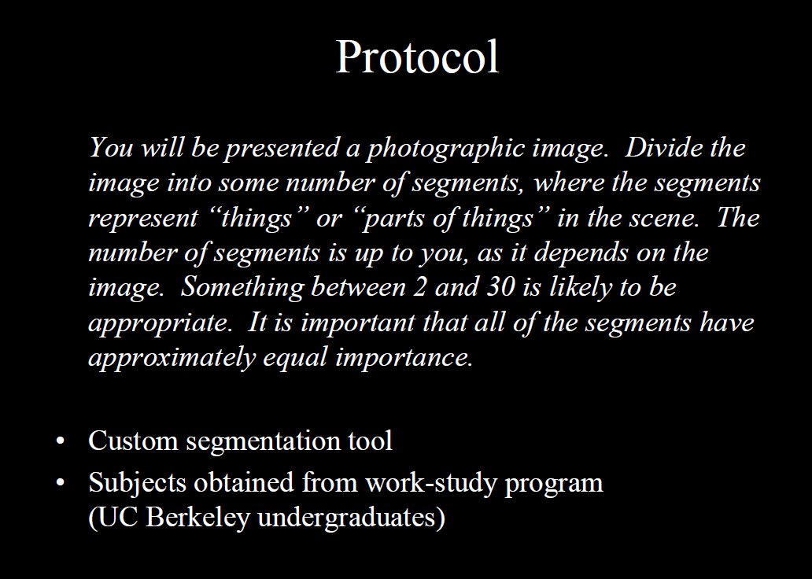
Berkeley Segmentation Data Set
David Martin, Charless Fowlkes, Doron Tal, Jitendra Malik
Credit: David Martin

Slide 23
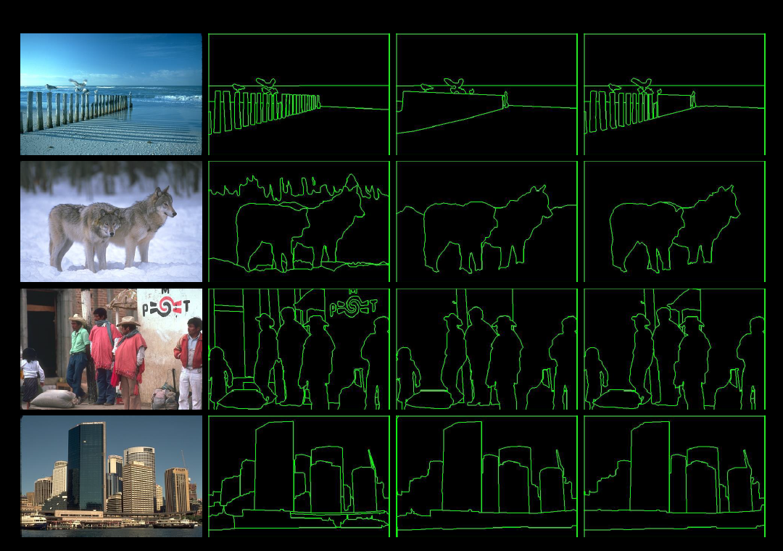
Credit: David Martin

Slide 24
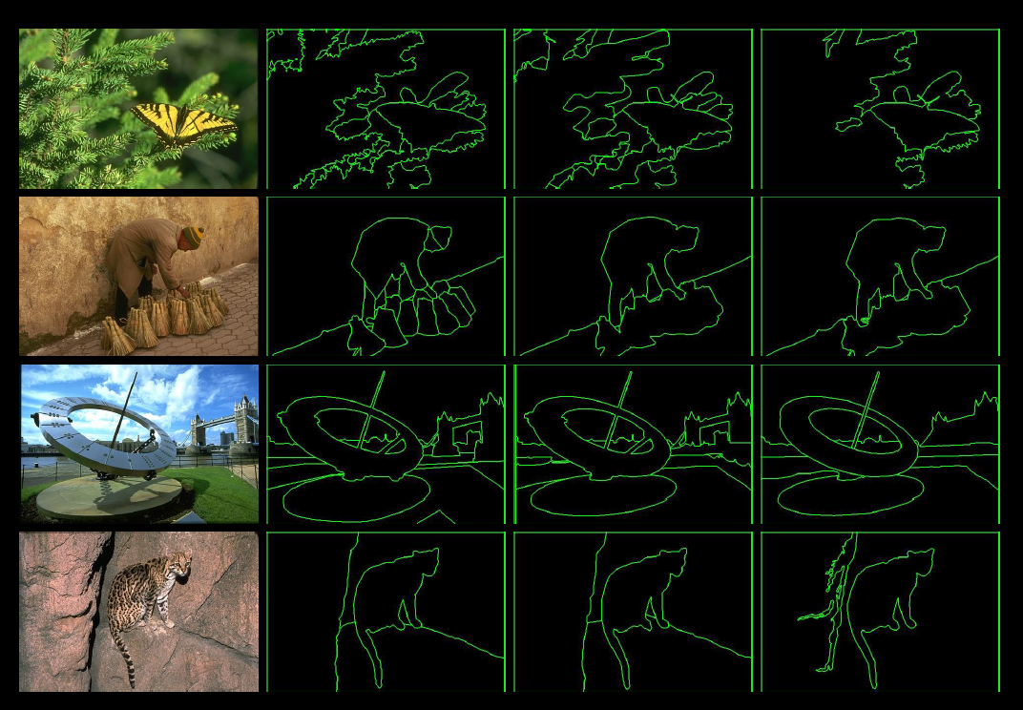
Credit: David Martin

Slide 25
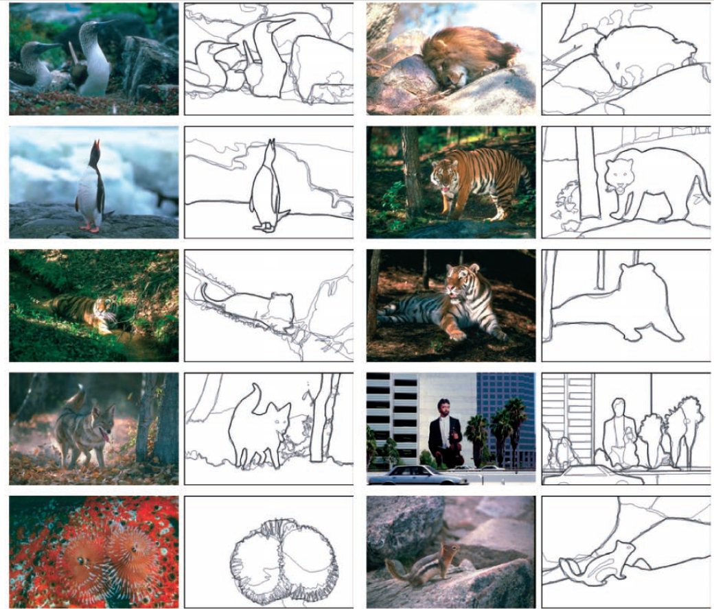
Learn from humans which combination of features is most indicative of a “good” contour?
[D. Martin et al. PAMI 2004]
Human-marked segment boundaries

Slide 26
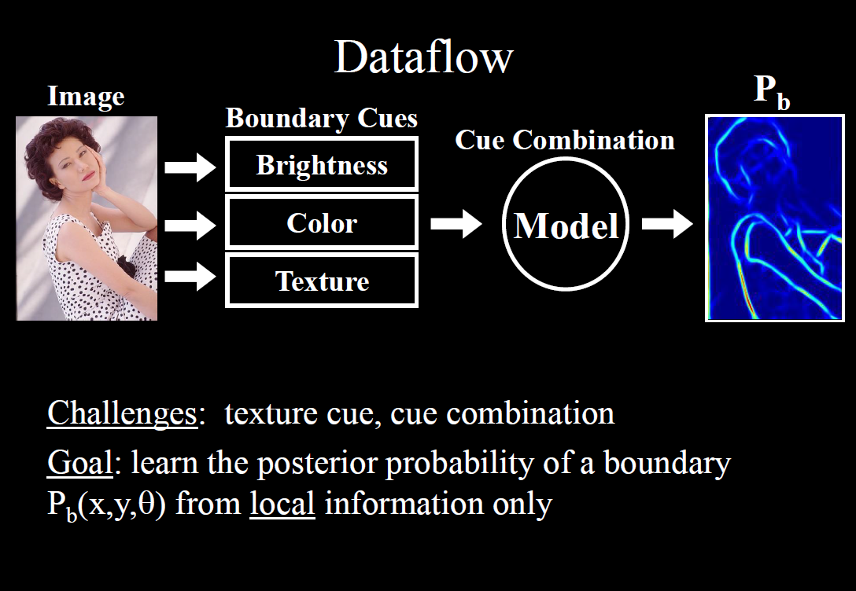
Credit: David Martin

Slide 27
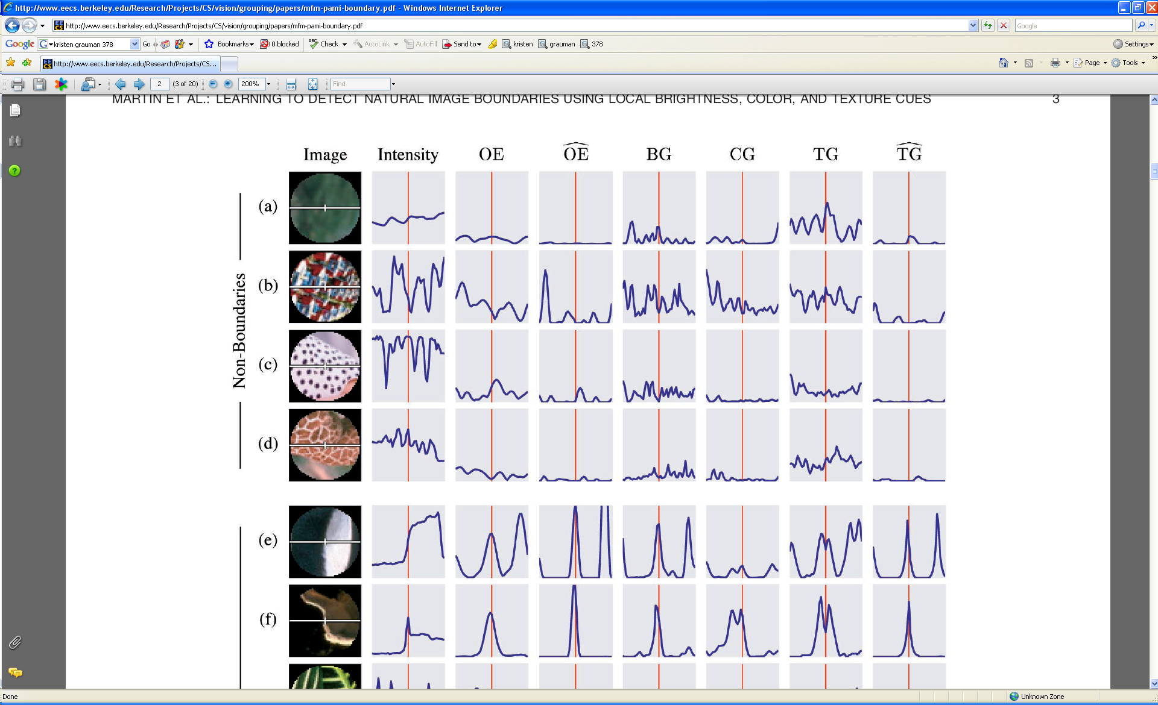
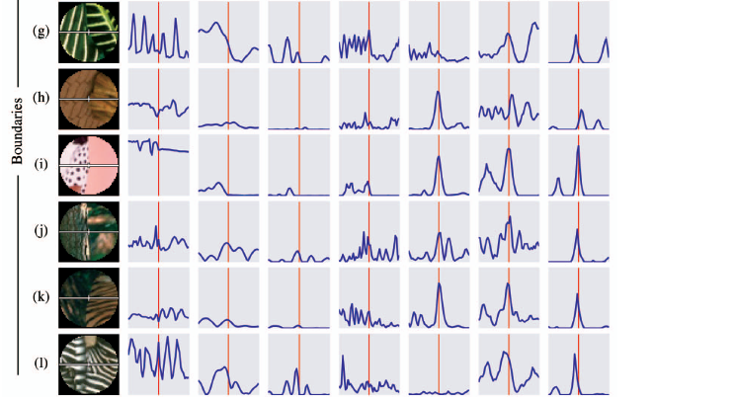
What features are responsible for perceived edges?
Feature profiles (oriented energy, brightness, color, and texture gradients) along the patch’s horizontal diameter
[D. Martin et al. PAMI 2004]
Kristen Grauman, UT-Austin

Slide 28
What features are responsible for perceived edges?
Feature profiles (oriented energy, brightness, color, and texture gradients) along the patch’s horizontal diameter
[D. Martin et al. PAMI 2004]
Kristen Grauman, UT-Austin

Slide 29
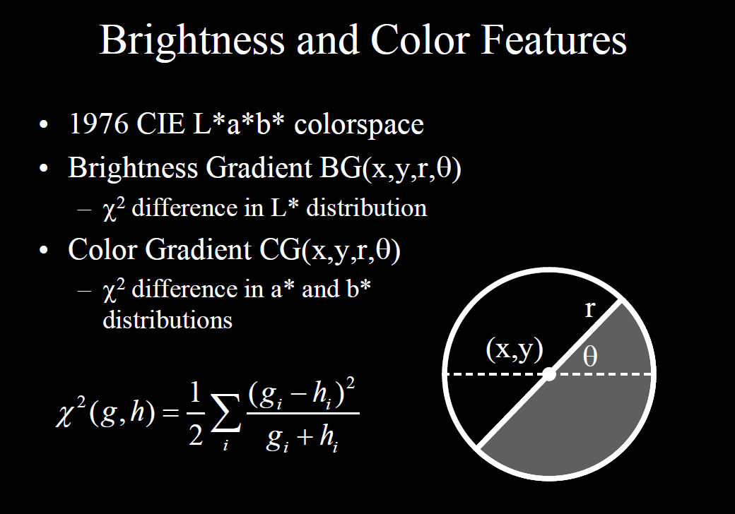
Credit: David Martin

Slide 30
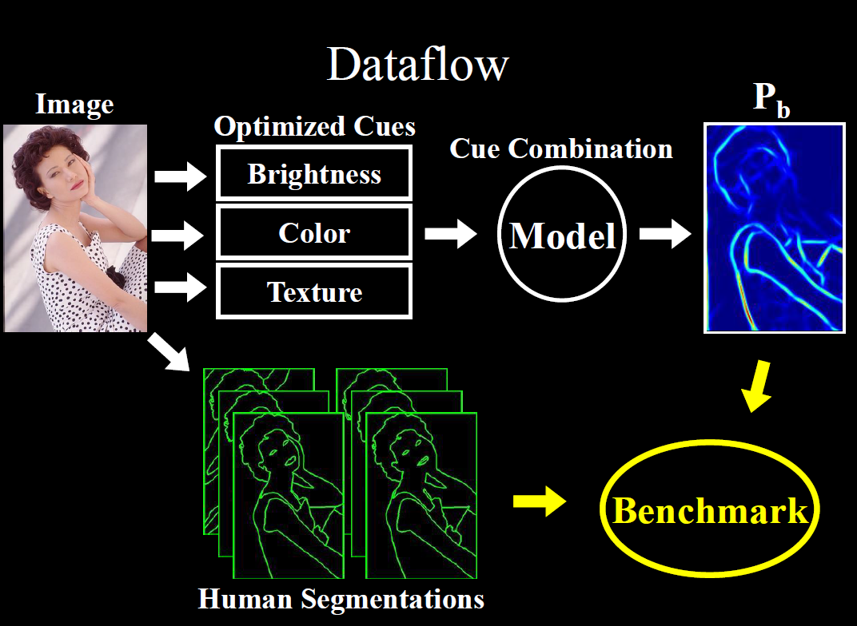
Credit: David Martin

Slide 31
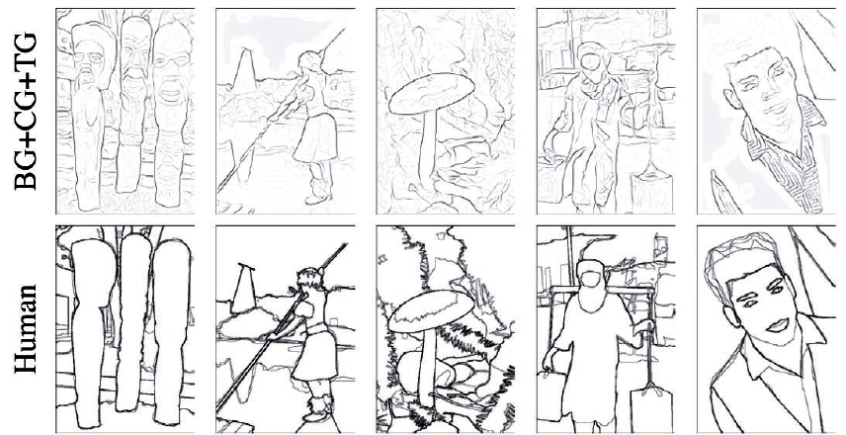
[D. Martin et al. PAMI 2004]
Kristen Grauman, UT-Austin

Slide 32
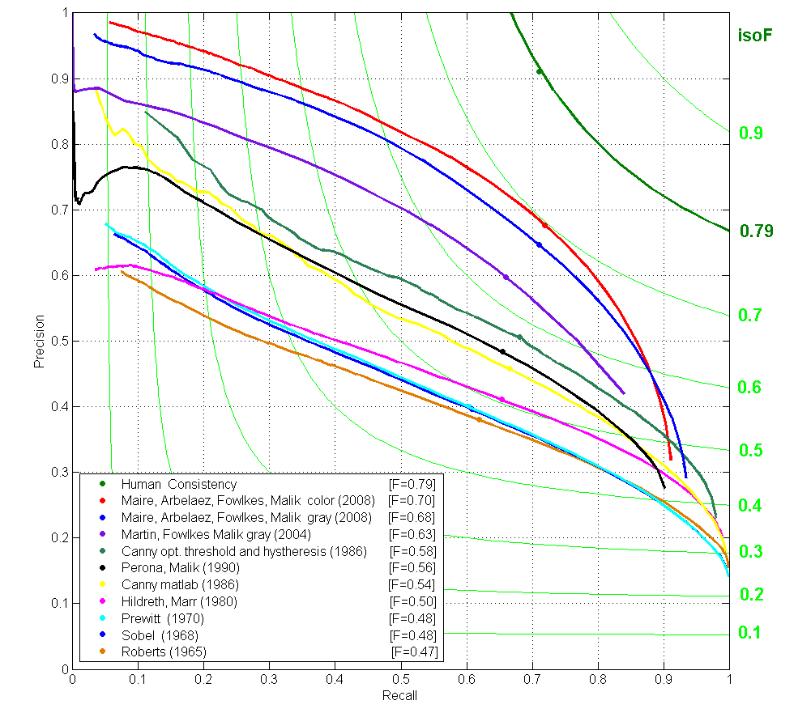
Contour Detection
Canny+opt thresholds
Human agreement
Canny
Prewitt, Sobel, Roberts
Learned with combined features
Source: Jitendra Malik: http://www.cs.berkeley.edu/~malik/malik-talks-ptrs.html

Slide 33
Recall: image filtering
Compute a function of the local neighborhood at each pixel in the image
  Function specified by a “filter” or mask saying how to combine values from neighbors.
Uses of filtering:
  Enhance an image (denoise, resize, etc)
  Extract information (texture, edges, etc)
  Detect patterns (template matching)
Adapted from Derek Hoiem

Slide 34
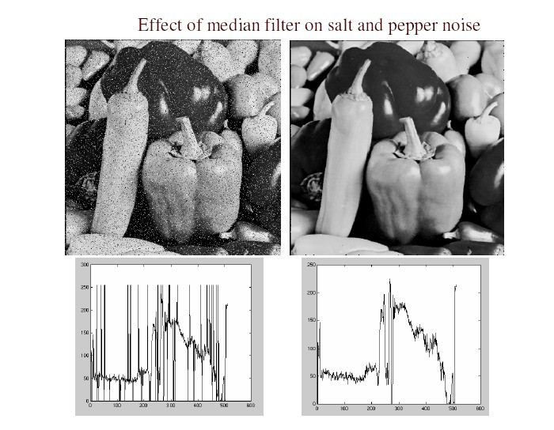
Filters for features
Map raw pixels to an intermediate representation that will be used for subsequent processing
Goal: reduce amount of data, discard redundancy, preserve what’s useful
Kristen Grauman, UT-Austin

Slide 35
Template matching
Filters as templates:
Note that filters look like the effects they are intended to find --- “matched filters”
Use normalized cross-correlation score to find a given pattern (template) in the image.
Normalization needed to control for relative brightnesses.

Slide 36


Template matching
Template (mask)
Scene
A toy example
Kristen Grauman, UT-Austin

Slide 37
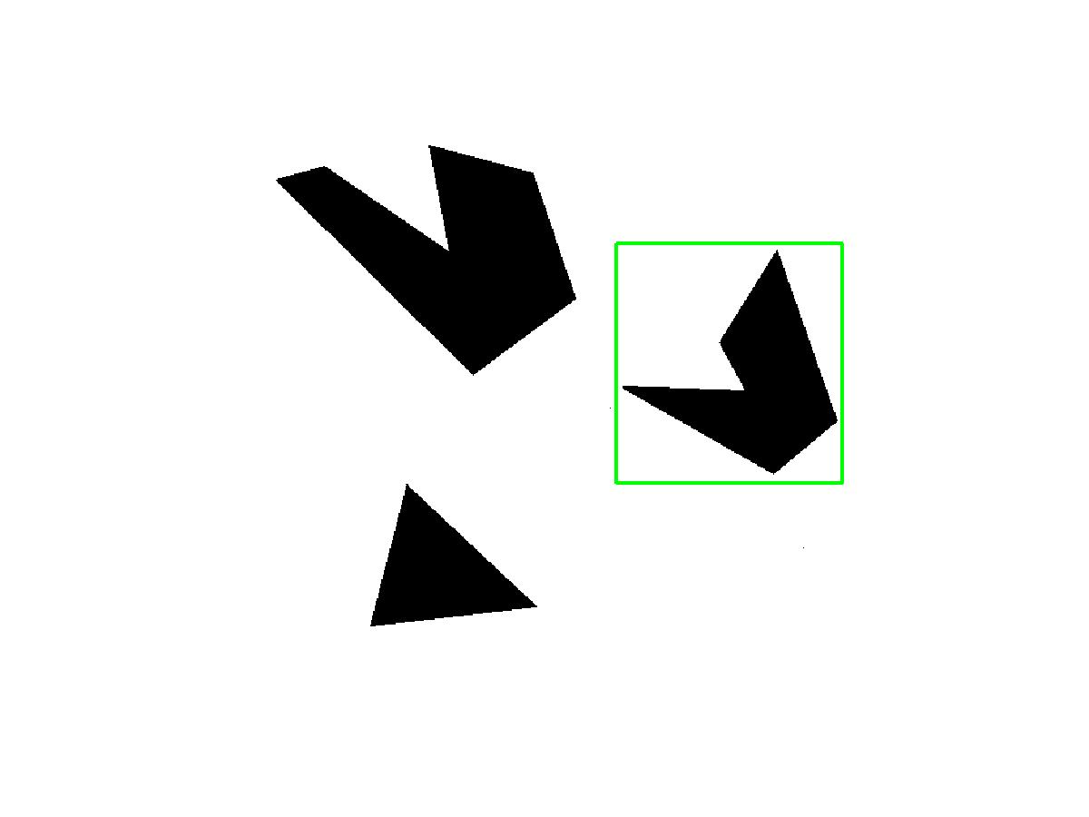
Template matching
Template
Detected template
Kristen Grauman, UT-Austin

Slide 38
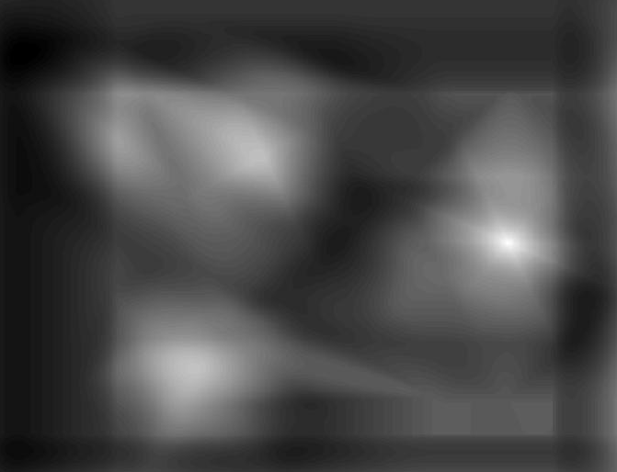
Template matching
Detected template
Correlation map
Kristen Grauman, UT-Austin

Slide 39
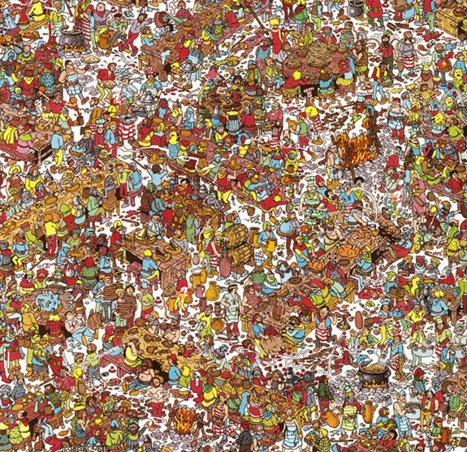
Where’s Waldo?
Template
Scene
Kristen Grauman, UT-Austin

Slide 40
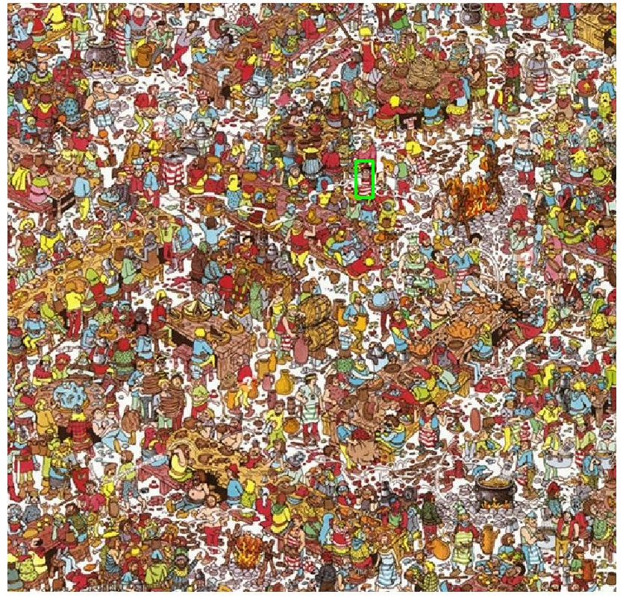
Where’s Waldo?
Template
Detected template
Kristen Grauman, UT-Austin

Slide 41
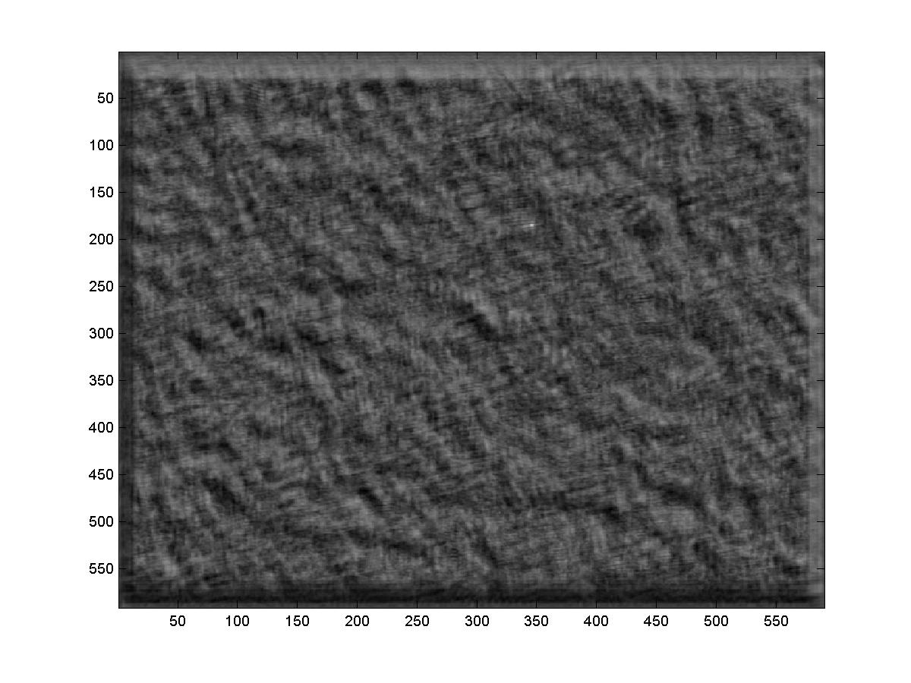
Where’s Waldo?
Detected template
Correlation map
Kristen Grauman, UT-Austin

Slide 42
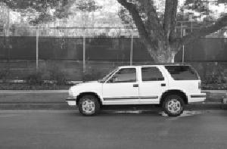

Template matching
Template
Scene
What if the template is not identical to some subimage in the scene?
Kristen Grauman, UT-Austin

Slide 43
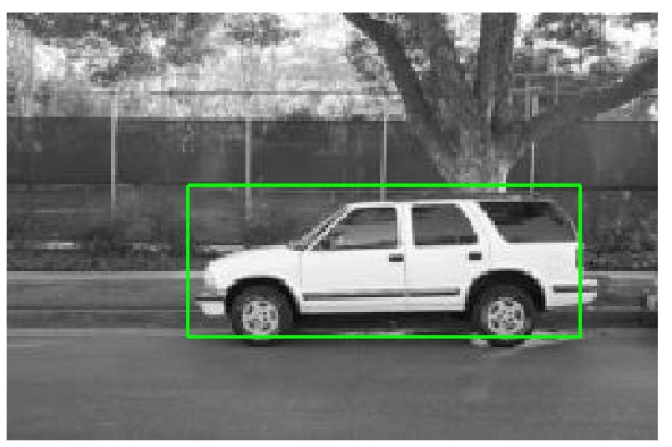
Template matching
Template
Detected template
Match can be meaningful, if scale, orientation, and general appearance is right.
How to find at any scale?
Kristen Grauman, UT-Austin

Slide 44
Recap: Mask properties
Smoothing
  Values positive
  Sum to 1 → constant regions same as input
  Amount of smoothing proportional to mask size
  Remove “high-frequency” components; “low-pass” filter
Derivatives
  Opposite signs used to get high response in regions of high contrast
  Sum to 0 → no response in constant regions
  High absolute value at points of high contrast
Filters act as templates
  Highest response for regions that “look the most like the filter”
  Dot product as correlation
Kristen Grauman, UT-Austin

Slide 45
Summary so far
Image gradients
Seam carving – gradients as “energy”
Gradients → edges and contours
Template matching
  Image patch as a filter
Kristen Grauman, UT-Austin

Slide 46
Today
Edge detection and matching
  process the image gradient to find curves/contours
  comparing contours
Binary image analysis
  blobs and regions
Kristen Grauman, UT-Austin

Slide 47
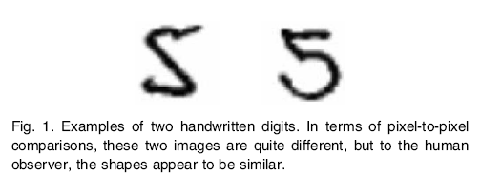
Motivation
Figure from Belongie et al.

Slide 48
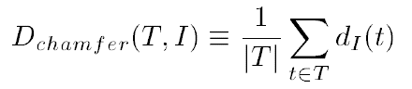
Chamfer distance
Average distance to nearest feature
Set of points in image
Set of points on (shifted) template
Minimum distance between point t and some point in I
Kristen Grauman, UT-Austin

Slide 49
Chamfer distance
Kristen Grauman, UT-Austin

Slide 50
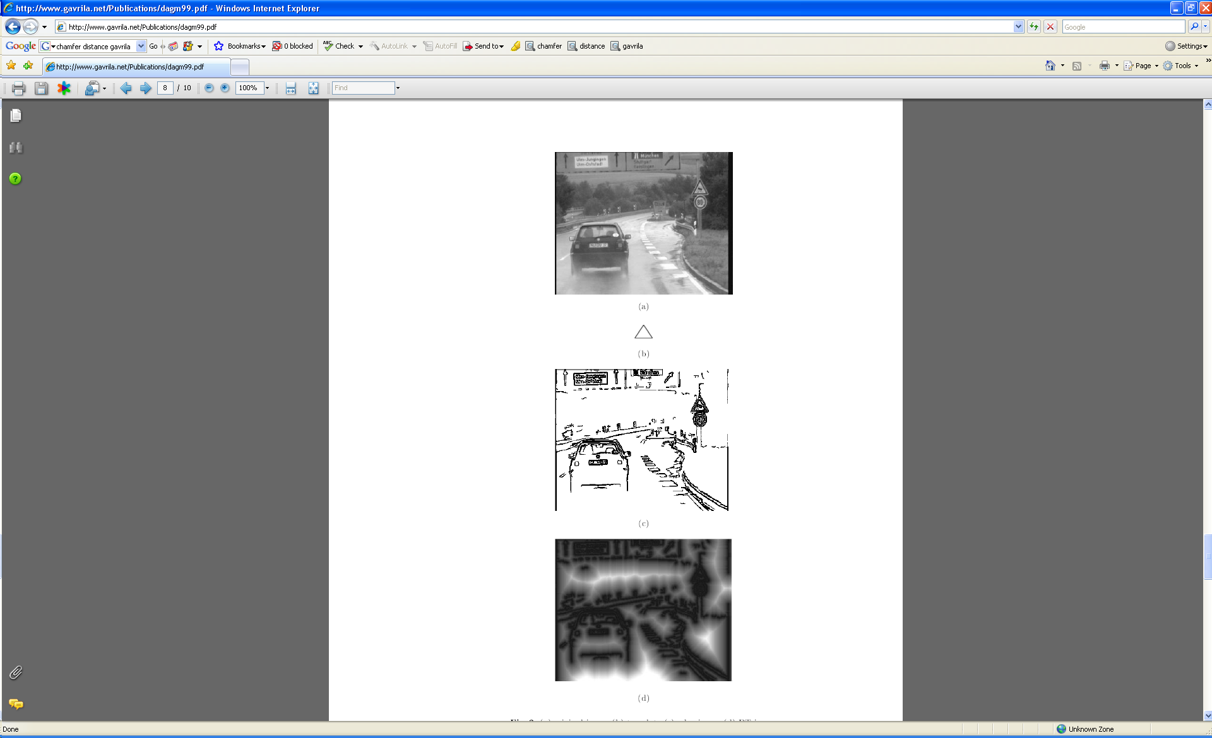
Chamfer distance
Average distance to nearest feature
How is the measure different than just filtering with a mask having the shape points?
How expensive is a naïve implementation?
Edge image

Slide 51
Distance transform
Image features (2D)
Distance Transform
1
0
1
2
3
4
3
2
1
0
1
2
3
3
2
1
1
0
1
2
3
2
1
0
1
0
0
1
2
1
0
1
2
1
1
2
1
0
1
2
3
2
2
2
1
0
1
2
4
3
3
2
1
0
1
2
5
4
4
3
2
1
0
1
Distance Transform is a function that for each image pixel p assigns a non-negative number corresponding to distance from p to the nearest feature in the image I
Features could be edge points, foreground points,…

Slide 52

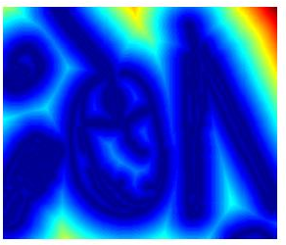

Distance transform
original
edges
distance transform
Value at (x,y) tells how far that position is from the nearest edge point (or other binary mage structure)
>> help bwdist
Kristen Grauman, UT-Austin

Slide 53
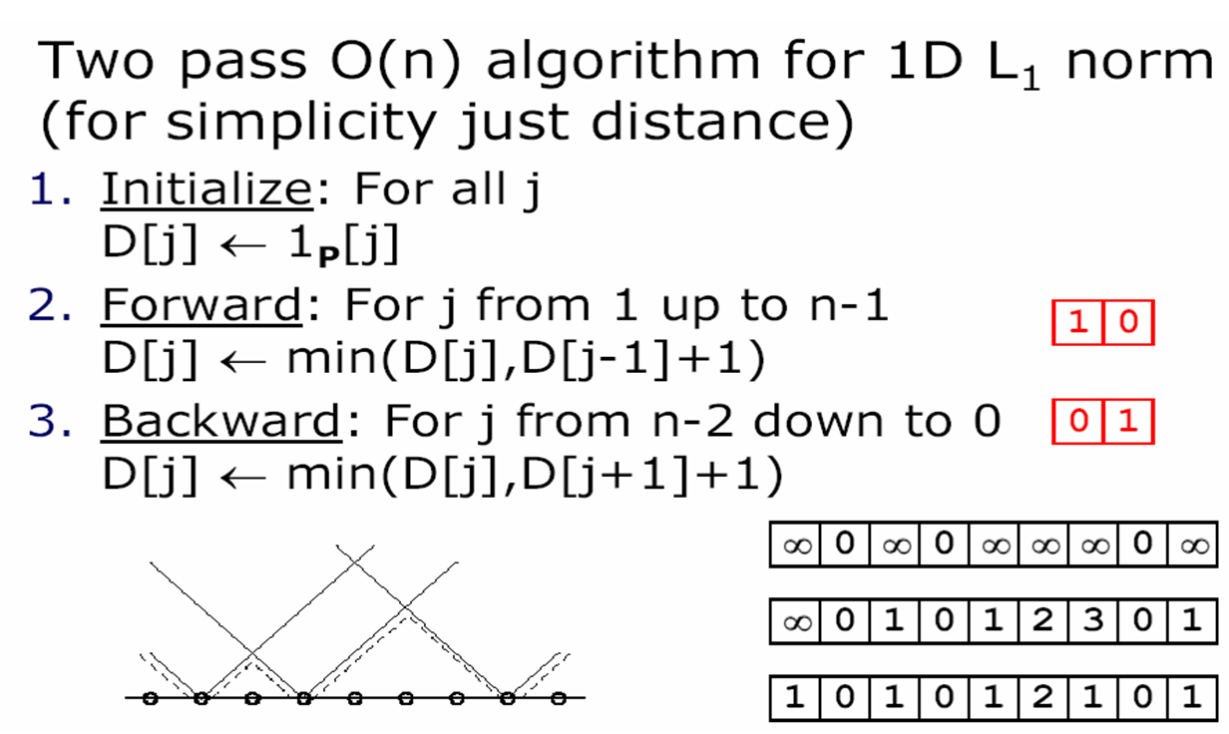
Distance transform (1D)
// 0 if j is in P, infinity otherwise
Adapted from D. Huttenlocher

Slide 54
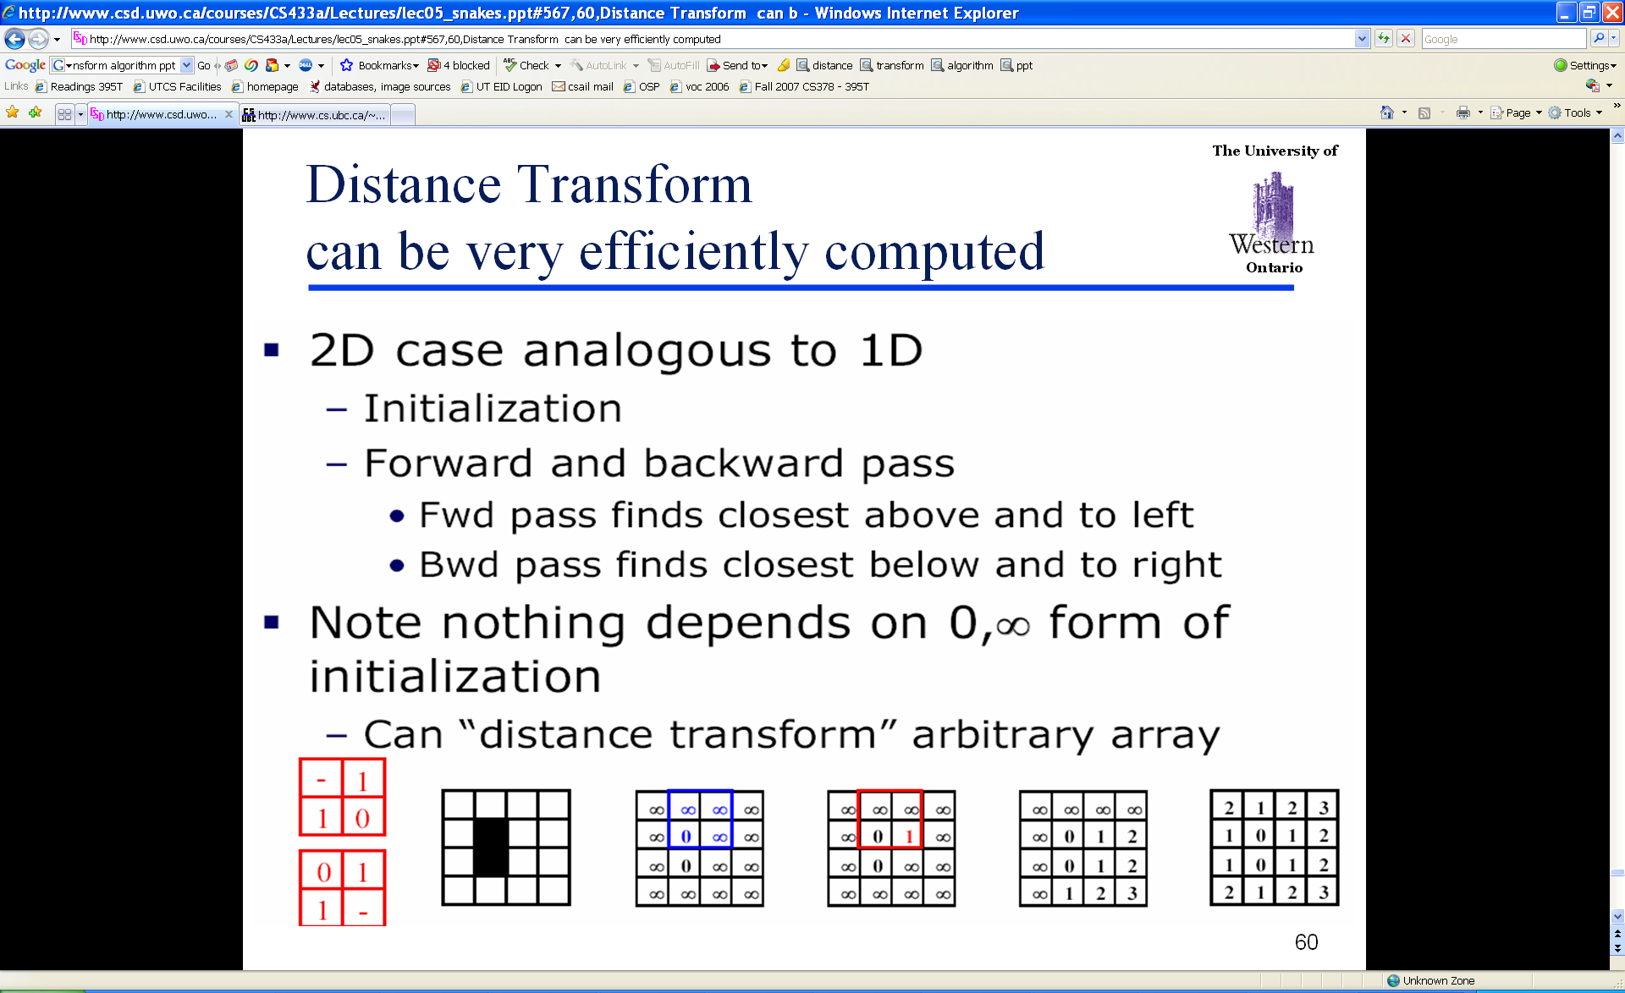
Distance Transform (2D)
Adapted from D. Huttenlocher

Slide 55
Chamfer distance
Average distance to nearest feature
Edge image
Distance transform image

Slide 56
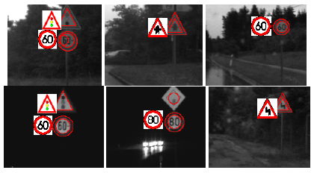
Chamfer distance
Edge image
Distance transform image
Fig from D. Gavrila, DAGM 1999

Slide 57
Chamfer distance: properties
Sensitive to scale and rotation
Tolerant of small shape changes, clutter
Need large number of template shapes
Inexpensive way to match shapes
Kristen Grauman, UT-Austin

Slide 58
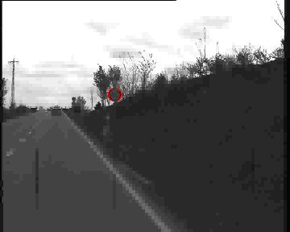
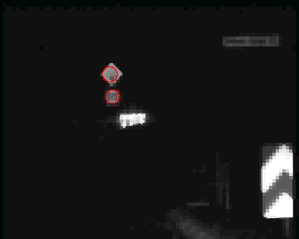
Chamfer matching system
Gavrila et al. http://gavrila.net/Research/Chamfer_System/chamfer_system.html

Slide 59
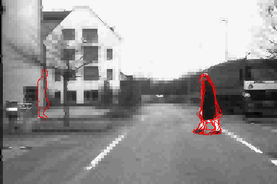
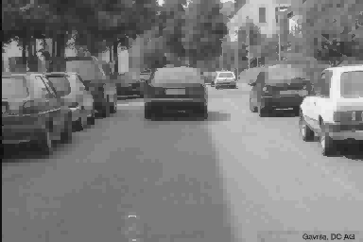
Chamfer matching system
Gavrila et al. http://gavrila.net/Research/Chamfer_System/chamfer_system.html

Slide 60
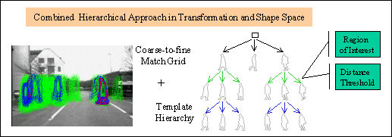
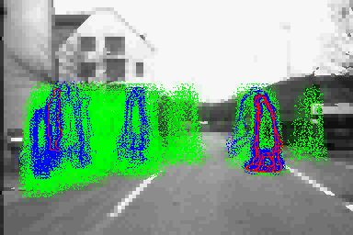
Chamfer matching system
Gavrila et al. http://gavrila.net/Research/Chamfer_System/chamfer_system.html

Slide 61
Today
Edge detection and matching
  process the image gradient to find curves/contours
  comparing contours
Binary image analysis
  blobs and regions

Slide 62
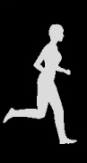
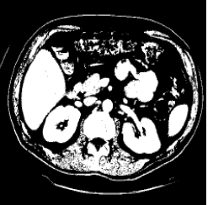
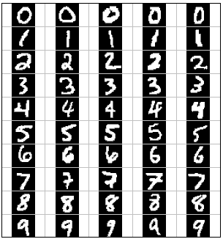
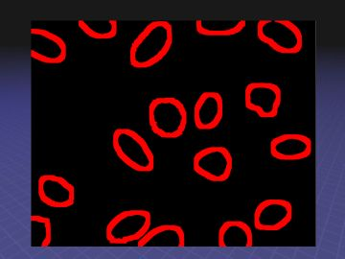




Binary images
Kristen Grauman, UT-Austin

Slide 63
Binary image analysis: basic steps
Convert the image into binary form
  Thresholding
Clean up the thresholded image
  Morphological operators
Extract separate blobs
  Connected components
Describe the blobs with region properties

Slide 64

Binary images
Two pixel values
  Foreground and background
  Mark region(s) of interest

Slide 65



Thresholding
Grayscale -> binary mask
Useful if object of interest’s intensity distribution is distinct from background
Example http://homepages.inf.ed.ac.uk/rbf/CVonline/LOCAL_COPIES/FITZGIBBON/simplebinary.html

Slide 66
Thresholding
Given a grayscale image or an intermediate matrix → threshold to create a binary output.
Example: edge detection
Gradient magnitude
fg_pix = find(gradient_mag > t);
Looking for pixels where gradient is strong.

Slide 67




Thresholding
Given a grayscale image or an intermediate matrix → threshold to create a binary output.
Example: background subtraction
-
=
Looking for pixels that differ significantly from the “empty” background.
Kristen Grauman, UT-Austin
fg_pix = find(diff > t);

Slide 68


Thresholding
Given a grayscale image or an intermediate matrix → threshold to create a binary output.
Example: intensity-based detection
fg_pix = find(im < 65);
Looking for dark pixels
Kristen Grauman, UT-Austin

Slide 69


Thresholding
Given a grayscale image or an intermediate matrix → threshold to create a binary output.
Example: color-based detection
fg_pix = find(hue > t1 & hue < t2);
Looking for pixels within a certain hue range.
Kristen Grauman, UT-Austin

Slide 70
Issues
What to do with “noisy” binary outputs?
  Holes
  Extra small fragments
How to demarcate multiple regions of interest?
  Count objects
  Compute further features per object
Kristen Grauman, UT-Austin

Slide 71
Morphological operators
Change the shape of the foreground regions via intersection/union operations between a scanning structuring element and binary image.
Useful to clean up result from thresholding
Basic operators are:
  Dilation
  Erosion

Slide 72



Dilation
Expands connected components
Grow features
Fill holes
Before dilation
After dilation
Kristen Grauman, UT-Austin

Slide 73


Erosion
Erode connected components
Shrink features
Remove bridges, branches, noise
Before erosion
After erosion
Kristen Grauman, UT-Austin

Slide 74

Structuring elements
Masks of varying shapes and sizes used to perform morphology, for example:
Scan mask across foreground pixels to transform the binary image
>> help strel

Slide 75
Dilation vs. Erosion
At each position:
Dilation: if current pixel is foreground, OR the structuring element with the input image.

Slide 76
Example for Dilation (1D)
Input image
1 | 0 | 0 | 0 | 1 | 1 | 1 | 0 | 1 | 1
1
1
1
Structuring Element
Output Image
1 | 1
Adapted from T. Moeslund

Slide 77
Example for Dilation
Input image
1 | 0 | 0 | 0 | 1 | 1 | 1 | 0 | 1 | 1
Structuring Element
1
1
1
Output Image
1 | 1

Slide 78
Example for Dilation
Input image
1 | 0 | 0 | 0 | 1 | 1 | 1 | 0 | 1 | 1
Structuring Element
1
1
1
Output Image
1 | 1 | 0

Slide 79
Example for Dilation
Input image
1 | 0 | 0 | 0 | 1 | 1 | 1 | 0 | 1 | 1
Structuring Element
1
1
1
Output Image
1 | 1 | 0 | 0

Slide 80
Example for Dilation
Input image
1 | 0 | 0 | 0 | 1 | 1 | 1 | 0 | 1 | 1
Structuring Element
1
1
1
Output Image
1 | 1 | 0 | 1 | 1 | 1

Slide 81
Example for Dilation
Input image
1 | 0 | 0 | 0 | 1 | 1 | 1 | 0 | 1 | 1
Structuring Element
1
1
1
Output Image
1 | 1 | 0 | 1 | 1 | 1 | 1

Slide 82
Example for Dilation
Input image
1 | 0 | 0 | 0 | 1 | 1 | 1 | 0 | 1 | 1
Structuring Element
1
1
1
Output Image
1 | 1 | 0 | 1 | 1 | 1 | 1 | 1

Slide 83
Example for Dilation
Input image
1 | 0 | 0 | 0 | 1 | 1 | 1 | 0 | 1 | 1
Structuring Element
1
1
1
Output Image
1 | 1 | 0 | 1 | 1 | 1 | 1 | 1

Slide 84
Example for Dilation
Input image
1 | 0 | 0 | 0 | 1 | 1 | 1 | 0 | 1 | 1
Structuring Element
1
1
1
Output Image
1 | 1 | 0 | 1 | 1 | 1 | 1 | 1 | 1 | 1
Note that the object gets bigger and holes are filled.
>> help imdilate

Slide 85

2D example for dilation
Shapiro & Stockman

Slide 86
Dilation vs. Erosion
At each position:
Dilation: if current pixel is foreground, OR the structuring element with the input image.
Erosion: if every pixel under the structuring element’s nonzero entries is foreground, OR the current pixel with S.

Slide 87
Example for Erosion (1D)
Input image
1 | 0 | 0 | 0 | 1 | 1 | 1 | 0 | 1 | 1
1
1
1
Structuring Element
_
Output Image
0

Slide 88
Example for Erosion (1D)
Input image
1 | 0 | 0 | 0 | 1 | 1 | 1 | 0 | 1 | 1
1
1
1
Structuring Element
_
Output Image
0 | 0

Slide 89
Example for Erosion
Input image
1 | 0 | 0 | 0 | 1 | 1 | 1 | 0 | 1 | 1
Structuring Element
1
1
1
Output Image
0 | 0 | 0

Slide 90
Example for Erosion
Input image
1 | 0 | 0 | 0 | 1 | 1 | 1 | 0 | 1 | 1
Structuring Element
1
1
1
Output Image
0 | 0 | 0 | 0

Slide 91
Example for Erosion
Input image
1 | 0 | 0 | 0 | 1 | 1 | 1 | 0 | 1 | 1
Structuring Element
1
1
1
Output Image
0 | 0 | 0 | 0 | 0

Slide 92
Example for Erosion
Input image
1 | 0 | 0 | 0 | 1 | 1 | 1 | 0 | 1 | 1
Structuring Element
1
1
1
Output Image
0 | 0 | 0 | 0 | 0 | 1

Slide 93
Example for Erosion
Input image
1 | 0 | 0 | 0 | 1 | 1 | 1 | 0 | 1 | 1
Structuring Element
1
1
1
Output Image
0 | 0 | 0 | 0 | 0 | 1 | 0

Slide 94
Example for Erosion
Input image
1 | 0 | 0 | 0 | 1 | 1 | 1 | 0 | 1 | 1
Structuring Element
1
1
1
Output Image
0 | 0 | 0 | 0 | 0 | 1 | 0 | 0

Slide 95
Example for Erosion
Input image
1 | 0 | 0 | 0 | 1 | 1 | 1 | 0 | 1 | 1
Structuring Element
1
1
1
Output Image
0 | 0 | 0 | 0 | 0 | 1 | 0 | 0 | 0

Slide 96
Example for Erosion
Input image
1 | 0 | 0 | 0 | 1 | 1 | 1 | 0 | 1 | 1
Structuring Element
1
1
1
Output Image
0 | 0 | 0 | 0 | 0 | 1 | 0 | 0 | 0 | 1
Note that the object gets smaller
>> help imerode

Slide 97
2D example for erosion
Shapiro & Stockman

Slide 98

Opening
Erode, then dilate
Remove small objects, keep original shape
Before opening
After opening

Slide 99
Closing
Dilate, then erode
Fill holes, but keep original shape
Before closing
After closing
Applet: http://bigwww.epfl.ch/demo/jmorpho/start.php

Slide 100
Issues
What to do with “noisy” binary outputs?
  Holes
  Extra small fragments
How to demarcate multiple regions of interest?
  Count objects
  Compute further features per object
Kristen Grauman, UT-Austin

Slide 101

Connected components
Identify distinct regions of “connected pixels”
Shapiro and Stockman

Slide 102

Connectedness
Defining which pixels are considered neighbors
4-connected
8-connected
Source: Chaitanya Chandra

Slide 103

Connected components
We’ll consider a sequential algorithm that requires only 2 passes over the image.
Input: binary image
Output: “label” image, where pixels are numbered per their component
Note: foreground here is denoted with black pixels.

Slide 104

Sequential connected components
Adapted from J. Neira

Slide 105
Sequential connected components

Slide 106
Sequential connected components

Slide 107
Sequential connected components

Slide 108

Connected components
Slide credit: Pinar Duygulu

Slide 109
Region properties
Given connected components, can compute simple features per blob, such as:
  Area (num pixels in the region)
  Centroid (average x and y position of pixels in the region)
  Bounding box (min and max coordinates)
  Circularity (ratio of mean dist. to centroid over std)
A2=170
A1=200

Slide 110
Binary image analysis: basic steps (recap)
Convert the image into binary form
  Thresholding
Clean up the thresholded image
  Morphological operators
Extract separate blobs
  Connected components
Describe the blobs with region properties

Slide 111
Matlab
N = hist(Y,M)
L = bwlabel (BW,N);
STATS = regionprops(L,PROPERTIES) ;
  'Area'
  'Centroid'
  'BoundingBox'
  'Orientation‘, …
IM2 = imerode(IM,SE);
IM2 = imdilate(IM,SE);
IM2 = imclose(IM, SE);
IM2 = imopen(IM, SE);

Slide 112

Example using binary image analysis: OCR
[Luis von Ahn et al. http://recaptcha.net/learnmore.html]

Slide 113

Example using binary image analysis: segmentation of a liver
Slide credit: Li Shen

Slide 114






Example using binary image analysis:
Bg subtraction + blob detection
…
Kristen Grauman, UT-Austin

Slide 115


Visual hulls
Kristen Grauman, UT-Austin

Slide 116

Example using binary image analysis:
Bg subtraction + blob detection
University of Southern California
http://iris.usc.edu/~icohen/projects/vace/detection.htm
Kristen Grauman, UT-Austin

Slide 117
Binary images
Pros
  Can be fast to compute, easy to store
  Simple processing techniques available
  Lead to some useful compact shape descriptors
Cons
  Hard to get “clean” silhouettes
  Noise common in realistic scenarios
  Can be too coarse of a representation
  Not 3d
Kristen Grauman, UT-Austin

Slide 118
Summary
Operations, tools
Features, representations
Derivative filters
Smoothing, morphology
Thresholding
Connected components
Matched filters
Histograms
Edges, gradients
Blobs/regions
Local patterns
Textures (next)
Color distributions
Kristen Grauman, UT-Austin

Slide 119

Next
Texture: See assigned reading
Reminder: A1 due next Friday

