Slide 1
Fitting: Voting and the Hough Transform
Tues Feb 14
Kristen Grauman
UT Austin

Slide 2
Today
Grouping : wrap up clustering algorithms
See slides from last time
Fitting : introduction to voting
Slide credit: Kristen Grauman

Slide 3
Last time
What are grouping problems in vision?
Inspiration from human perception
Gestalt properties
Bottom-up segmentation via clustering
Algorithms:
Mode finding and mean shift: k-means, mean-shift
Graph-based: normalized cuts
Features: color, texture, …
Quantization for texture summaries
Slide credit: Kristen Grauman
Notes:
3

Slide 4
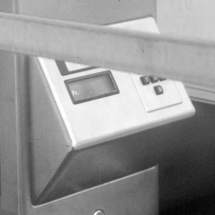
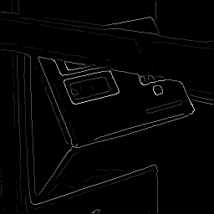
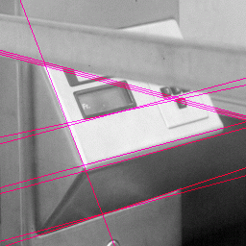
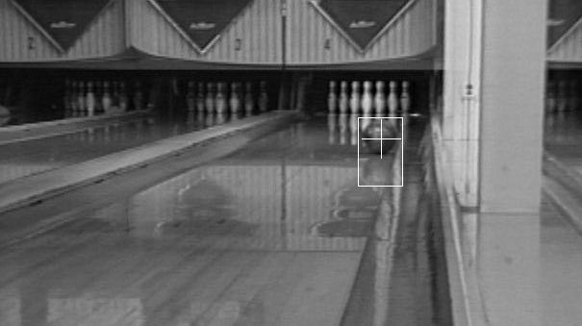
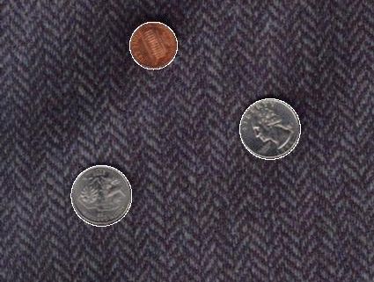
Now: Fitting
Want to associate a model with observed features
[Fig from Marszalek & Schmid, 2007]
For example, the model could be a line, a circle, or an arbitrary shape.
Slide credit: Kristen Grauman

Slide 5
Fitting: Main idea
Choose a parametric model to represent a set of features
Membership criterion is not local
Can’t tell whether a point belongs to a given model just by looking at that point
Three main questions:
What model represents this set of features best?
Which of several model instances gets which feature?
How many model instances are there?
Computational complexity is important
It is infeasible to examine every possible set of parameters and every possible combination of features
Slide credit: L. Lazebnik

Slide 6
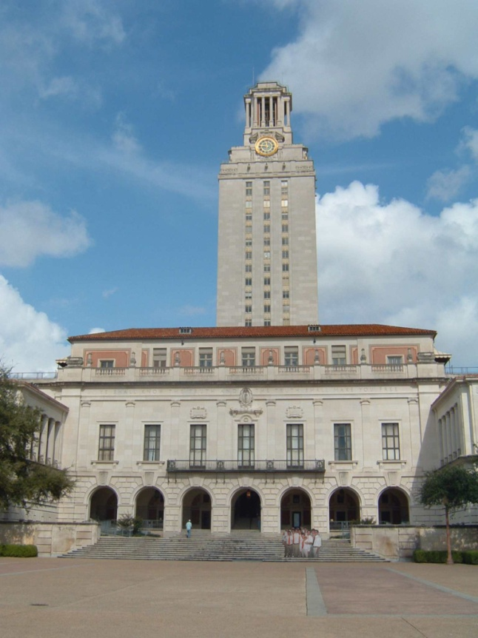
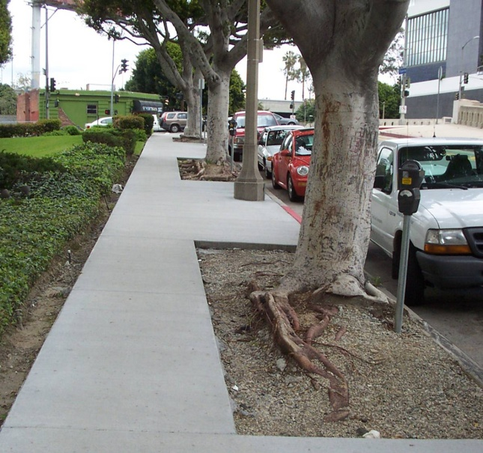
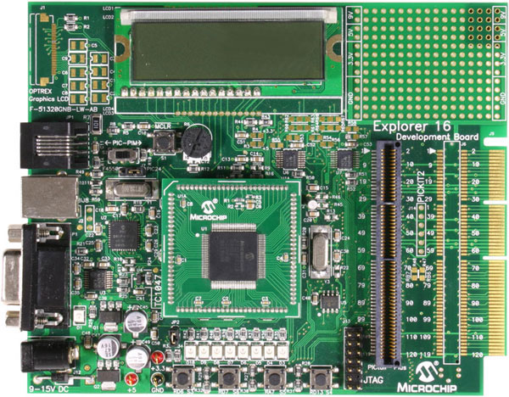
Example: Line fitting
Why fit lines?
Many objects characterized by presence of straight lines
Wait, why aren’t we done just by running edge detection?
Slide credit: Kristen Grauman

Slide 7
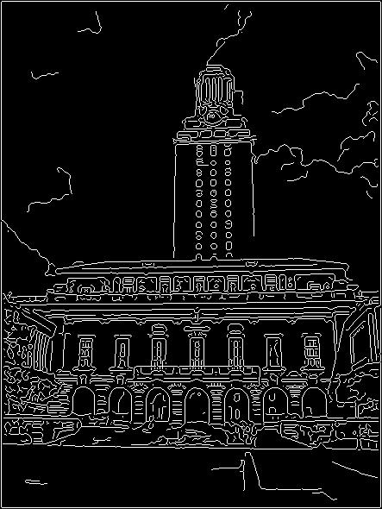
Difficulty of line fitting
Extra edge points (clutter), multiple models:
which points go with which line, if any?
Only some parts of each line detected, and some parts are missing:
how to find a line that bridges missing evidence?
Noise in measured edge points, orientations:
how to detect true underlying parameters?
Slide credit: Kristen Grauman

Slide 8
Voting
It’s not feasible to check all combinations of features by fitting a model to each possible subset.
Voting is a general technique where we let the features vote for all models that are compatible with it.
Cycle through features, cast votes for model parameters.
Look for model parameters that receive a lot of votes.
Noise & clutter features will cast votes too, but typically their votes should be inconsistent with the majority of “good” features.
Slide credit: Kristen Grauman

Slide 9
Fitting lines: Hough transform
Given points that belong to a line, what is the line?
How many lines are there?
Which points belong to which lines?
Hough Transform is a voting technique that can be used to answer all of these questions.
Main idea:
1. Record vote for each possible line on which each edge point lies.
2. Look for lines that get many votes.
Slide credit: Kristen Grauman

Slide 10
Finding lines in an image: Hough space
y
b
b₀
x
m₀
m
image space
Hough (parameter) space
Connection between image (x,y) and Hough (m,b) spaces
A line in the image corresponds to a point in Hough space
To go from image space to Hough space:
given a set of points (x,y), find all (m,b) such that y = mx + b
Slide credit: Steve Seitz

Slide 11
Finding lines in an image: Hough space
y
b
y₀
x₀
x
m
image space
Hough (parameter) space
Connection between image (x,y) and Hough (m,b) spaces
A line in the image corresponds to a point in Hough space
To go from image space to Hough space:
given a set of points (x,y), find all (m,b) such that y = mx + b
What does a point (x₀, y₀) in the image space map to?
Answer: the solutions of b = -x₀m + y₀
this is a line in Hough space
Slide credit: Steve Seitz

Slide 12
Finding lines in an image: Hough space
y
b
(x₁, y₁)
y₀
(x₀, y₀)
b = –x₁m + y₁
x₀
x
m
image space
Hough (parameter) space
What are the line parameters for the line that contains both (x₀, y₀) and (x₁, y₁)?
It is the intersection of the lines b = –x₀m + y₀ and b = –x₁m + y₁

Slide 13
Finding lines in an image: Hough algorithm
y
b
x
m
image space
Hough (parameter) space
How can we use this to find the most likely parameters (m,b) for the most prominent line in the image space?
Let each edge point in image space vote for a set of possible parameters in Hough space
Accumulate votes in discrete set of bins; parameters with the most votes indicate line in image space.

Slide 14
Polar representation for lines
Issues with usual (m,b) parameter space: can take on infinite values, undefined for vertical lines.
Image columns
[0,0]
: perpendicular distance from line to origin
: angle the perpendicular makes with the x-axis
Image rows
Point in image space → sinusoid segment in Hough space
Slide credit: Kristen Grauman

Slide 15
Hough transform algorithm
Using the polar parameterization:
Basic Hough transform algorithm
Initialize H[d, θ]=0
for each edge point I[x,y] in the image
for θ = [θ_{min} to θ_{max} ] // some quantization
H[d, θ] += 1
Find the value(s) of (d, θ) where H[d, θ] is maximum
The detected line in the image is given by
H: accumulator array (votes)
d
θ
Time complexity (in terms of number of votes per pt)?
Source: Steve Seitz

Slide 16
Original image
Canny edges
Vote space and top peaks
Slide credit: Kristen Grauman

Slide 17
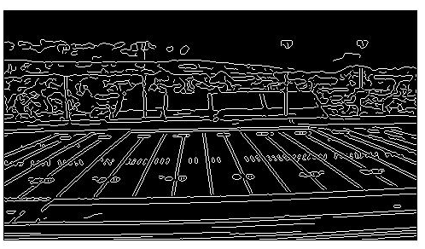
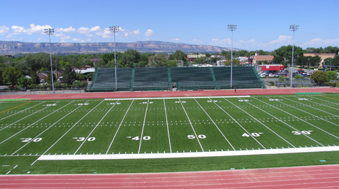
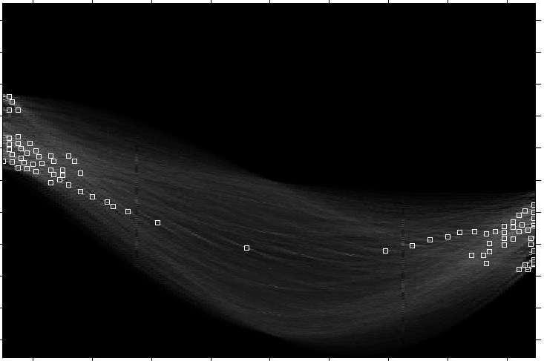
Showing longest segments found
Slide credit: Kristen Grauman

Slide 18
https://www.youtube.com/watch?v=ebfi7qOFLuo

Slide 19
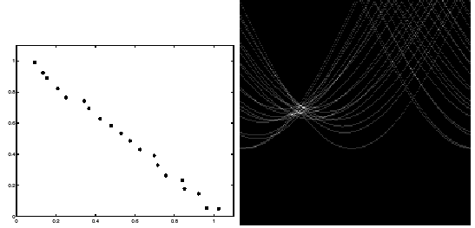
Impact of noise on Hough
y
d
x
θ
Image space
edge coordinates
Votes
What difficulty does this present for an implementation?

Slide 20
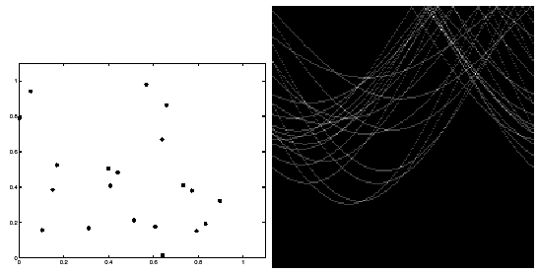
Impact of noise on Hough
Image space
edge coordinates
Votes
Here, everything appears to be “noise”, or random edge points, but we still see peaks in the vote space.

Slide 21
Extensions
Extension 1: Use the image gradient
same
for each edge point I[x,y] in the image
θ = gradient at (x,y)
H[d, θ] += 1
same
same
(Reduces degrees of freedom)
Extension 2
give more votes for stronger edges
Extension 3
change the sampling of (d, θ) to give more/less resolution
Extension 4
The same procedure can be used with circles, squares, or any other shape

Slide 22
Extensions
Extension 1: Use the image gradient
same
for each edge point I[x,y] in the image
compute unique (d, θ) based on image gradient at (x,y)
H[d, θ] += 1
same
same
(Reduces degrees of freedom)
Extension 2
give more votes for stronger edges (use magnitude of gradient)
Extension 3
change the sampling of (d, θ) to give more/less resolution
Extension 4
The same procedure can be used with circles, squares, or any other shape…
Source: Steve Seitz

Slide 23
Summary
Clustering and segmentation algorithms
Kmeans
Mean shift
Normalized cuts
MRF for interactive
Quantizing features
Summarize spatial statistics over prototypical feature
Fitting via voting
Fitting vs. grouping
Hough Transform for lines

Slide 24
Coming up
Thursday: More on Hough transform
Circles, arbitrary shapes
Reminder: A2 is due next Friday

