Slide 1
Look-ahead before you leap
Dinesh Jayaraman, Kristen Grauman

Slide 2
Overview
Problem
Methods
Experiments
Conclusion

Slide 3
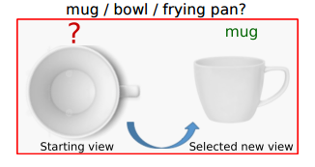
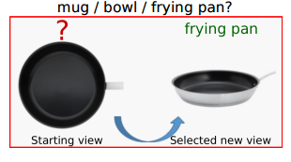
Problem: Active Recognition
Hard to understand in one view. Acquire new views.
“Active Recognition”
Recognition system can select which views to see.

Slide 4
Components of Active Recognition
Per-view Recognition
Control
Evidence Fusion
Control (change view)
Per-view recognition
Evidence Fusion

Slide 5
Related Work
Independent pipelines
Certain heuristics
Predict next-best move.
Some predefined categories.
Train for 1 view recognition.

Slide 6
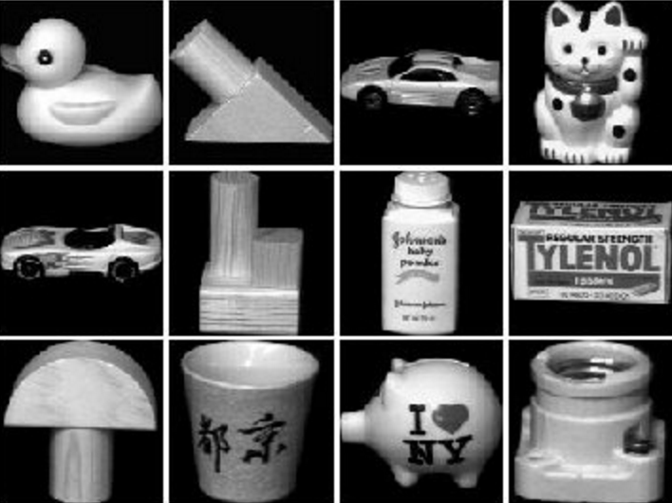
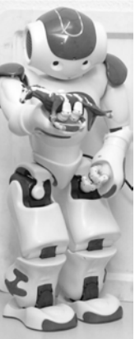
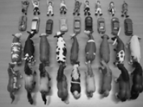
Applications
Instance recognition from
turn-table scans
Toy category recognition with custom robot
Slide Credit: Dinesh Jayaraman

Slide 7
Overview
Problem
Methods
Experiments
Conclusion

Slide 8
Method Overview
Perception
Action selection
Evidence fusion
JOINT TRAINING
Look-ahead
FORECASTING THE EFFECTS OF ACTIONS
Multi-task training of active recognition components + look-ahead.
Slide Credit: Dinesh Jayaraman

Slide 9
System Architecture
Actor
Sensor
Aggregator
Look- ahead
Classifier (RCNN)

Slide 10
Unrolled Architecture
Time t
Time t+1
Time T
Actor
m(t)
Actor
Sensor
Aggregator
Sensor
Classifier
Aggregator
p(t)
s(t)
a(t)
a(t+1)
m(t)
a(t) =
s1,s2,s3…, s(t)
m(t+1)
a(t+1)
LOOKAHEAD
a(t+1)
LOOKAHEAD
Trained through combination of gradient descent and REINFORCE

Slide 11
Overview
Problem
Methods
Experiments
Conclusion

Slide 12
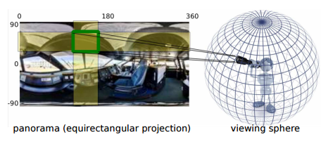
Accurate Scene Categorization
Dataset: Sun360
8992 panoramic images
Indoor and outdoor scenes
Goal: predict scene
Baselines: single view, randow views (average), random views(recurrent), transinformation, seqDP, transinformation + SeqDP

Slide 13
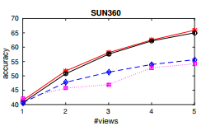
Normal vs Active RNN
Look-Ahead active RNN outperforms all baseline

Slide 14
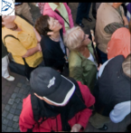
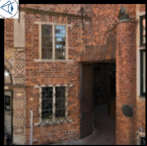
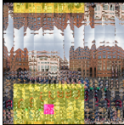
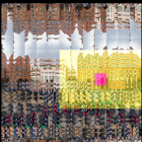
Scene Categorization Result
Ground Truth: plaza courtyard

Slide 15
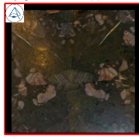
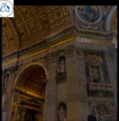
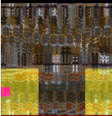
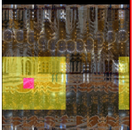
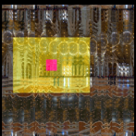
Ground Truth: Church

Slide 16
Object Categorization
Dataset: GERMS
6 videos
136 objects rotated around different fixed axis
Goal: predict instance
Baselines: single view, randow views (average), random views(recurrent), transinformation, seqDP, transinformation + SeqDP

Slide 17
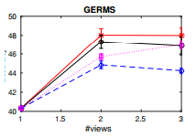
Normal vs Active RNN
Training all 3 components jointly is most critical to performance

Slide 18
GERMS have less accuracy as compared to SUN360

Slide 19
Why?
GERMS dataset is small as compared to SUN360.
Single degree of motion as compared to two in SUN360.

Slide 20
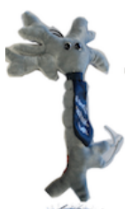
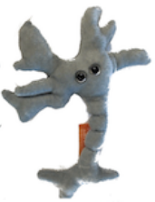
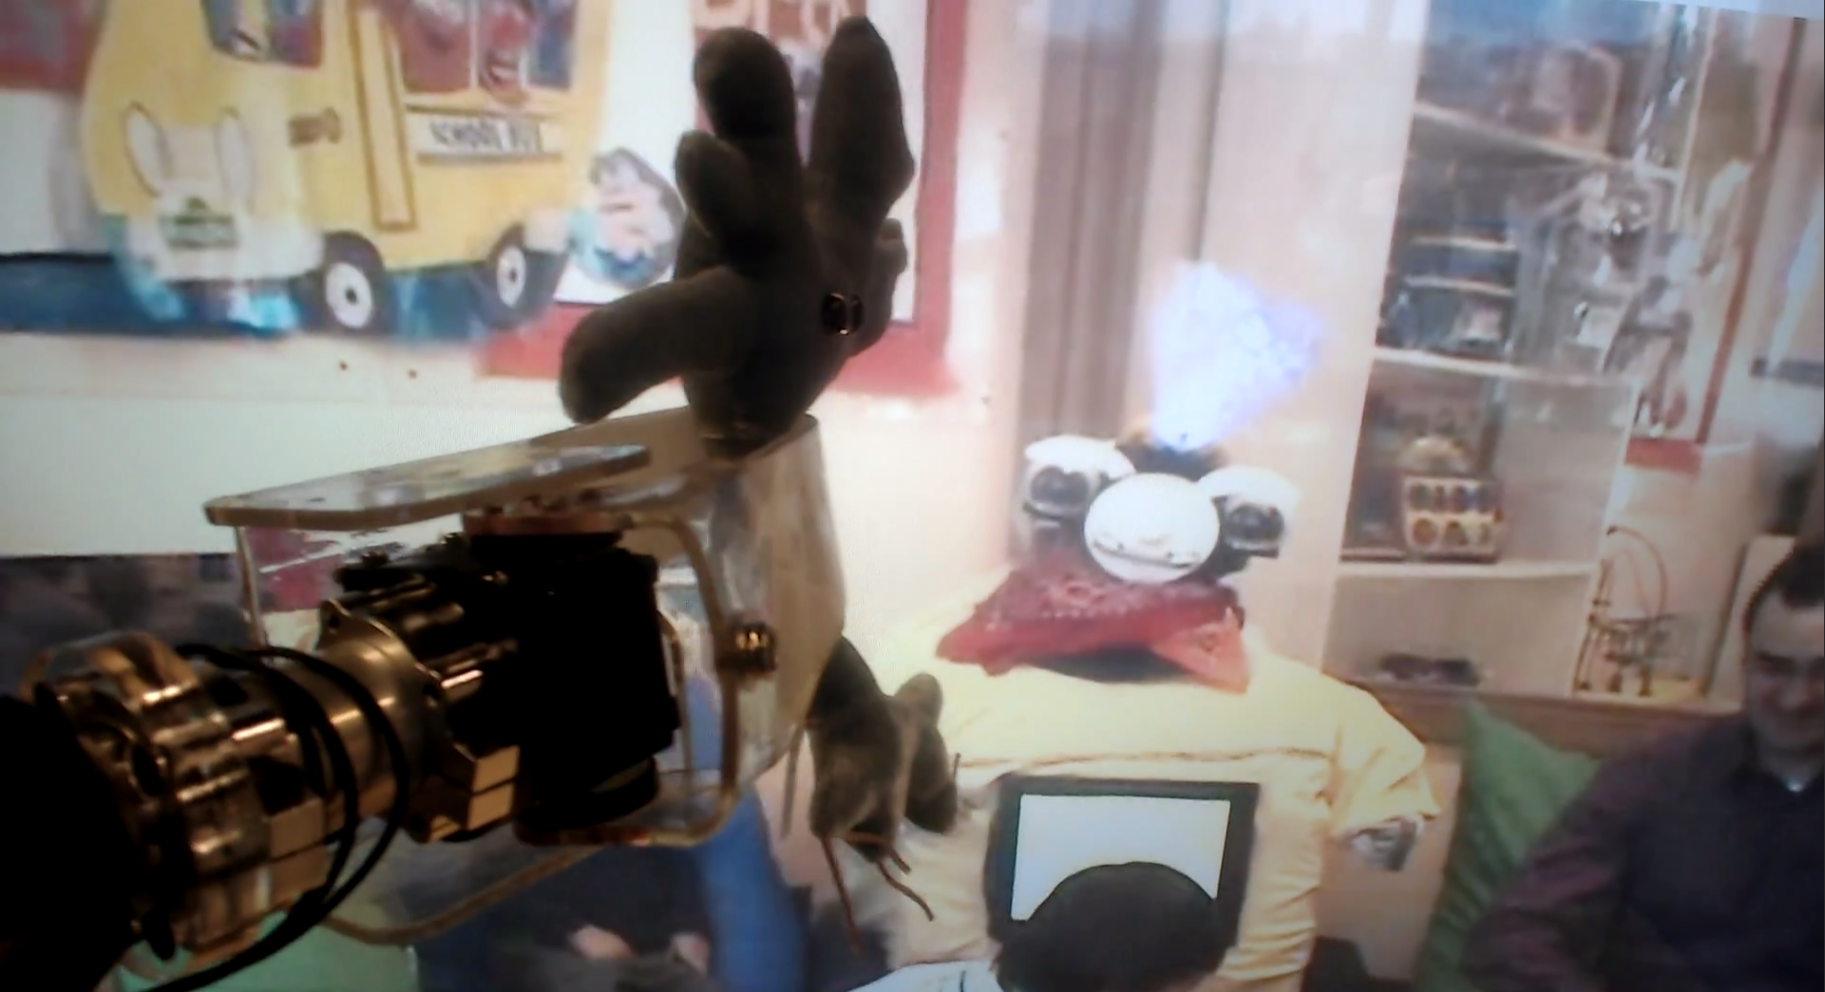
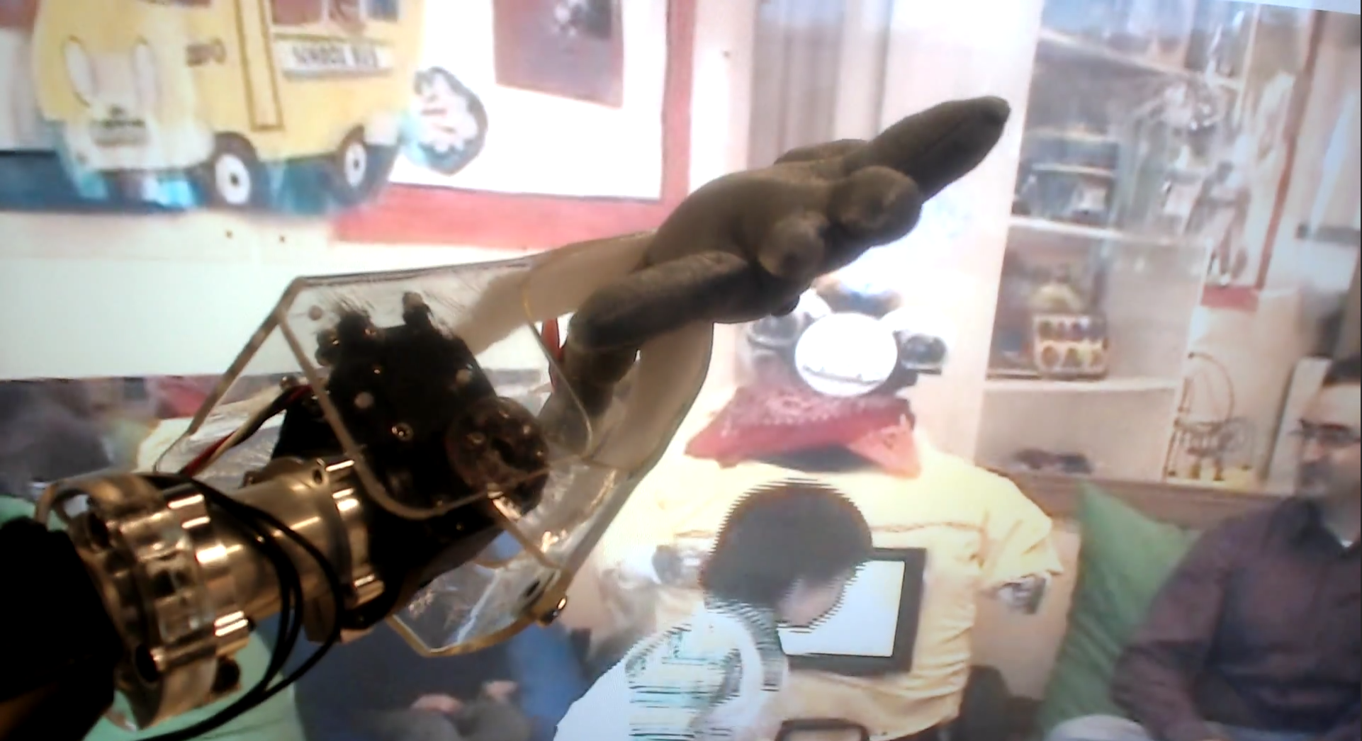
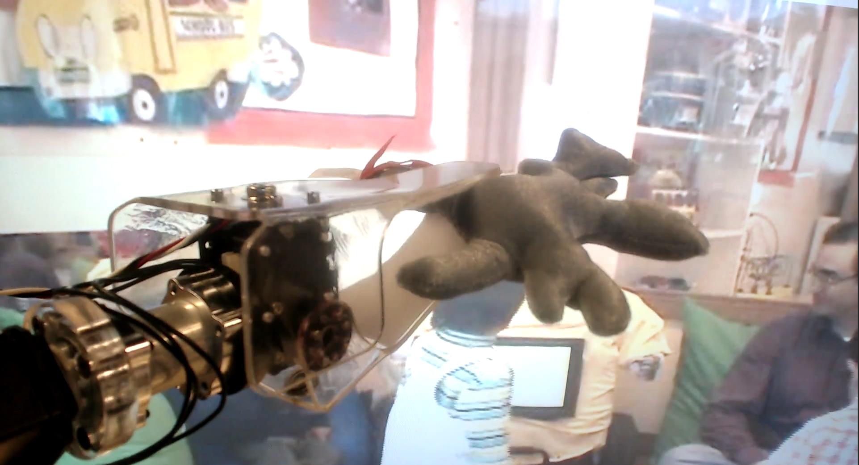
Object Categorization Result
Predicted Label:
T=1
T=2
T=3
Slide Credit: Dinesh Jayaraman

Slide 21
Future Work
Need more large 3-D and video benchmark dataset.
Extension to other real word problems.

Slide 22
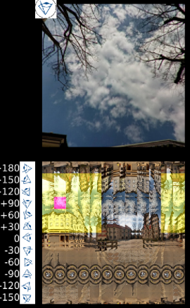
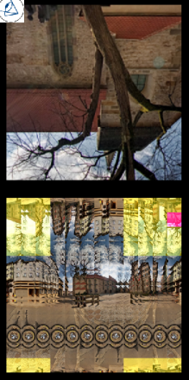
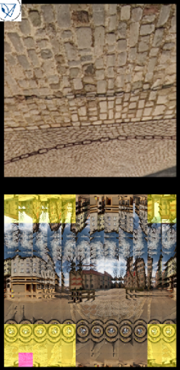
Failure Cases
Notes:
Predict street at T = 2 but because of T=3 view, it changes it prediction. Though street score is still high but give more preference to plaza courtyard.

Slide 23
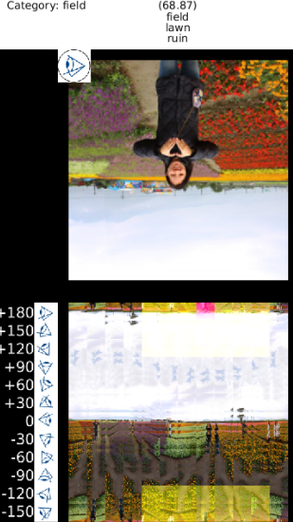
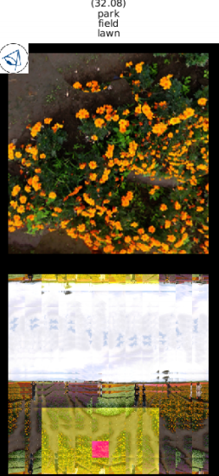
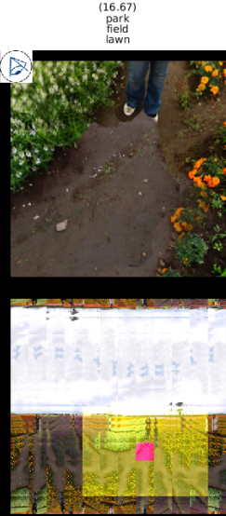
Failure Cases
Notes:
Field having different flowers but it recognize it as park.

Slide 24
Conclusion
Problem
Active recognition
Methods
RNN with look-ahead module
End to end joint training with gradient descent and REINFORCE.
Experiments
Outperformed all baselines on scene categorization and object detection.
Need more large 3-D and video benchmark dataset.

Slide 25
Thank You

