Slide 1
Finding Tiny Faces
CVPR 2017
Peiyun Hu, and Deva Ramanan (Robotics Institute, CMU)
Picture taken from: P. Hu, D. Ramanan, “Finding Tiny Faces”, CVPR 2017.
Presented by: Lakshay

Slide 2
Problem
Cues for recognizing a 3px tall face are fundamentally different than those for recognizing a 300px tall face.
Scale Invariance
Is it better to use scale-invariant features or scale-specific detectors?
Image Resolution
Are faces detected better at some resolutions than others?
Contextual Reasoning
Is context useful for detecting faces? How much context?
Picture taken from: P. Hu, D. Ramanan, “Finding Tiny Faces”, CVPR 2017.

Slide 3
Highlights
Traditional approach: fixed-size template, fine image pyramid
Different detectors for different scales --- exploit different cues at different scales
Coarse image pyramid --- capture extreme scale challenges
Model context as a fixed-size receptive field across all scale-specific templates
Templates over features extracted from multiple layers of a deep model --- foveal descriptors
Picture taken from: P. Hu, D. Ramanan, “Finding Tiny Faces”, CVPR 2017.

Slide 4
Context and Resolution
What is the best way to find small faces of size 25x20?
Context – Intuitively, context will help in finding small faces
Resolution – To find faces of size 25x20, why define a template of any size other than 25x20?
What is the best way to find large faces of size 250x200?
Context – Is context still valuable?
Resolution – Any surprises here?

Slide 5
Context in Human Vision
Bounding box
3X
300 px
Greater context improves accuracy for small faces.
Simulate similar behavior with “hypercolumn” features!
Picture taken from: P. Hu, D. Ramanan, “Finding Tiny Faces”, CVPR 2017.

Slide 6
Hypercolumn Features
Semantic information
Vector of activations of all CNN units above a pixel
Finer details
Picture taken from: Hariharan et al., “Hypercolumns for Object Segmentation and Fine-grained Localization”, CVPR 2015.

Slide 7
Improvement with Context
Higher layers have larger receptive fields.
18.9% improvement with 291x291 features
(as compared to 27x27)
1.5% improvement with added context
Picture taken from: P. Hu, D. Ramanan, “Finding Tiny Faces”, CVPR 2017.

Slide 8
Improvement with Context
Context is important, but foveal structure is important too!
For small faces, using only large templates degrades accuracy.
Picture taken from: P. Hu, D. Ramanan, “Finding Tiny Faces”, CVPR 2017.

Slide 9
Resolution
What if we train a template whose size intentionally differs from the target object to be detected?
Picture taken from: P. Hu, D. Ramanan, “Finding Tiny Faces”, CVPR 2017.

Slide 10
But why?
ImageNet has over 80% of its data between 40-140 pixels. Pre-trained models are optimized for objects within such range of size.
Large faces: 0.5X
Small faces: 2X
In between: 1X
Picture taken from: P. Hu, D. Ramanan, “Finding Tiny Faces”, CVPR 2017.

Slide 11
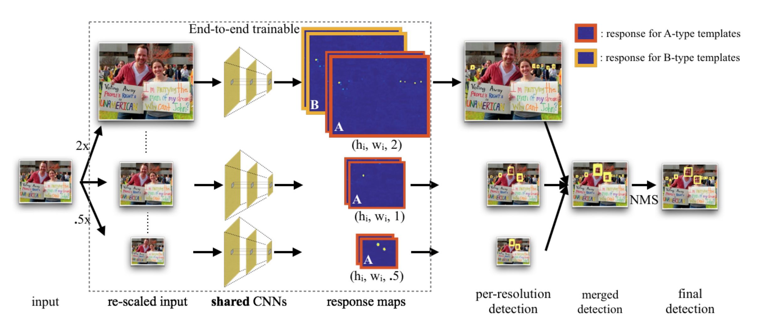
Architecture
Picture taken from: P. Hu, D. Ramanan, “Finding Tiny Faces”, CVPR 2017.

Slide 12
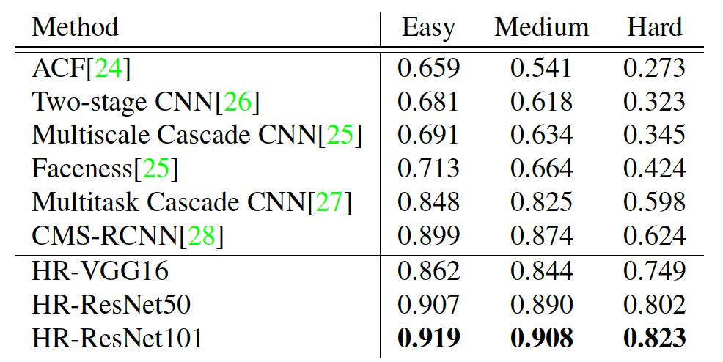
Results
Big improvement on hard subset!

Slide 13
Results

Slide 14
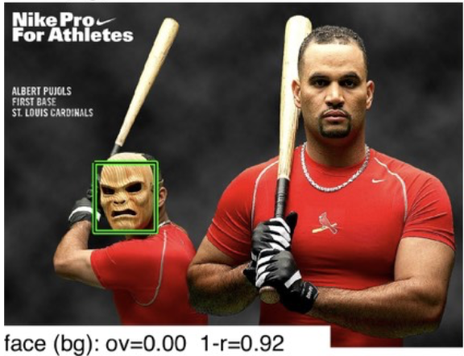
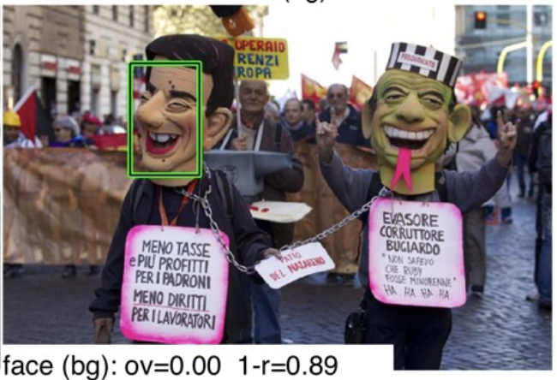
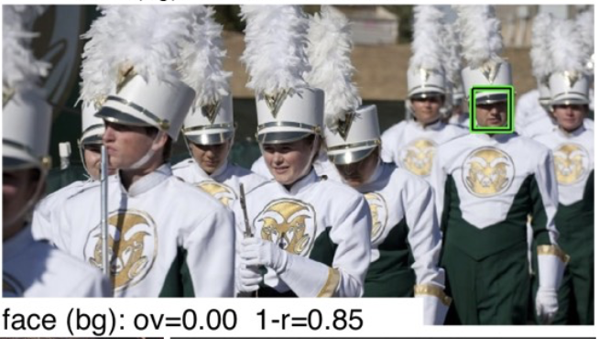
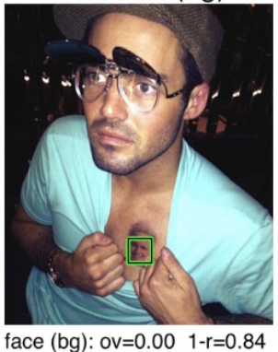
Results

Slide 15
Discussion
Strengths
The method improves the performance on hard subset by 2X!
The paper answers the hard question of encoding context.
Remarks
The authors could have proved their resolution hypothesis by training on resized ImageNet data.

