Slide 1
Active Object Recognition using Vocabulary Trees Natasha Govender, Jonathan Claassens, Philip Torr, Jonathan Warrell
Presented by: Manu Agarwal

Slide 2
Outline
Particulars of the experiment
Comparing uniqueness scores
- Intra-class variation
- Inter-class variation
Textureness vs uniqueness
- Intra-class variation
- Inter-class variation
Using entropy instead of tf-idf
- Intra-class variation
- Inter-class variation

Slide 3
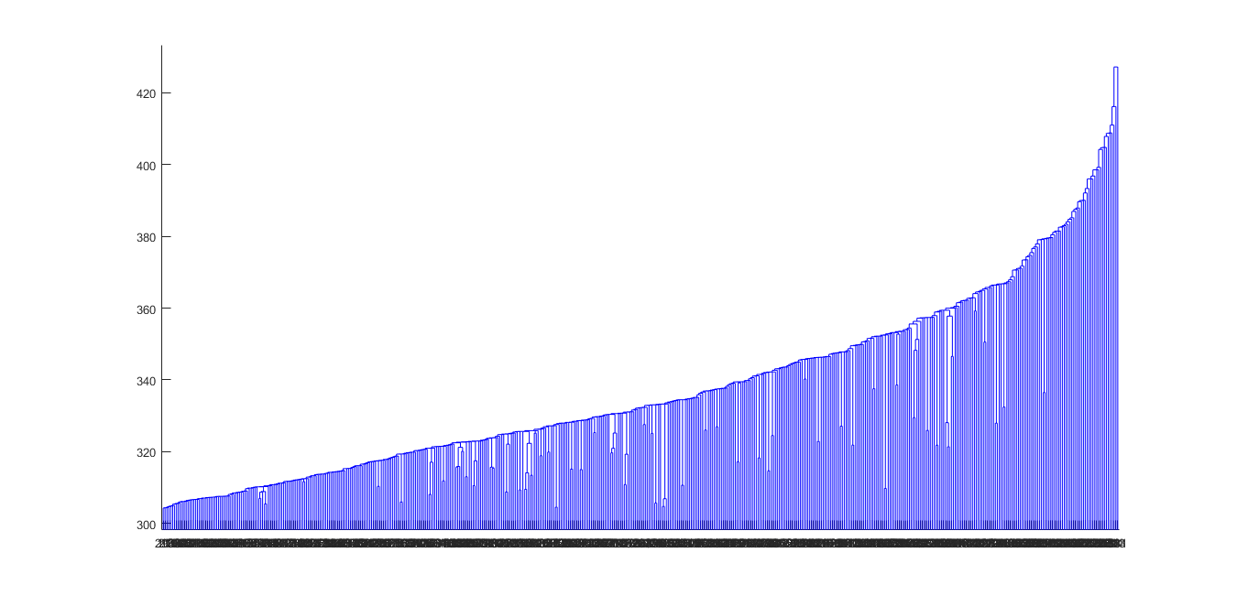
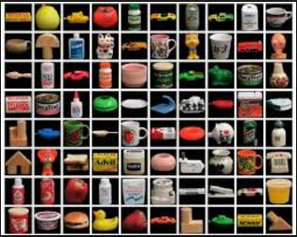
Selector Component
Features

Slide 4
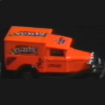
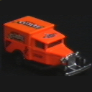
Object Verification and Recognition
Features
Update belief
Features

Slide 5
Particulars of the experiment
COIL dataset

Slide 6
Visualization of the COIL dataset

Slide 7
Visualization of the COIL dataset

Slide 8
Visualization of the COIL dataset

Slide 9
Visualization of the COIL dataset

Slide 10
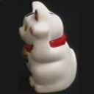
Visualization of the COIL dataset

Slide 11
Visualization of the COIL dataset

Slide 12
Visualization of the COIL dataset

Slide 13
Visualization of the COIL dataset

Slide 14
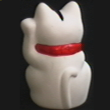
Visualization of the COIL dataset

Slide 15
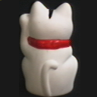
Visualization of the COIL dataset

Slide 16
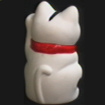
Visualization of the COIL dataset

Slide 17
Visualization of the COIL dataset

Slide 18
Visualization of the COIL dataset

Slide 19
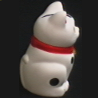
Visualization of the COIL dataset

Slide 20
Visualization of the COIL dataset

Slide 21
Visualization of the COIL dataset

Slide 22
Visualization of the COIL dataset

Slide 23
Visualization of the COIL dataset

Slide 24
Visualization of the COIL dataset

Slide 25
COIL dataset
Set of 100 objects imaged at every 5 degrees
Used 20 different objects imaged at every 20 degrees
Images captured around the y-axis (1 DoF)

Slide 26
Particulars of the experiment
k=2
20 diverse object categories
tf-idf ; entropy
SIFT descriptors

Slide 27
Vocabulary Tree

Slide 28
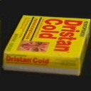
Intra-class variation
<
<
120.21
125.74
173.41

Slide 29
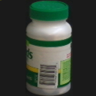
Intra-class variation
<
<
67.70
125.74
145.08

Slide 30
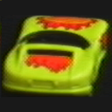
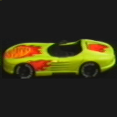
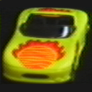
Intra-class variation
<
<
149.92
169.27
183.78

Slide 31
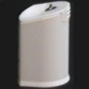
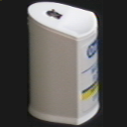
Intra-class variation
<
<
33.85
98.22
169.27

Slide 32
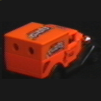
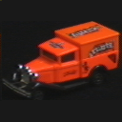
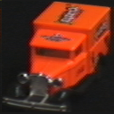
Intra-class variation
<
<
76.21
101.22
127.84

Slide 33
Conclusions
Close-up images are given higher uniqueness scores
Images with visible text are given higher uniqueness scores
Plain images such as those of onion are given low uniqueness scores

Slide 34
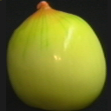
Inter-class variation
<
<
76.21
145.08
183.78

Slide 35
Inter-class variation
<
<
33.85
76.21
98.21

Slide 36
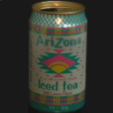
Inter-class variation
<
<
102.31
236.97
324.03

Slide 37
Conclusions
Images depicting the front view of the object are given higher scores

Slide 38
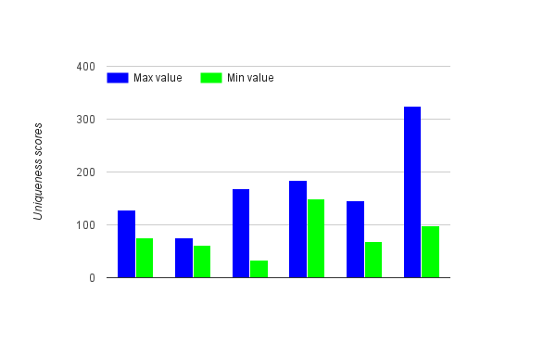
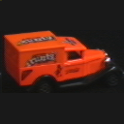
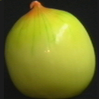
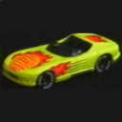
Comparison across classes

Slide 39
Comparing Textureness with uniqueness

Slide 40
Comparing Textureness with uniqueness
<
<
33.85
76.21
98.21
<
<
23
32
35

Slide 41
Comparing Textureness with uniqueness
<
<
98.21
288.14
324.03
<
<
31
44
67

Slide 42
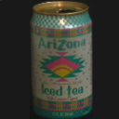
Comparing Textureness with uniqueness
<
<
102.31
236.96
324.03
<
<
49
67
75

Slide 43
Comparing Textureness with uniqueness
<
<
33.85
76.21
98.21
<
<
13
28
31

Slide 44
Conclusions
There is a very strong correlation between textureness and uniqueness within class
Not as strong a correlation when comparing objects from different classes

Slide 45
Using Entropy instead of tf-idf

Slide 46
Intra-class variation
<
<
120.21
125.74
173.41
<
<
45.30
67.18
71.21

Slide 47
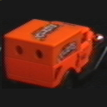
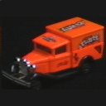
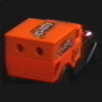
Intra-class variation
<
<
76.21
101.22
127.84
<
<
49.17
71.73
88.91

Slide 48
Inter-class variation
<
<
33.85
76.21
98.21
<
<
3.01
8.28
32.97

Slide 49
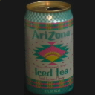
Inter-class variation
<
<
102.31
236.96
324.03
<
<
45.83
67.11
69.08

Slide 50
Conclusions
The two metrics behave pretty much in a similar fashion
tf-idf gives more weightage to visible text than entropy does

Slide 51
Thank You!

