Slide 1
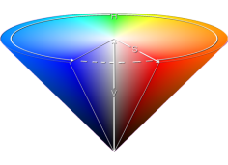
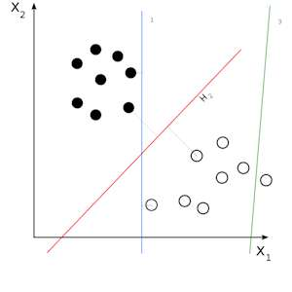
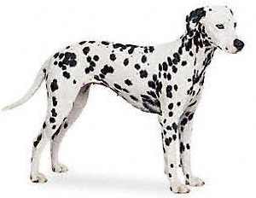
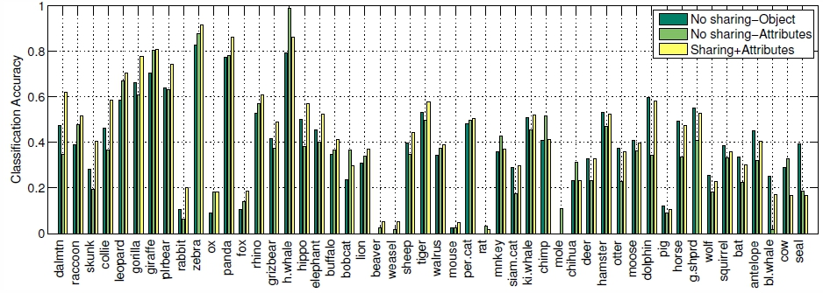
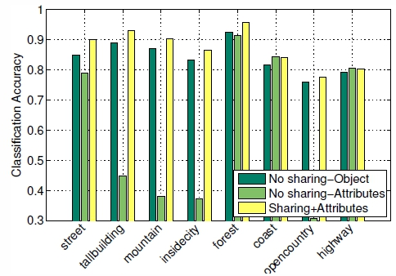
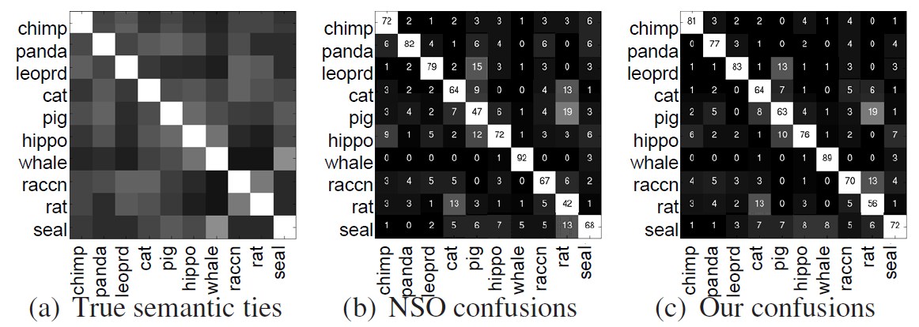
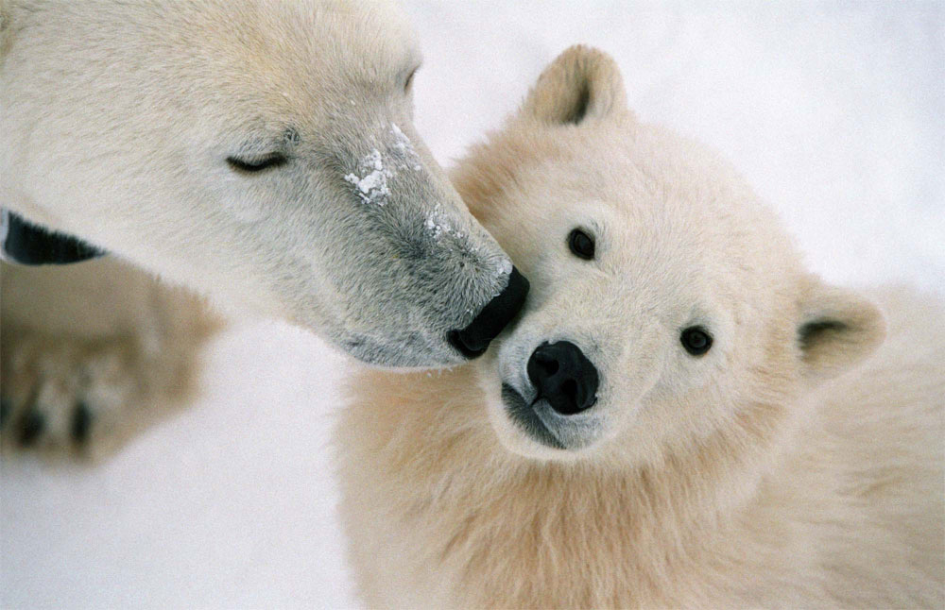
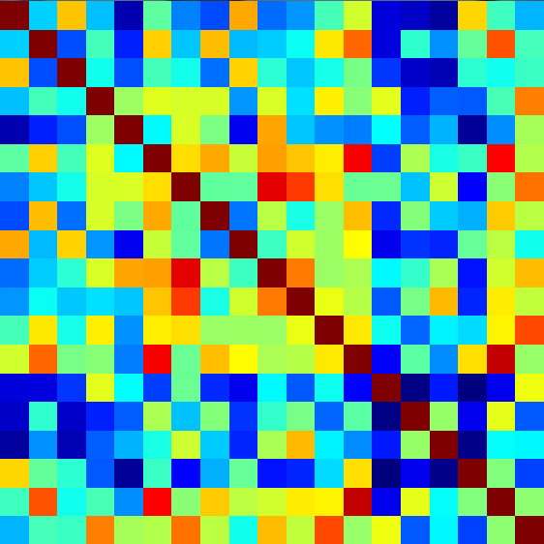
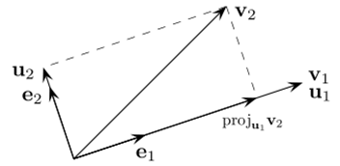
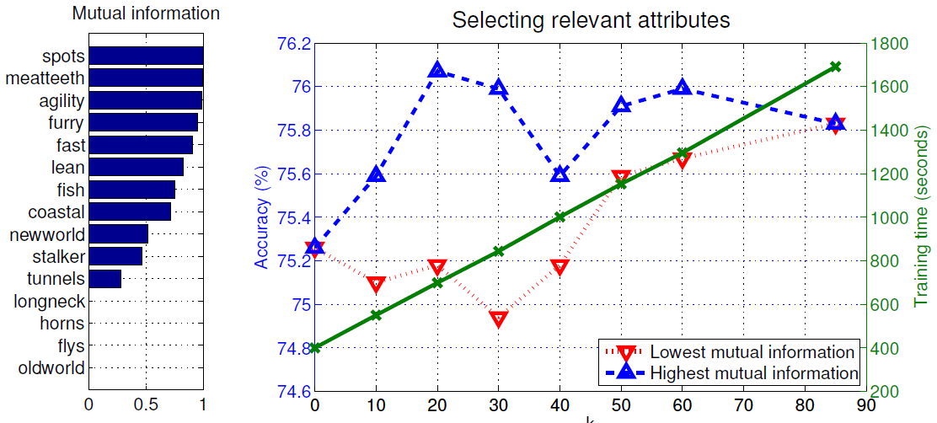
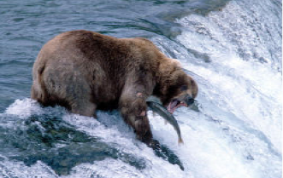
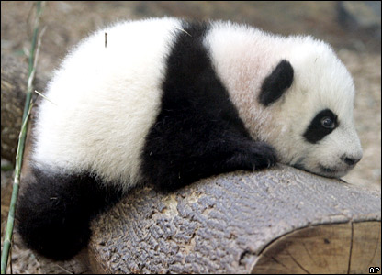
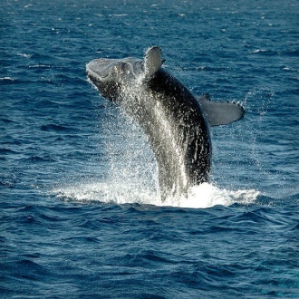
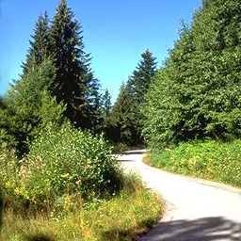
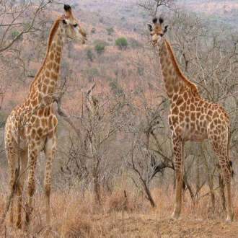
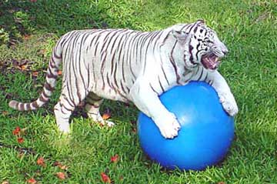
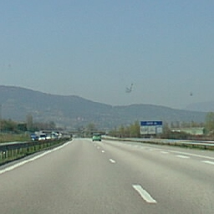
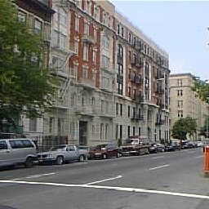
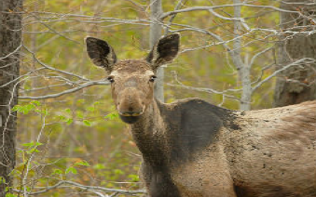
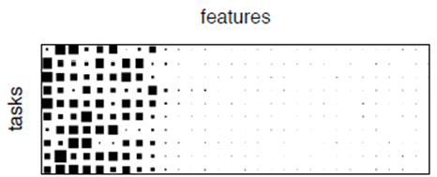
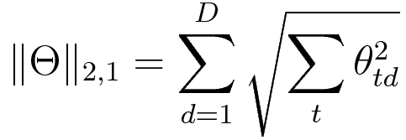
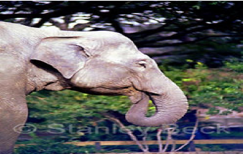
Sharing Features Between Objects and Their Attributes
Sung Ju Hwang₁, Fei Sha₂ and Kristen Grauman₁
1 University of Texas at Austin, 2 University of Southern California
Problem
Existing approaches to attribute-based recognition treat attributes as mid-level features or semantic labels to infer relations.
Algorithm
We adopt the alternating optimization algorithm from [Argyriou08] that can train classifiers and learn the shared features at each step.
Analysis
Visual
features
color
Object class classifier
Object class
Learning shared features for linear classifiers
Recognition accuracy for each class
Dalmatian
Initialization
1) Initialize covariance matrix Ω with a scaled identity matrix I/D
Animals with Attributes
Outdoor scene recognition
patches
Separate training
gradients
Attributes
Variable updates
2) Transform the variables using the covariance matrix Ω
Attributes classifier
White, Spots, Long leg
: transformed n-th feature vector
However, in conventional models, attribute-labeled data does not directly introduce new information when learning the objects; supervision for objects and attributes is separate.
→ This may reduce the impact of the extra semantic information attributes provide.
: transformed classifier weights
Independent
classifier
training
3) Solve for the optimal weights , while holding Ω fixed.
Alternate until W converges
We make improvements on 33 of 50 AWA classes, and on all classes of OSR.
Classes with more distinct attributes benefit more from feature sharing: e.g. Dalmatian, leopard, giraffe, zebra
Main Idea
We propose to simultaneously learn shared features that are discriminative for both object and attribute tasks.
Semantically meaningful prediction
Polar bear
Dalmatian
White
Spots
4) Update the covariance matrix Ω
Our method makes more semantically meaningful predictions.
Reduces confusion between semantically distinct pairs
Introduces confusion between semantically close pairs
Motivation:
By regularizing the object classifiers to use visual features shared by attributes, we aim to
select features associated with generic semantic concepts
avoid overfitting when object-labeled data is lacking
Feature
learning
: weight vectors
: smoothing parameter
(for numerical stability)
u₁
u₂
u₃
Shared features
u_{D}
Extension to Kernel classifiers
Selecting useful attributes for sharing
x₁
x₂
x₃
Input visual features
x_{D}
4) Apply the algorithm for the linear classifiers on the transformed features
Are all attributes equally useful?
2) Compute the basis vector B and diagonal matrix S using Gram-Schmidt process
3) Transform the data according to the learned B and S
No. Attributes with high mutual information yield better features, as they provide more information for disambiguation.
Learning shared features via regularization
1) Formulate kernel matrix K
Sharing features via sparsity regularization
Example object class / attribute predictions
Object classifier
general
Training set specific
sparsity
Multitask Feature Learning: Sparsity regularization on the parameters across different tasks results in shared features with better generalization power.
Experimental results
Predicted Object
Predicted Attributes
Red: incorrect prediction
Attribute
classifier
Dataset
NSO
Dolphin
NSA
Fast, active, toughskin, chewteeth, forest, ocean, swims
Multitask feature learning
AWA
OSR
NSA
Walrus
Fast, active, toughskin, fish, forest, meatteeth, strong
How can we promote common sparsity across different parameters?
→ We use a (2,1)-norm regularizer that minimizes L1 norm across tasks [Argyriou08].
Dataset | Animals with Attributes (AWA) | Outdoor Scene Recognition (OSR)
# images | 30,475 | 2,688
# classes | 50 | 8
# attributes | 85 | 6
Algorithm | Linear | Kernelized
Ours
Grizzly bear
Ours
Sparsity regularizer
1) Our method is more robust to background clutter, as it has a more refined set of features from sparsity regularization with attributes.
NSO
Grizzly bear
NSA
Strong, inactive, vegetation, quadrupedal, slow, walks, big
loss function
Transformed (Shared) features
NSA
Rhinoceros
Strong, toughskin, slow, walks, vegetation, quadrupedal, inactive
: n-th feature vector
: n-th label for task t
: parameter (weight vector) for task t
Methods compared
Ours
Moose
Ours
: Orthogonal transformation to a shared feature space
1) No sharing-Obj. : Baseline SVM classifier for object class recognition
2) No sharing-Attr. : Baseline object recognition on predicted attributes as in Lampert’s approach
3) Sharing-Obj. : Our multitask feature sharing with the object class classifiers only
4) Sharing-Attr. : Our multitask feature sharing method with object class + attribute classifiers
2) Our method makes robust predictions in atypical cases.
: regularization parameter
L2-norm:
Joint data fitting
NSO
Giant Panda
NSA
Quadrupedal, oldworld, walks, ground, furry, gray, chewteeth
(2,1)-norm
NSA
Rabbit
Quadrupedal, oldworld, ground, walks, tail, gray, furry
L1-norm: sparsity
Recognition accuracy
Ours
Rhinoceros
Ours
Convex optimization
3) When our method fails, it often makes more semantically “close” predictions.
SVM loss function on the original feature space
Trace norm regularization.
Conclusion/Future Work
Covariance matrix.
By sharing features between objects and attributes, we improve object class recognition rates.
By exploiting the auxiliary semantics, our approach effectively regularizes the object models.
Future work
1) Extension to other semantic labels beyond attributes. 2) Learning to share structurally.
However, the (2,1)-norm is nonsmooth. We instead solve an equivalent form, in which the features are replaced with a covariance matrix that measures the relative effectiveness of each dimension.
Our approach makes substantial improvements over the baselines. Exploiting the external semantics the auxiliary attribute tasks provide, our learned features generalize better---particularly when less training data is available.
[Argyriou08] M. Argyriou, T. Evgeniou, Convex Multi-task Feature Learning, Machine Learning, 2008

